Slide 1
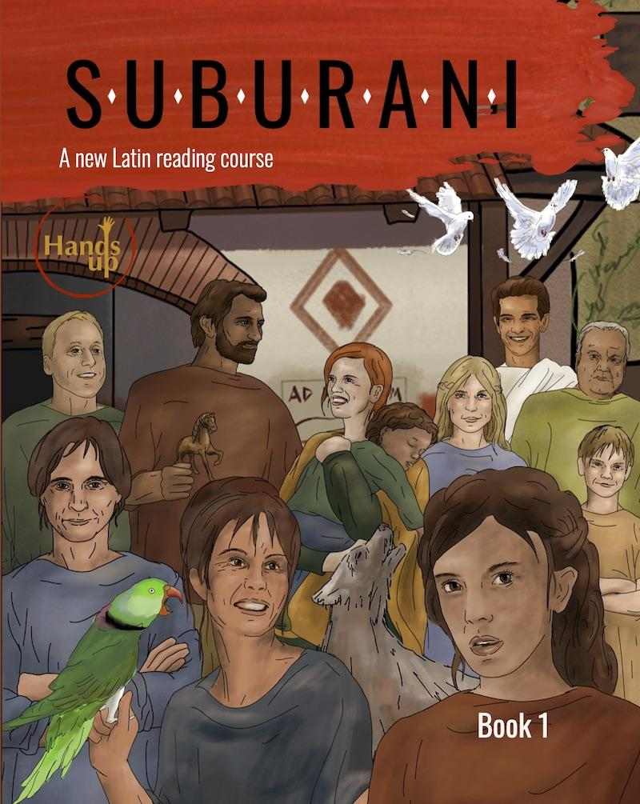

Teaching with
SUBURANI Book I
Chapters 1–16
Suitable for Latin I or Latin I and part of Latin II

Slide 2


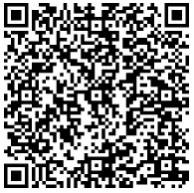
Leigh Grace Rouyer
Hands Up Education
leighgrace.rouyer@hands-up-education.org
@HandsUpEduc
Scan to learn more about upcoming training sessions, in-person and online!

Slide 3
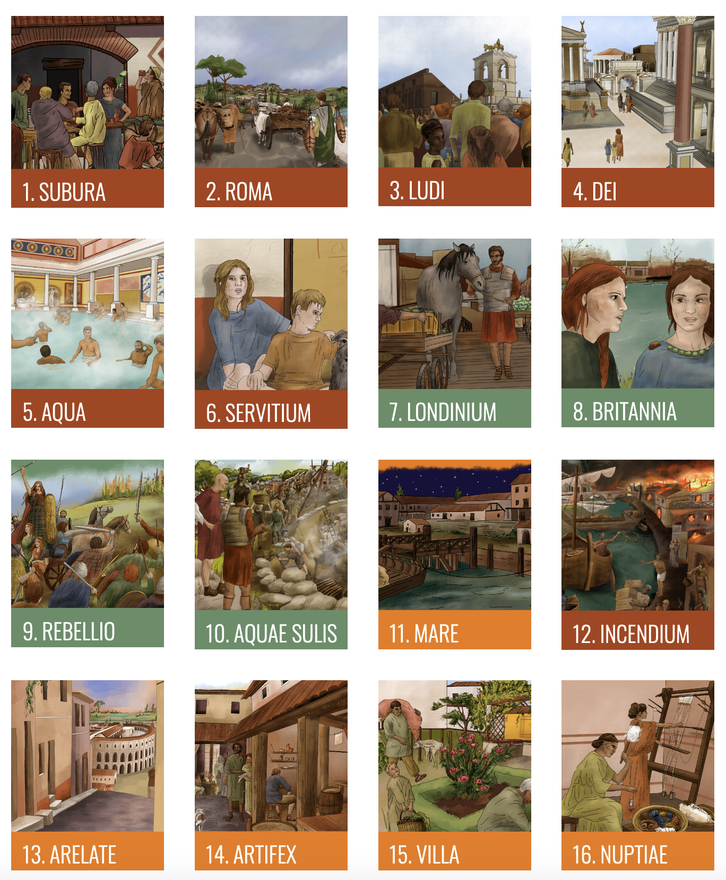
Each chapter:
16 pages
10 pages language
5 pages civilization
1 page myth or history

Slide 4
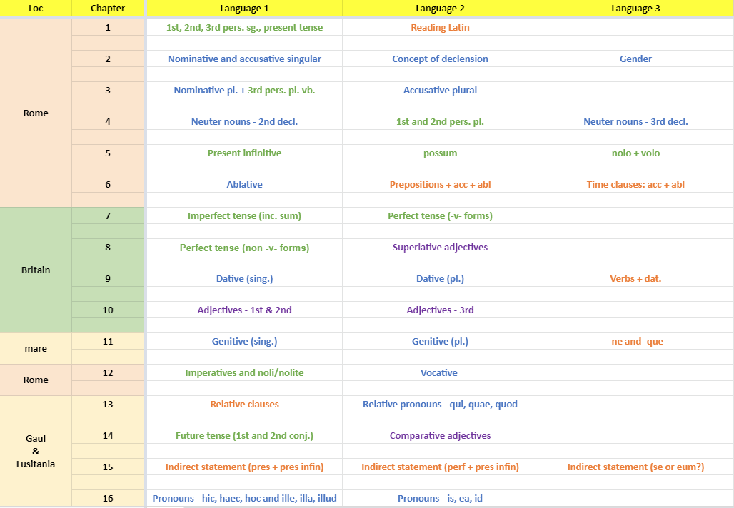
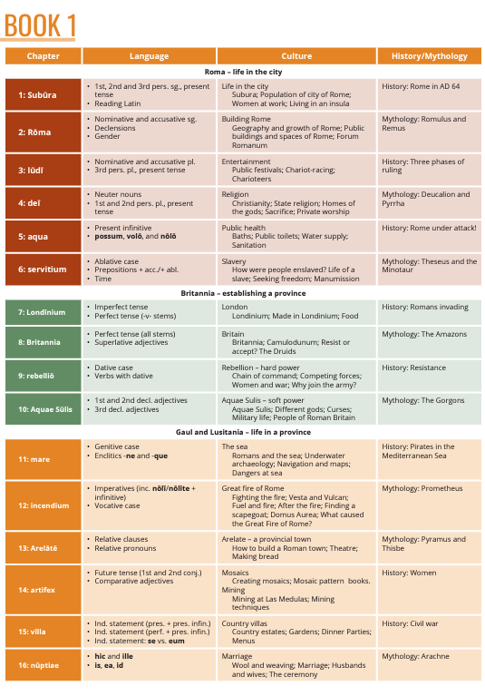
https://hands-up-education.org/curriculum.html
Notes:
https://hands-up-education.org/suburani_book/suburani-overview.pdf
I think it’s worth looking at how certain language concepts are presented, especially if you’re new to Suburani and coming from a course that had things in a different order. This was an element that I was most nervous about when I switched, but it turned out just fine. Students can indeed learn about the Dative before the Genitive with great success.
Ways to divide up the book: If you want it to be focused on one place/cultural moment, you could divide it according to the colors/places they go. With Latin 1, however, you would probably want to divide these into smaller units to emphasize the language and culture, especially in the beginning.

Slide 5
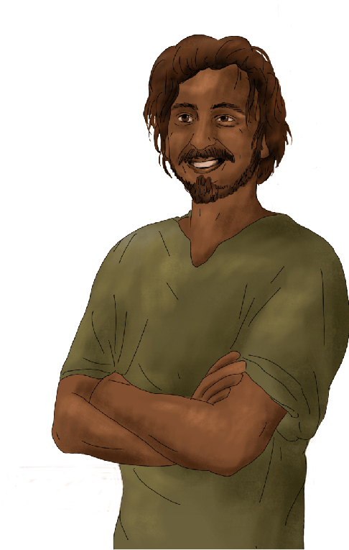
Nota Bene:
The information in this presentation is meant only to help generate ideas or act as examples. We do not believe there is a “correct” or “one-size-fits-all” way of teaching the course.
Part of what makes Suburani so special is the collaboration and community resources available. We value your ideas, opinions, and ingenuity!
Notes:
So much depends on factors like student ability levels, age, and motivation, amount of class time you have together (and how that's spread over the weeks), and also very importantly your priorities as a teacher (to what extent do you want to focus on language vs civ? What kind of language learning experience do you want students to have - e.g. do you want them to spend most of their time reading vs do you want to introduce further linguistic terminology / language manipulation compared to the book, etc).

Slide 6
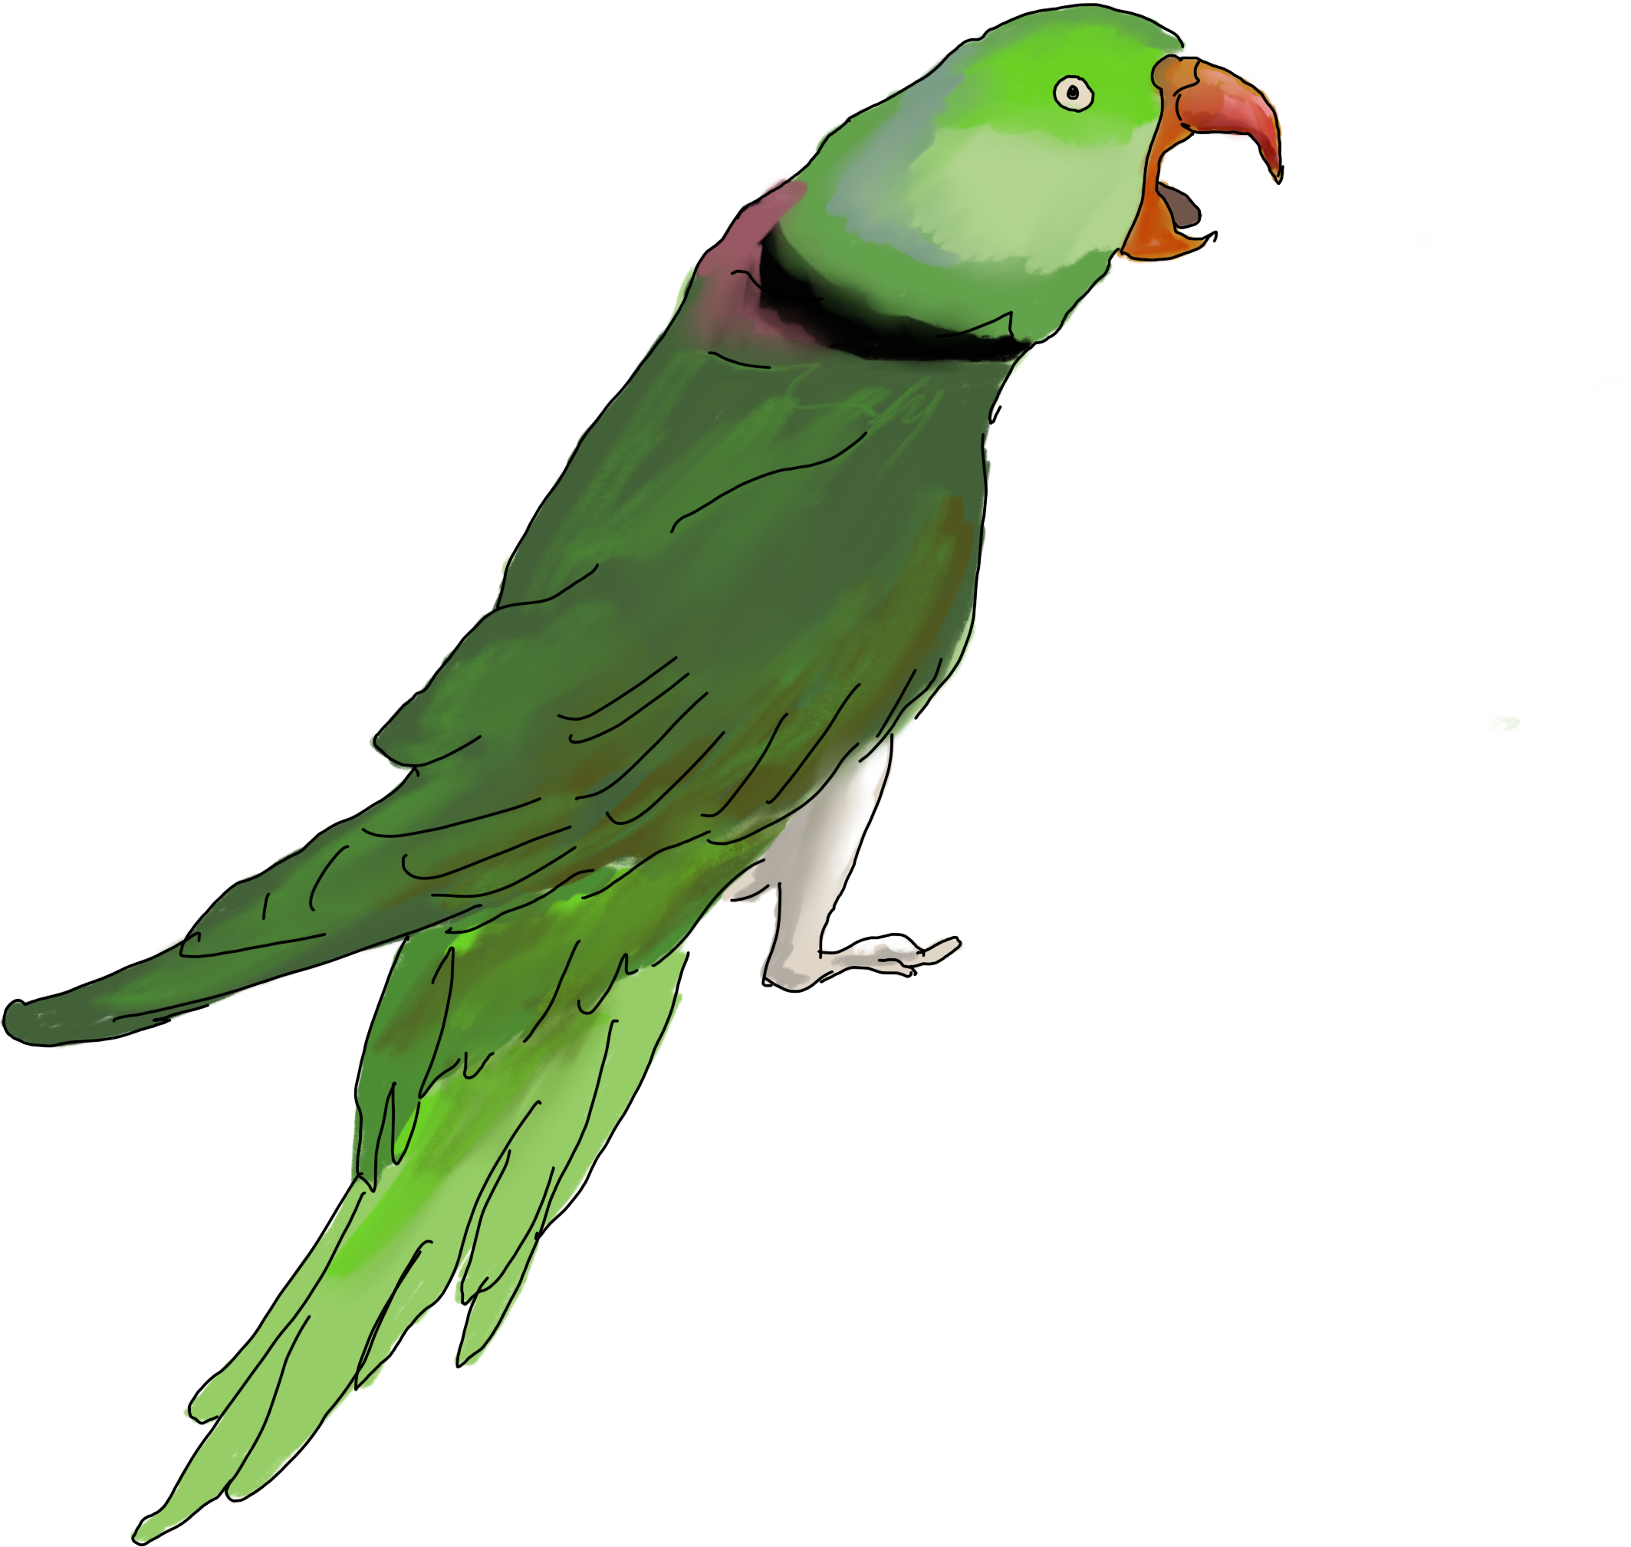
Common Questions
Can you finish Book 1 in one school year?
Do you have to read every story?
How often do you give an assessment?
What kinds of projects or “fun stuff” can you do with Book 1?
Does Book 1 prepare students for standardized assessments like the NLE?
Notes:
Yes, you can finish it, but you don’t have to. I usually get through 14 of the 16 chapters because I do several supplemental units with novellas, projects, etc.
You do NOT have to read every story, and the book isn’t designed with the intention that you will
There are assessments available for each chapter of book 1, and there are several other types of assessments available in the community resources. I tend to give smaller assessments within each chapter and then a larger unit test after 2 or 3 chapters depending on how much new information is covered
There are so many projects and activities you can do and I will share several that I use. Please know that there are so many other ideas shared on the website and the Facebook group!
Yes, we have alignments made already for Intro and Beginning (those will be shared soon) and several of my projects are designed to help supplement to make sure that students get the minutiae that may not be explicitly taught in book 1. We are excited that the NLE will be offering a Beginning Reading Comprehension exam. I intend to have my students take it, as I believe this curriculum lends itself best to reading assessments. I also do regular bell ringer activities that help prep students for NLE questions. I’ll briefly go over those as well

Slide 7
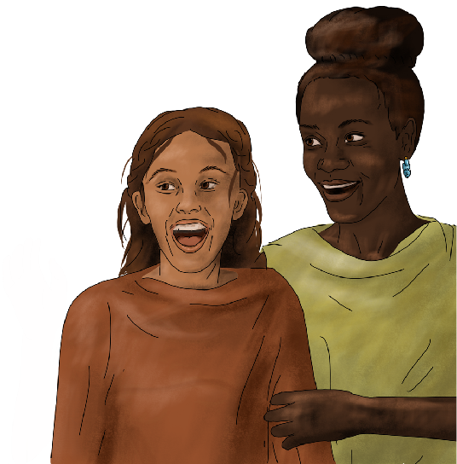
Sample Overview of Semester 1
Assumes 18 weeks, meeting 5 days a week for ~45-minute classes.
  90 potential meetings total, but give or take with holidays, weather, or shortened schedules, it comes to 80 at my school.
Primary Units: Supplemental Unit/Activities:
Unit 1: Celer novella
Chapters 1-3 7 Hills of Rome Project (group)
Unit 2: Olympians Project (individual)
Chapters 4 and 5 Kings Project (partner/group)
Assessments:
Vocabulary Quizzes for each chapter
Grammar Quizzes for each chapter/major concept
Unit Tests: Primarily reading comprehension,
incorporates history, culture, and mythology
Notes:
I use the Celer novella after Unit 1 to serve as a sort of brain break but also to show my students how much they’ve already learned. They’re always excited that they are reading a book in another language. Celer is also, of course, one of their favorite characters, and they love meeting the animals. There are several teachers who use novellas as their primary text, and I use several of Amy Mason’s plans when I teach the unit. I use the novella to introduce a STEM project on the 7 Hills of Rome. I will talk more about that project if there’s interest at another Webinar or conference for those who want details. I’m happy to share all of my plans. I pair the Olympians project with Ch. 4, because it introduces the concept of religion. The Kings project wraps up the semester, but it can be given at any point after Ch. 1. Romulus and Remus are introduced in the civ section of Ch. 2.

Slide 8
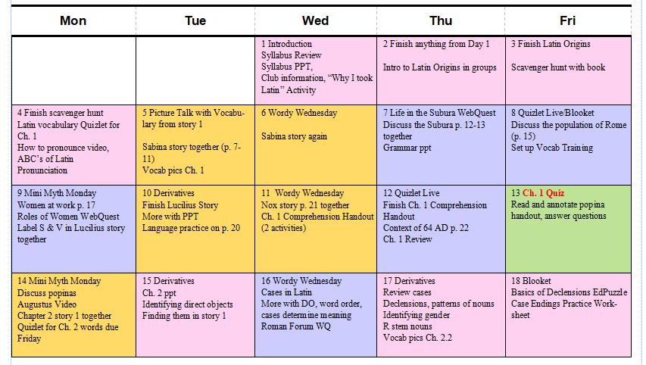
Sample Plans/Pacing for Semester 1
Notes:
Pink: the day is mostly activities that I made or that have not much to do with the book
Orange: Story from the text
Blue: Civ or grammar from the text
Green: assessment
First assessment is on 13th day of class
First story is on 5th day of class

Slide 9
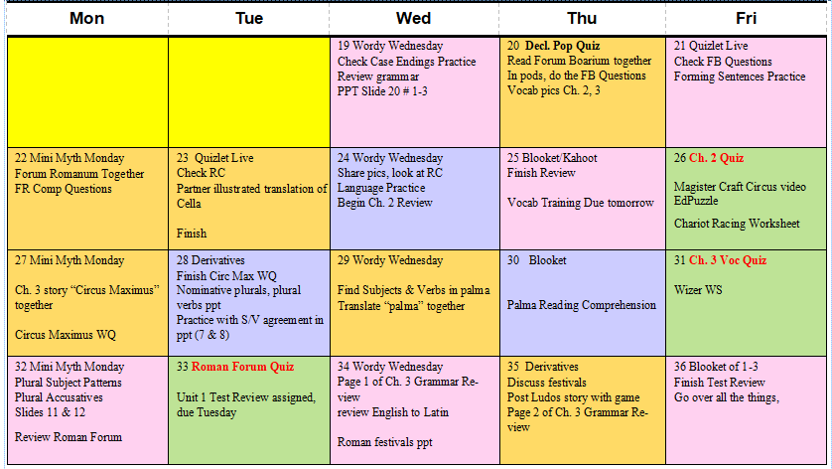

Slide 10
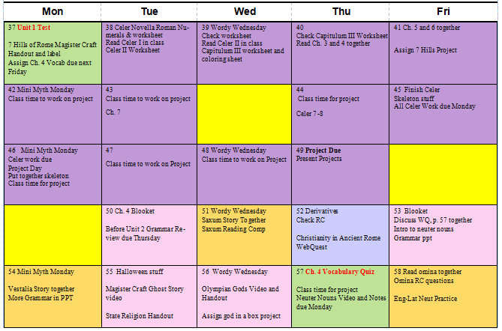
Notes:
Unit 1 Test is day 37
Celer novella unit and project took 12 days, could easily be excluded and would let the teacher get through Ch. 6 or 7

Slide 11
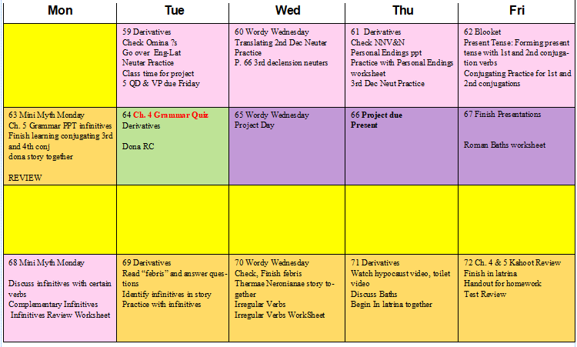

Slide 12
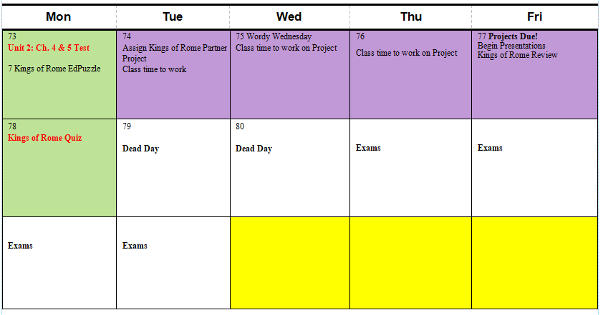
Notes:
Unit 2 test Day 73, almost the same number of days as Unit 1, ends with another project that is optional and could theoretically be any time in Semester 1

Slide 13
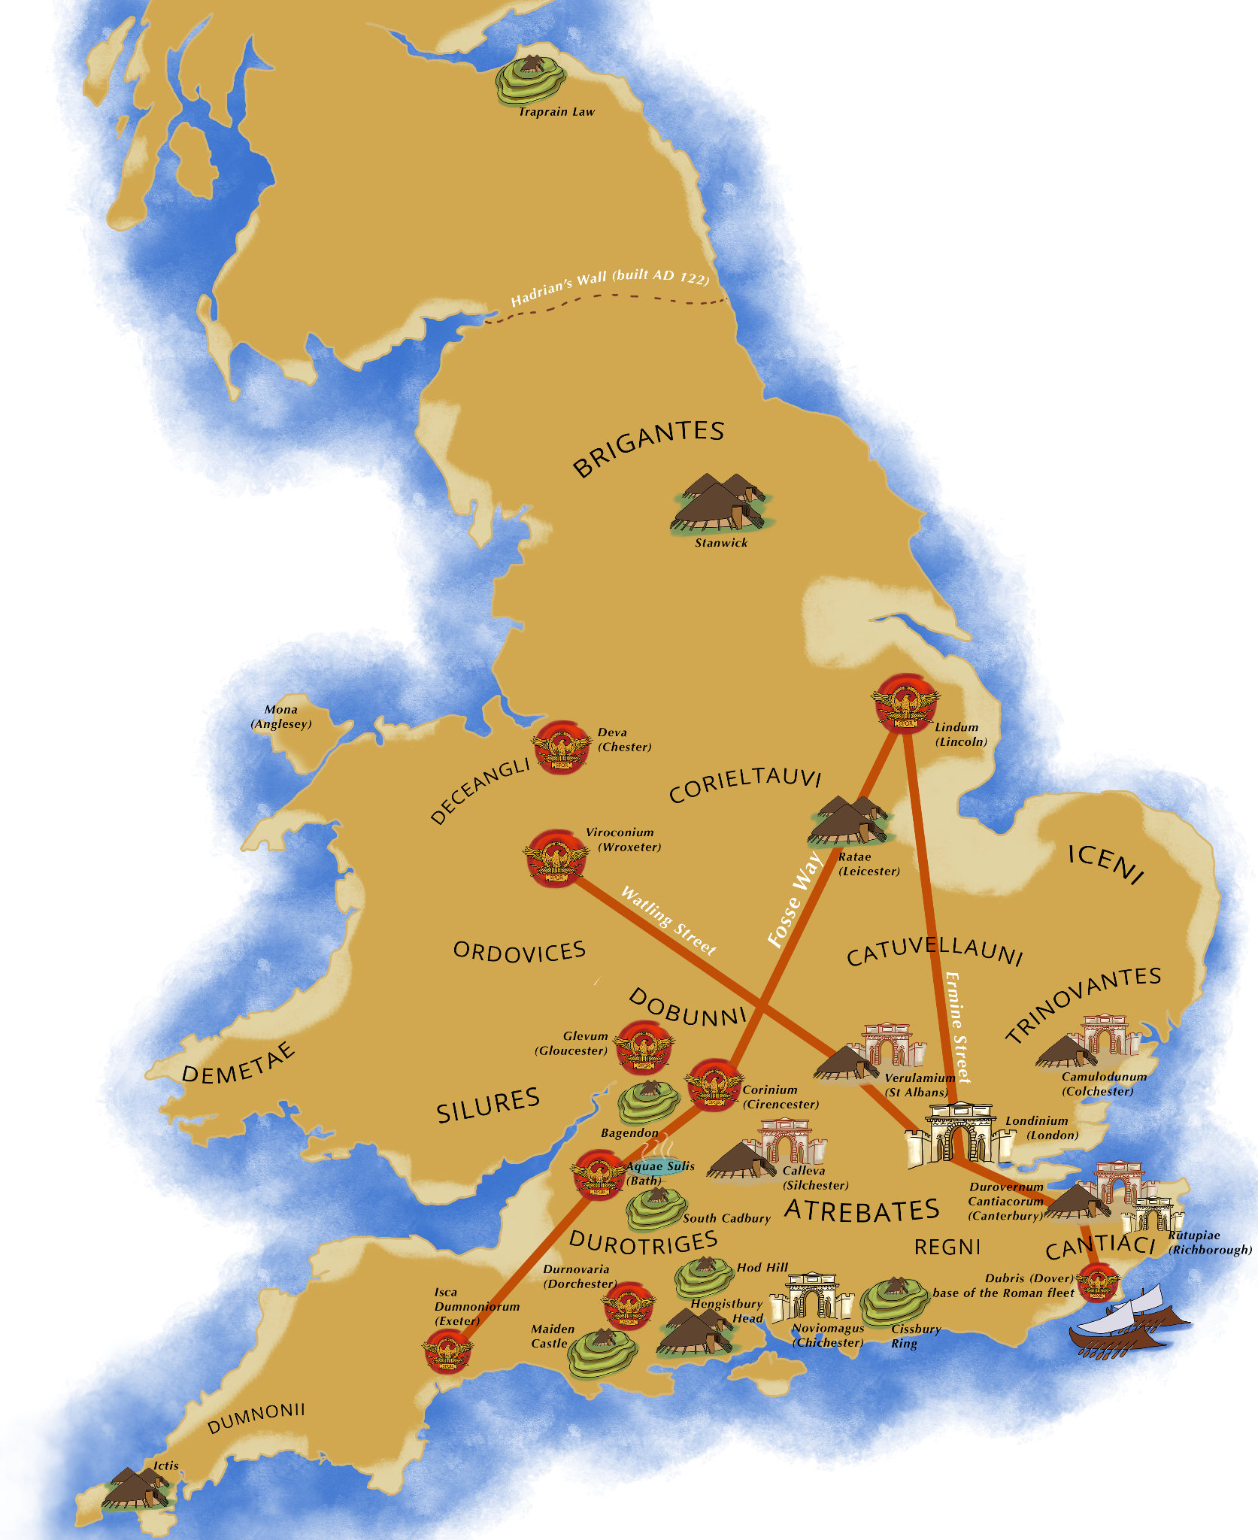
Determining the Pace for
Your Program
How often do you see your students?
How old are your students?
Do you plan to “stick to the stories” or incorporate the culture, history, and mythology?
Do you want to supplement more grammar practice?
Do you want time for projects?
How often do you want/need to give a formal assessment?
Notes:
Are you on a block or semester schedule?
Are you teaching middle schoolers or a full Carnegie unit?
Questions you might want to ask yourself as you plan or reassess: "do I feel the pace allowed students to be engaged in the plot well?", "were there points where the language felt tricky, and I needed to allow more time?", "were there points where I could have moved more quickly, to keep interest levels up?", "were there points where they needed more practice and I could provide additional materials?", "how did my higher/lower ability students fare?", "do I feel like there were topics in the book that we didn't get engaged in easily, that I could skip/speed up?", "were there things I didn't have time for, that I'd like to prioritize?" etc etc).

Slide 14
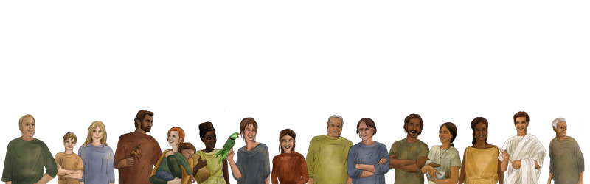
Frequent Activities
Daily Bell Ringers: Mini Myth Mondays, Blooket or Quizlet Live, Daily Derivatives, Wordy Wednesdays
  Reinforce vocabulary with games and derivatives that come from that day’s story
  All of these are good preparation for NLE
  Often the myths come from the book, but I also use D’aulaire’s and TedEd videos
Stories as a class:
  Whole class translating: teacher led, student volunteer
  Popcorn translation
  Speed-dating translation
  Group or partner translating
  Illustrated translations (no English allowed)
  Reading Comprehensions or Decem Quaestiones instead of producing a translation
  Games like Bingo

Slide 15
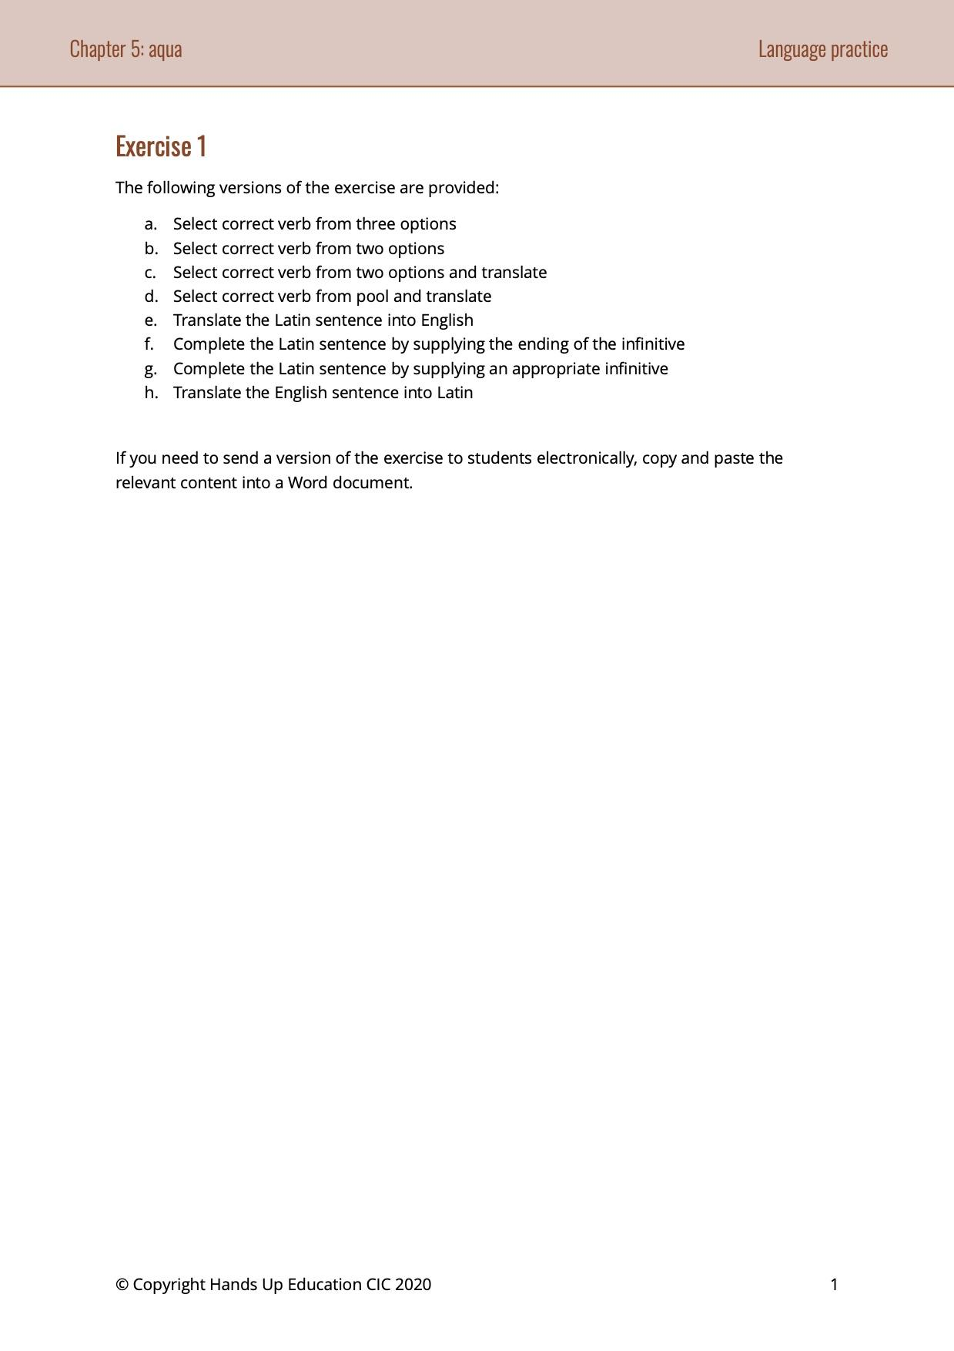
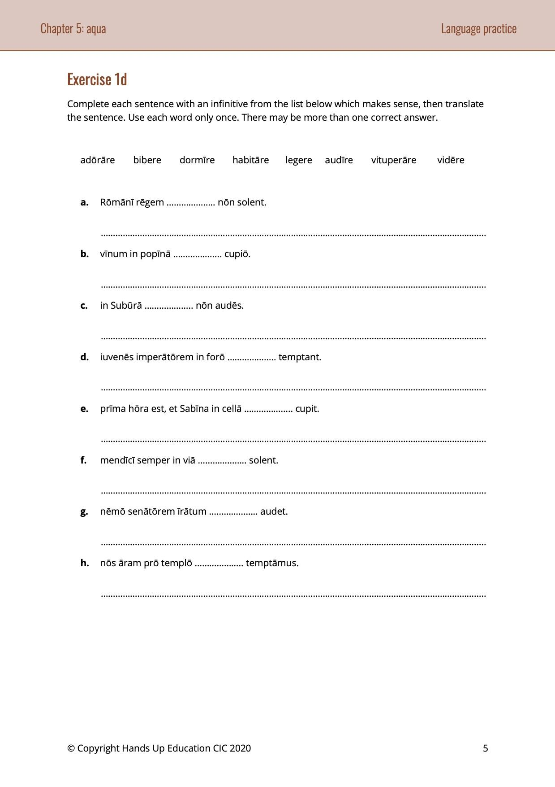
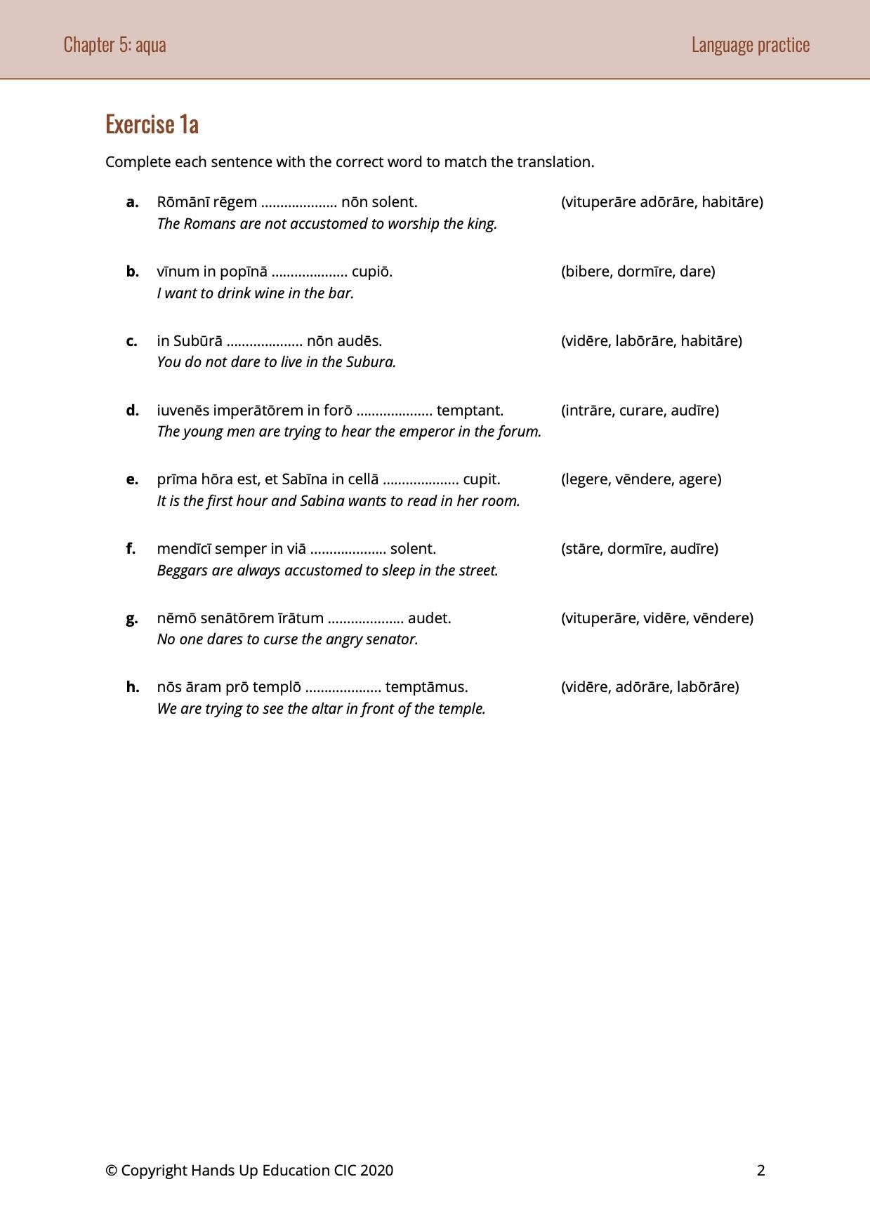

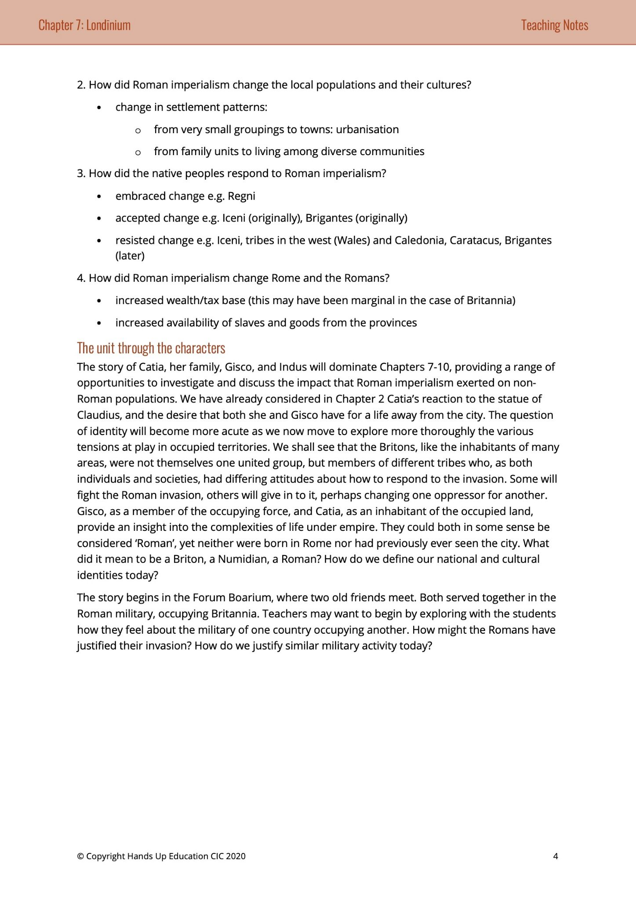
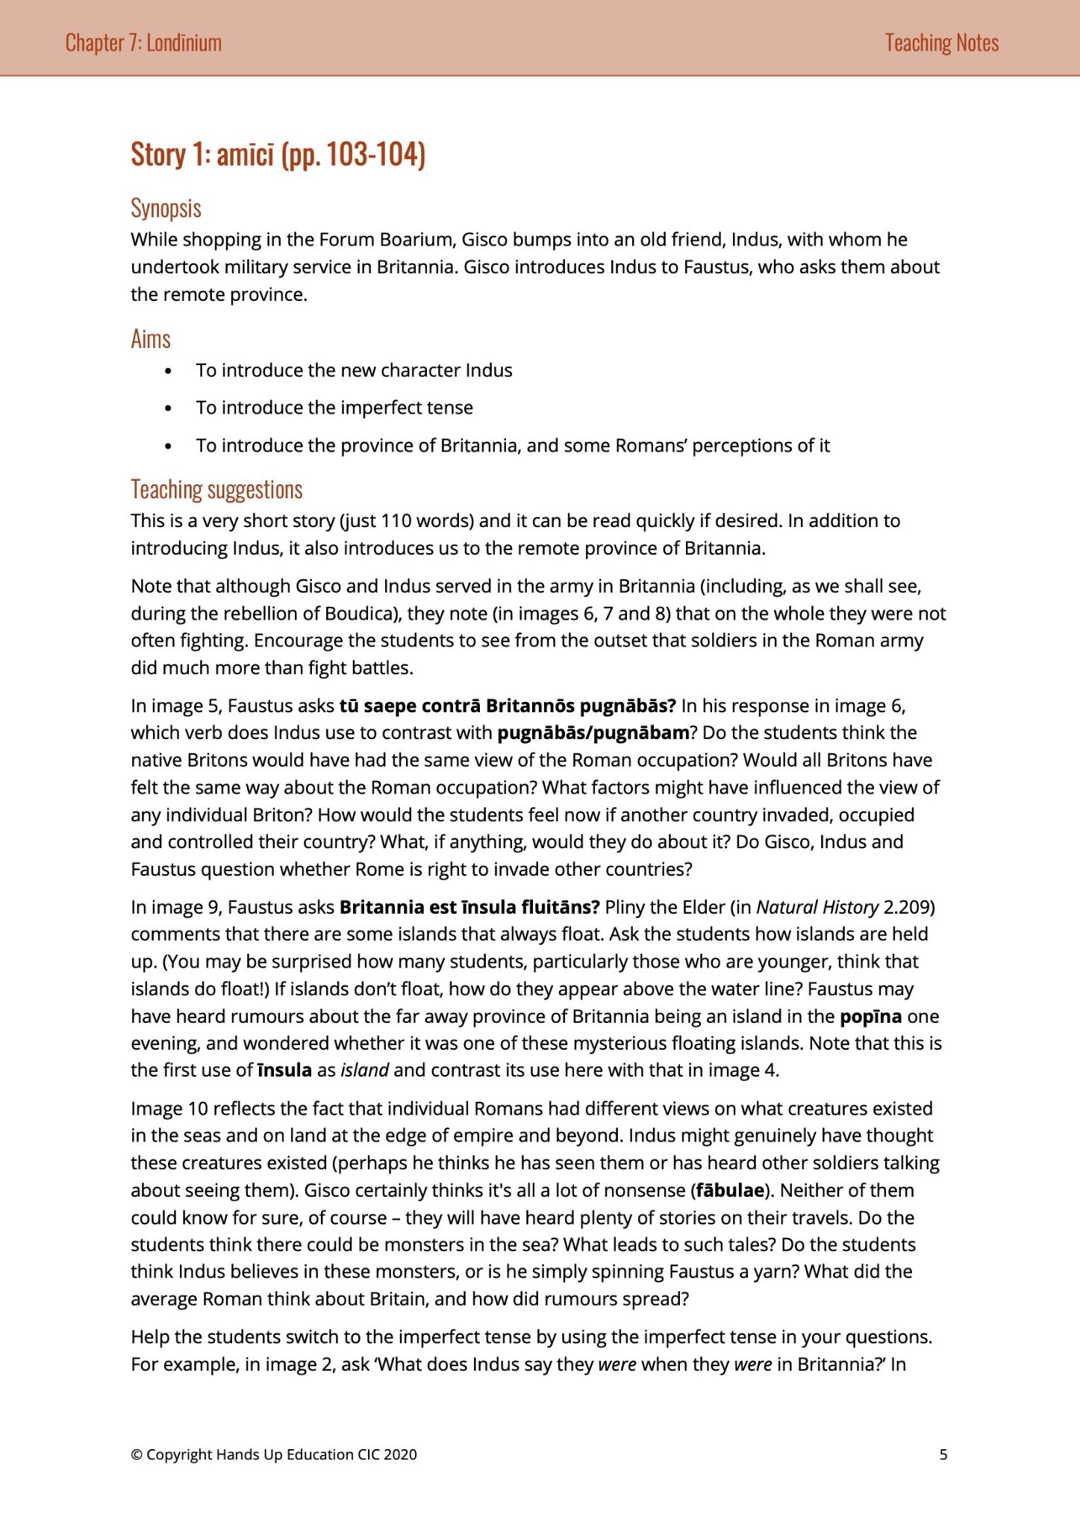
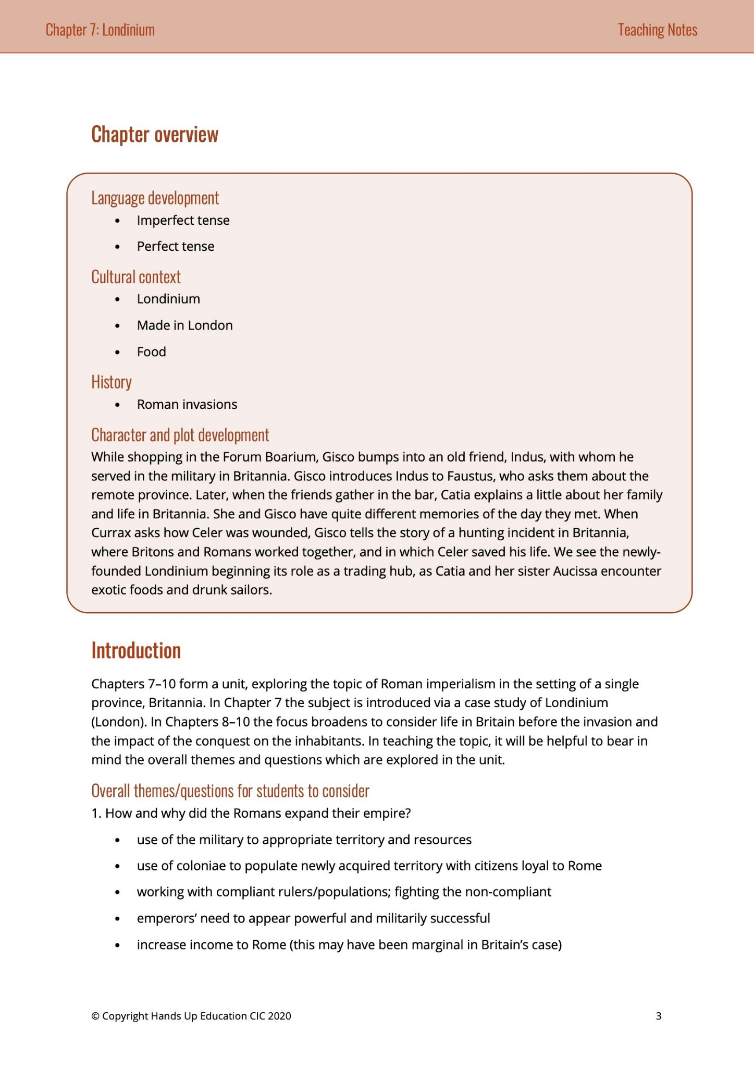
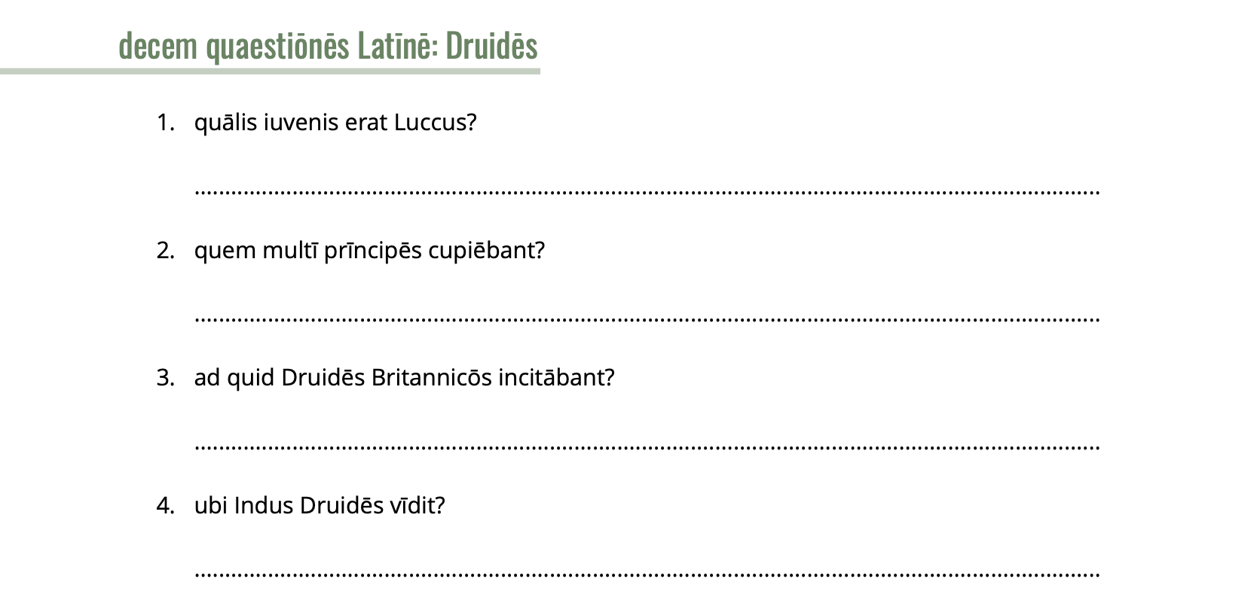

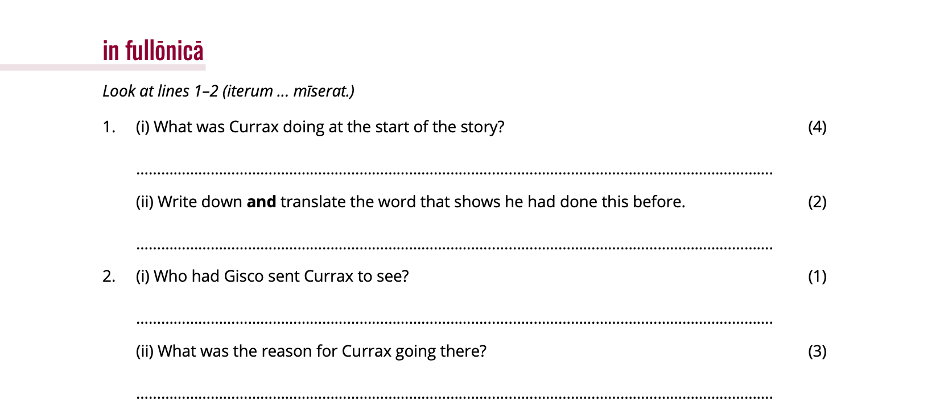
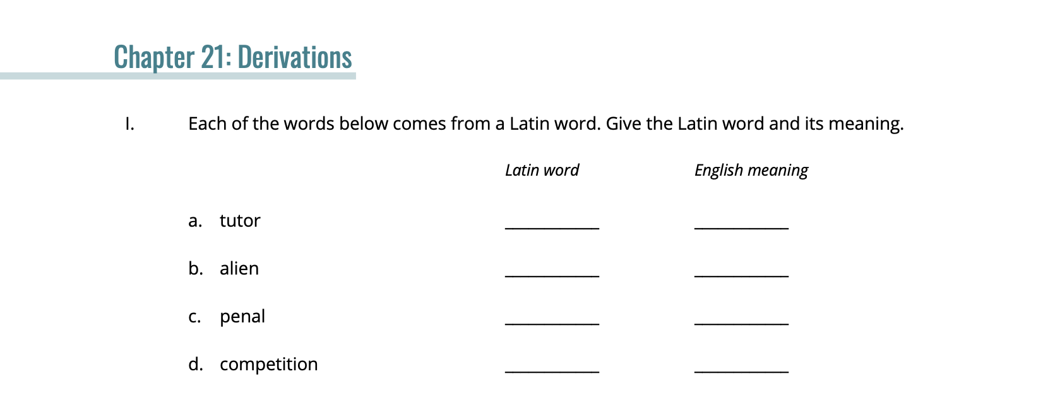
Downloadable Resources
Notes:
PDF and Doc (so you can easily edit)
Assessments for each chapter, differentiated grammar or language exercises
Reading Comprehension and other activities for each story
Teacher notes

Slide 16
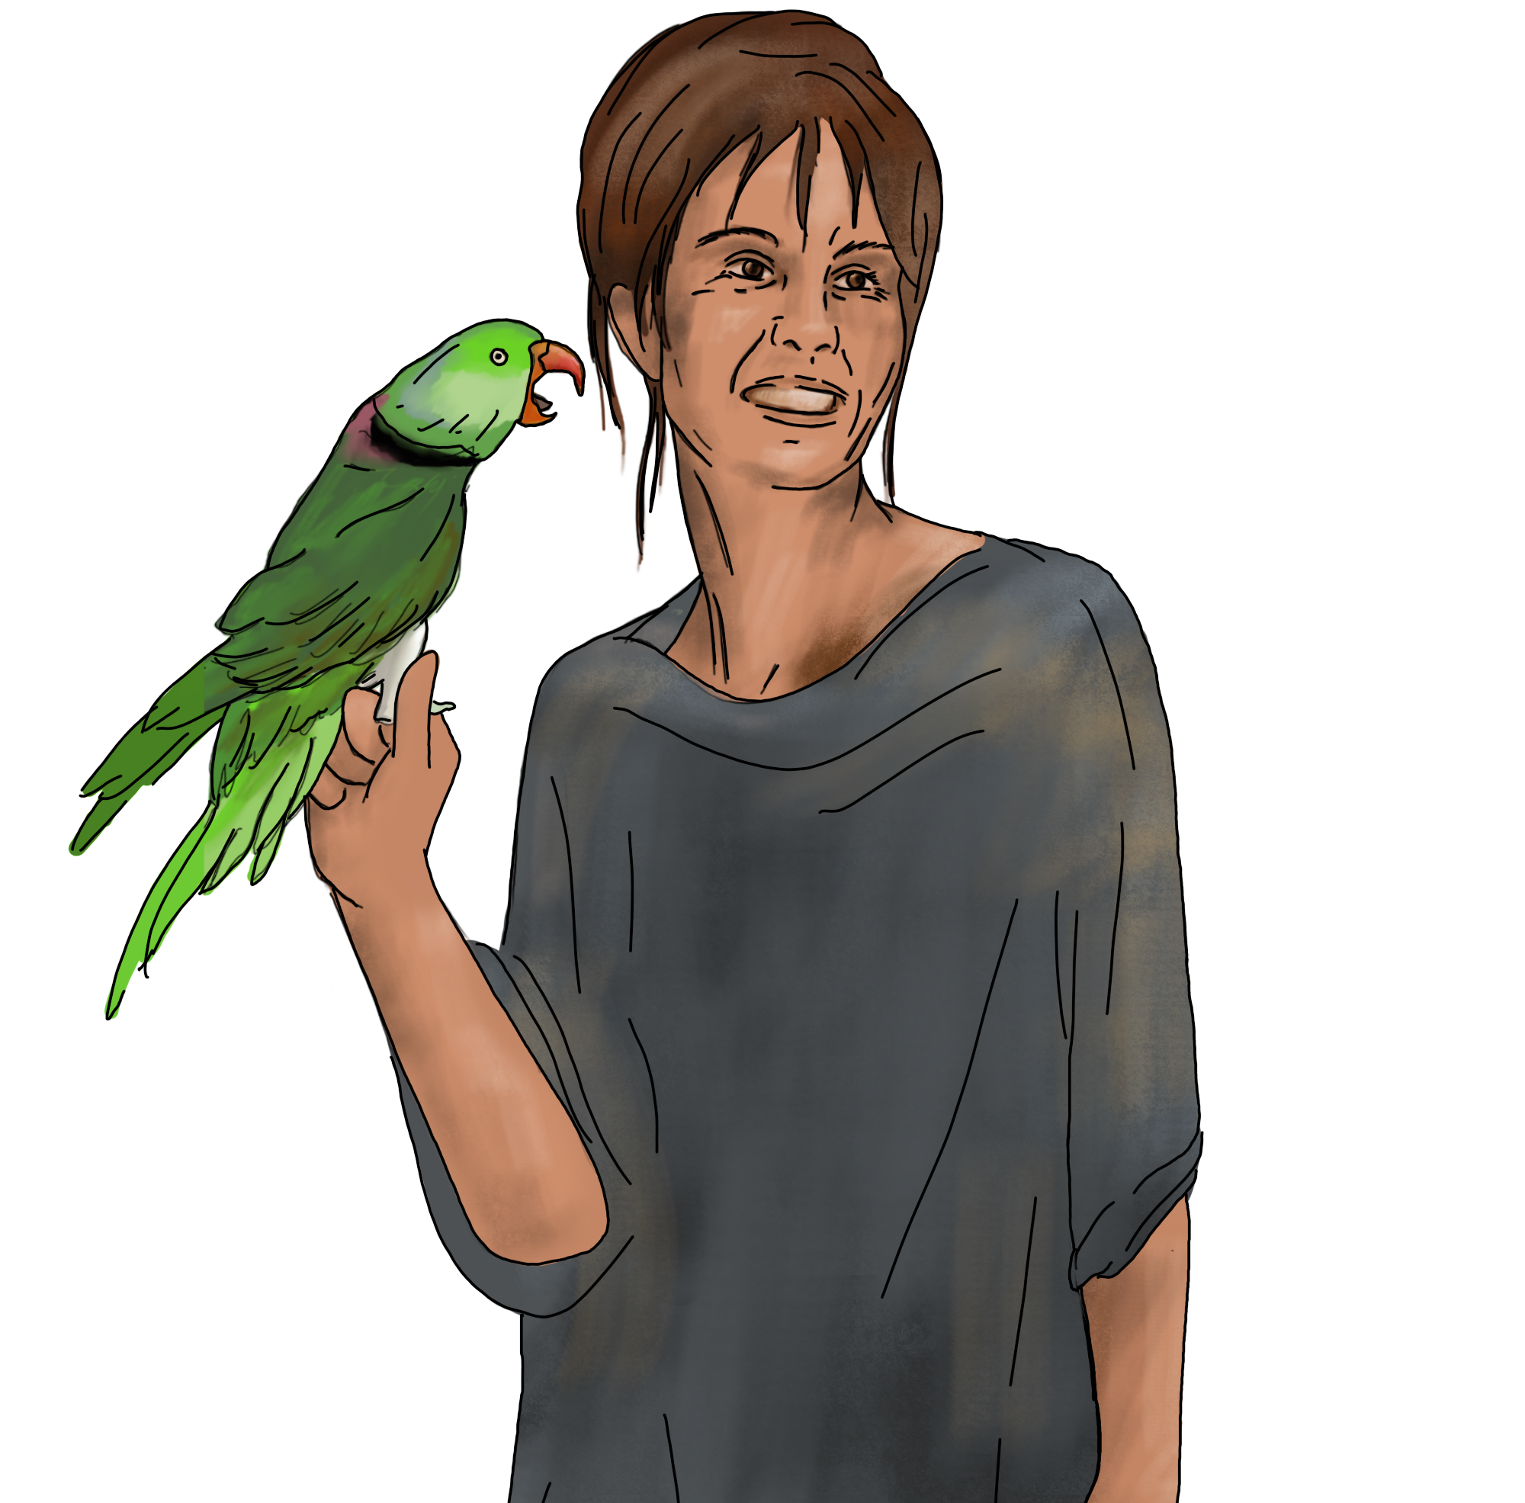
Regular Assessments
Vocabulary Trainer is due the day of each chapter vocabulary quiz or that chapter’s assessment if there isn’t a separate quiz
Vocabulary Quizzes by chapter
Separate quizzes on intensive grammar topics
  (e.g., noun declension endings, forming a verb tense, prepositions, etc.)
Culture topics assessed either through projects, on unit test,
or as a separate quiz
Unit Tests:
  Application based
  One or two passages, assess comprehension of unseen passage,
  grammar questions from a seen passage
  Separate grammar topics assessed sometimes, other times just on a quiz

Slide 17
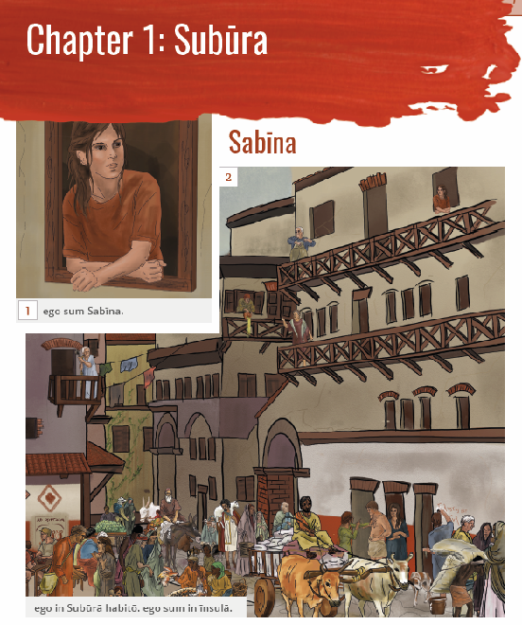
Typical Day Plan:
Bell Ringer Activity
Story together
  Listening, making predictions, asking questions
  Partner/group translating, comprehension games, illustrating meaning
Grammar or Culture activity
Comprehension assessment
  Reading comprehensions, informal discussion, exit tickets
Notes:
If you are wanting more ideas on how to approach reading a story, you can check out our training session on November 4th, as well as previously recorded sessions on this topic. It has good information that will give you tools for adjusting your pacing and making sure that you retain engagement and language progression is smooth.

Slide 18
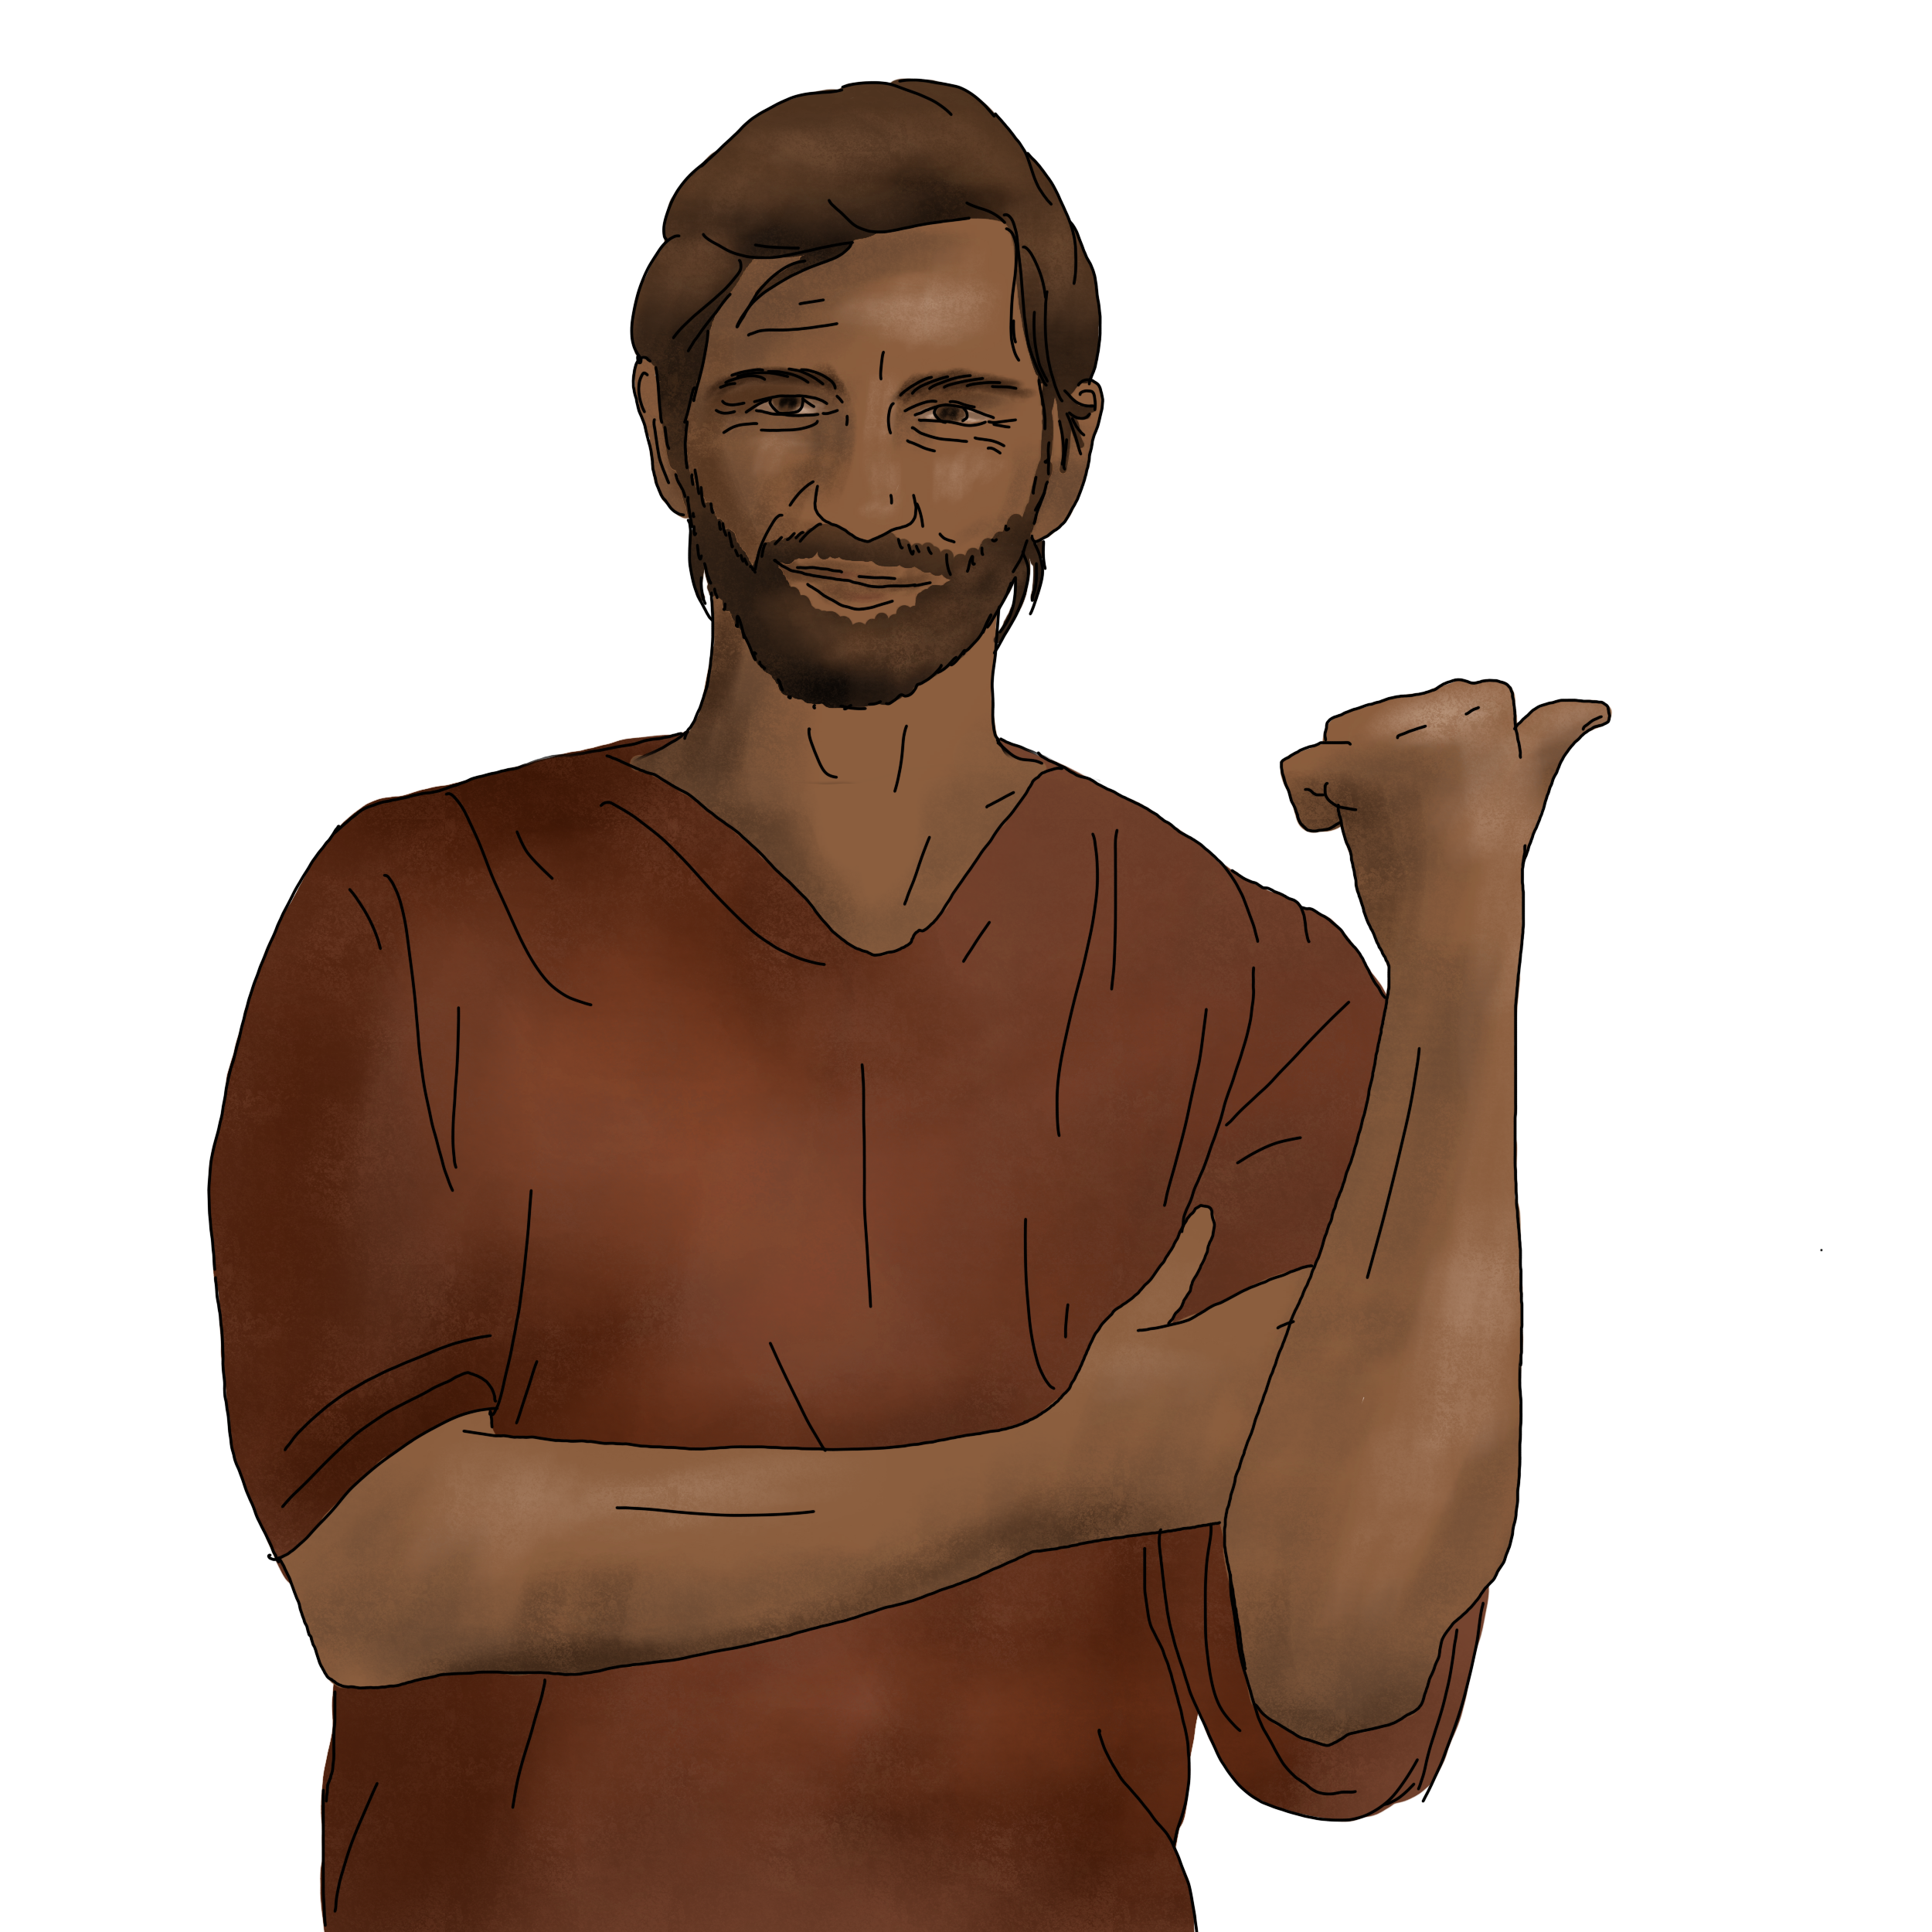
Sample Overview of Semester 2
Primary Units:
Unit 3: Unit 5:
Chapters 6-8 Chapters 11-12
Unit 4: Unit 6:
Chapters 9-10 Chapters 13-14
Supplemental Unit/Activities:
Epistula Project (individual)
Roman Britain Unit
Theater Mask Project (individual)
Assessments:
Vocabulary Quizzes for each chapter
Grammar Quizzes for each chapter/major concept
Unit Tests: Primarily reading comprehension, incorporates history,
culture, and mythology
Notes:
I move quicker in semester 2 and it doesn’t seem to be an issue
Fewer projects because the spring has so many short schedules and breaks, as well as NLE and JCL convention
I make the culture, history, and civ for Roman Britain its own unit for assessment. So much of this history might be easier to digest for our UK programs, but I know my students are really starting with little basic knowledge of Britain, so this lets them focus on that information separately. We dive deeper on Boudica, Druids, and comparing the Roman and British armies. It’s a lot of fun.
I finish at Ch. 14 after the Sabina and Alexander story with whether or not Sabina should stay or go. Nice cliff hanger. We start with the mining story in Ch. 14 as review in Book 2.
Other points that make sense: end of Chapter 10 (end of Roman Britain), end of Chapter 11 (all cases met - well except vocative but whatever), Chapter 12 (dramatic storyline end point), etc.

Slide 19



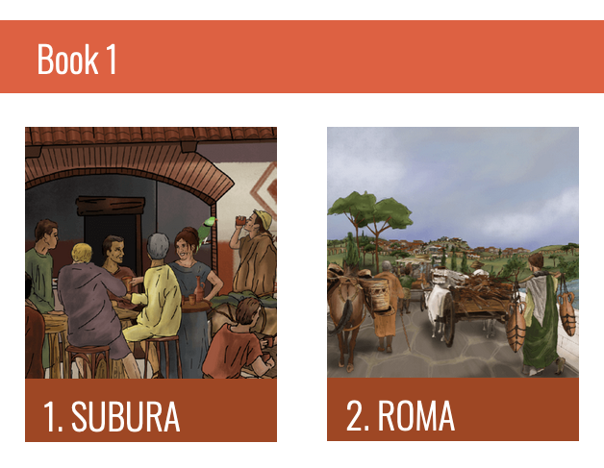
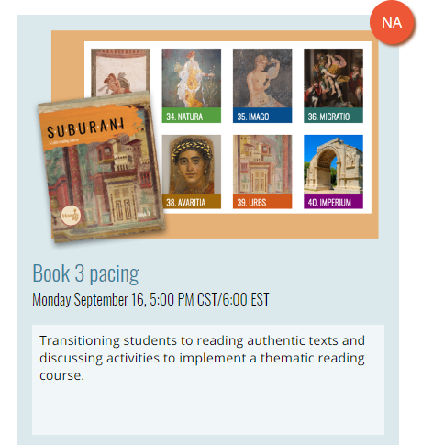
Find out more
contact@hands-up-education.org
@HandsUpEduc
@HandsUpEduc
Scan to sign up for the next webinar, Monday, September 16th!

