Slide 1
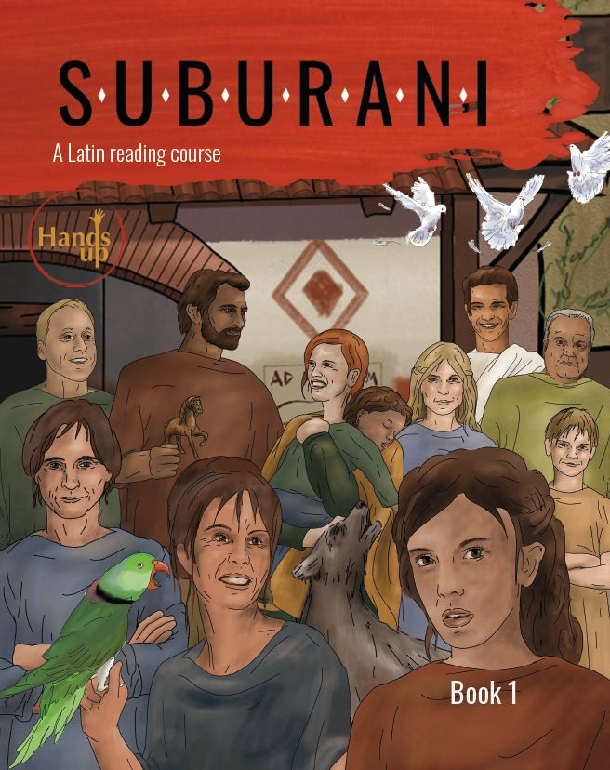
2 textbooks
Latin 1 and 2
GCSE
Print and online editions
Book 1: Chapters 1-16
Book 2: Chapters 16-32
Book 3 … ?

Slide 2
Each chapter:
- 16 pages
- 10 pages language
- 5 pages civilization
- 1 page myth or history

Slide 3
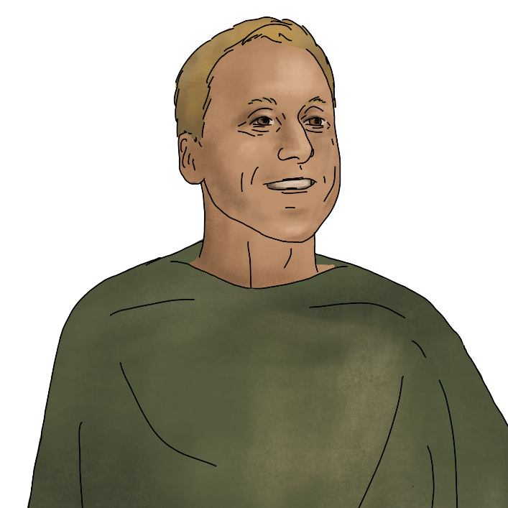
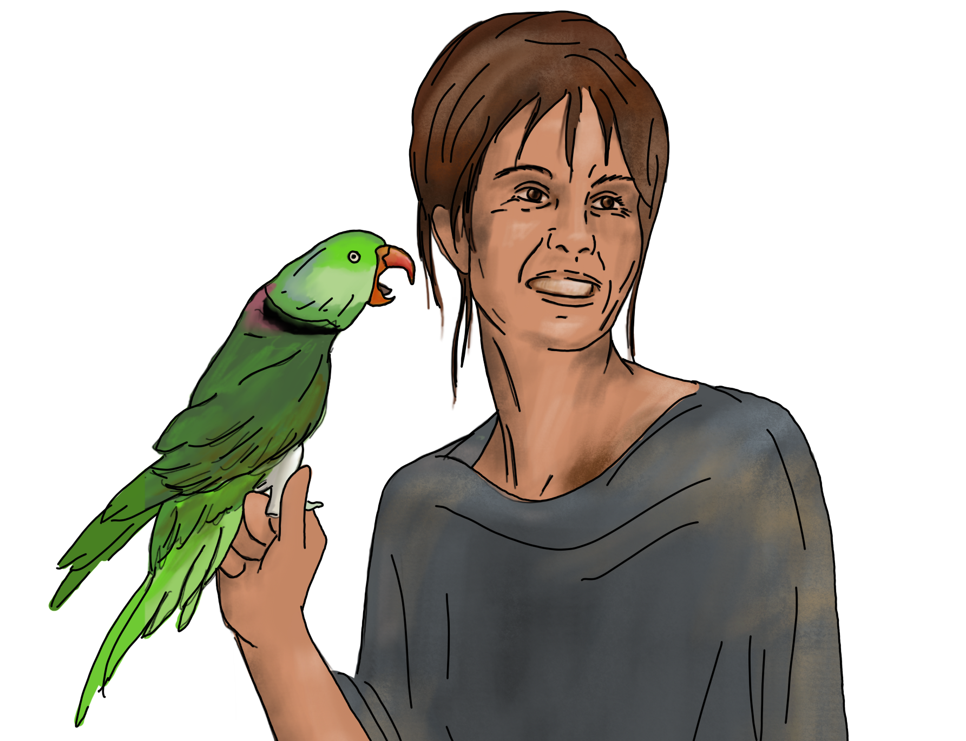
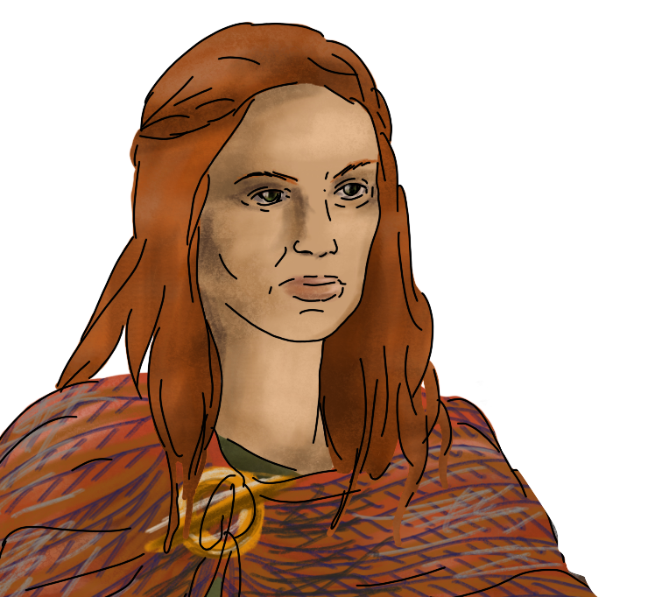
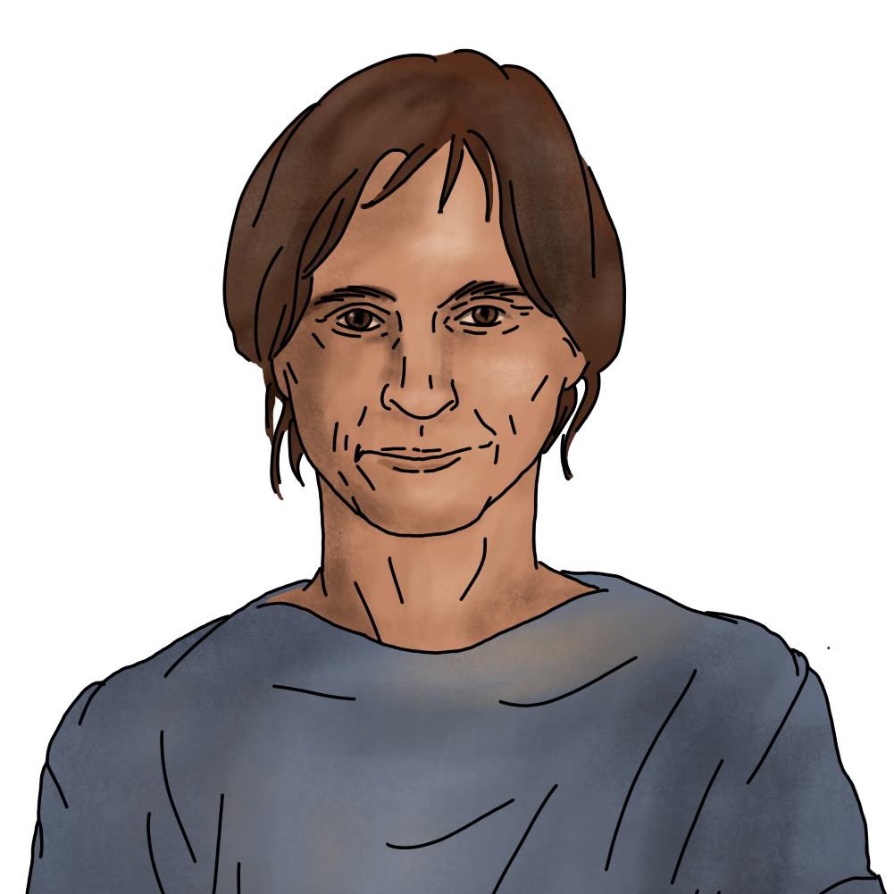
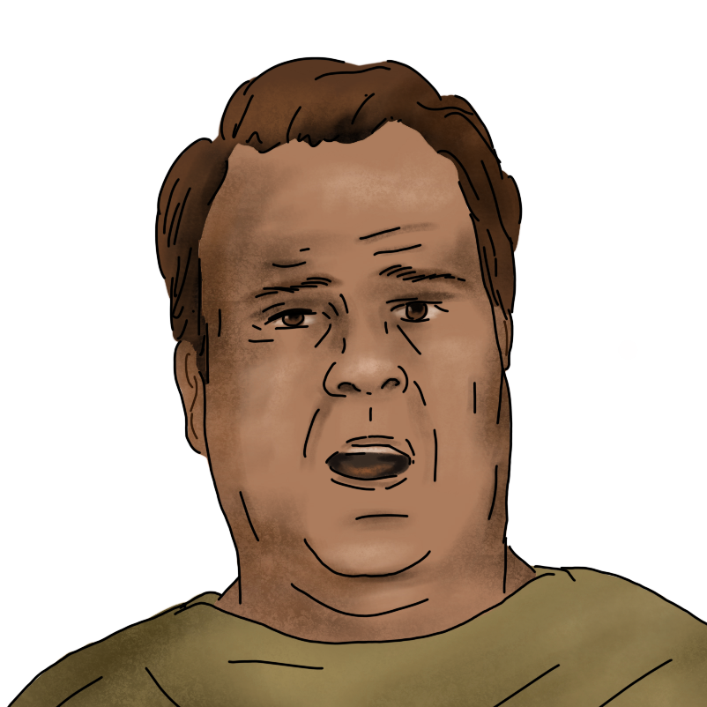
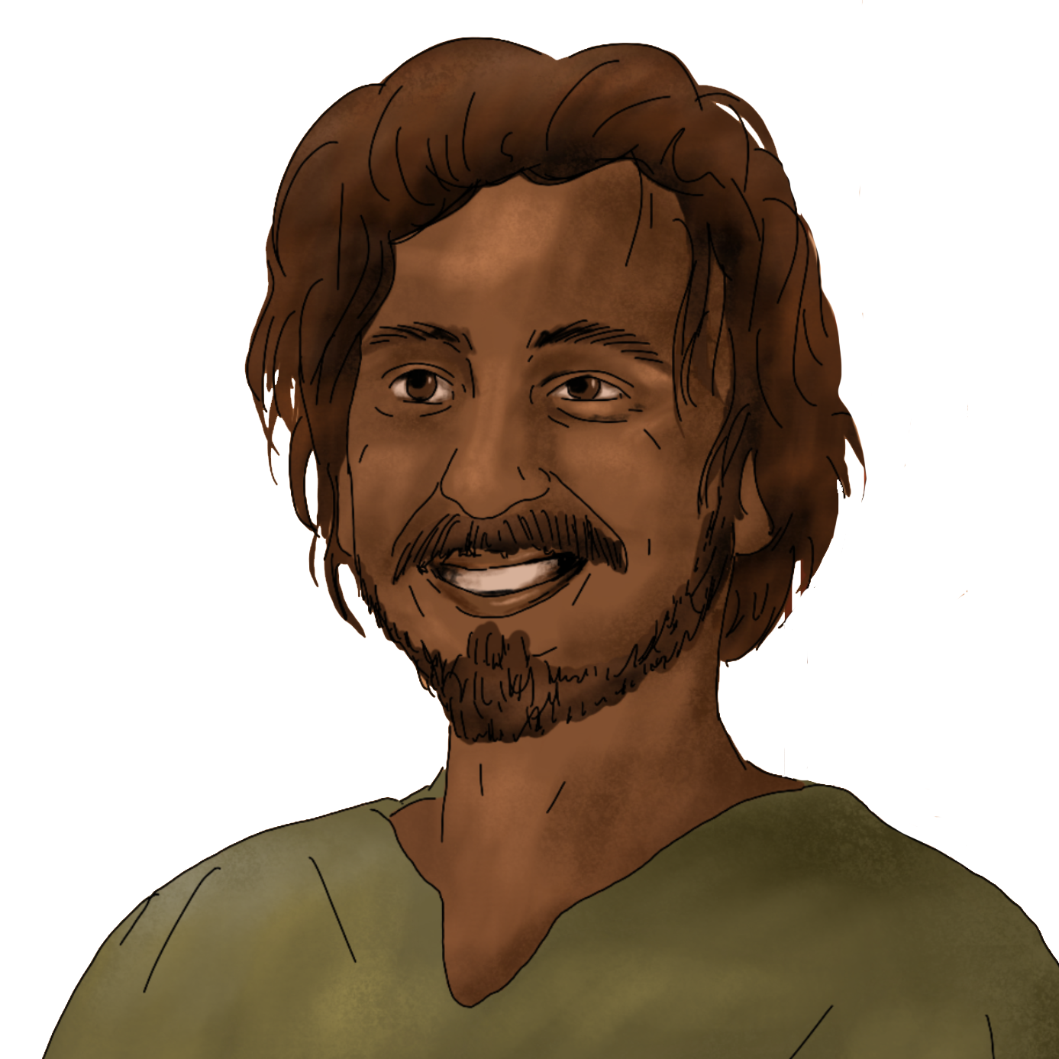
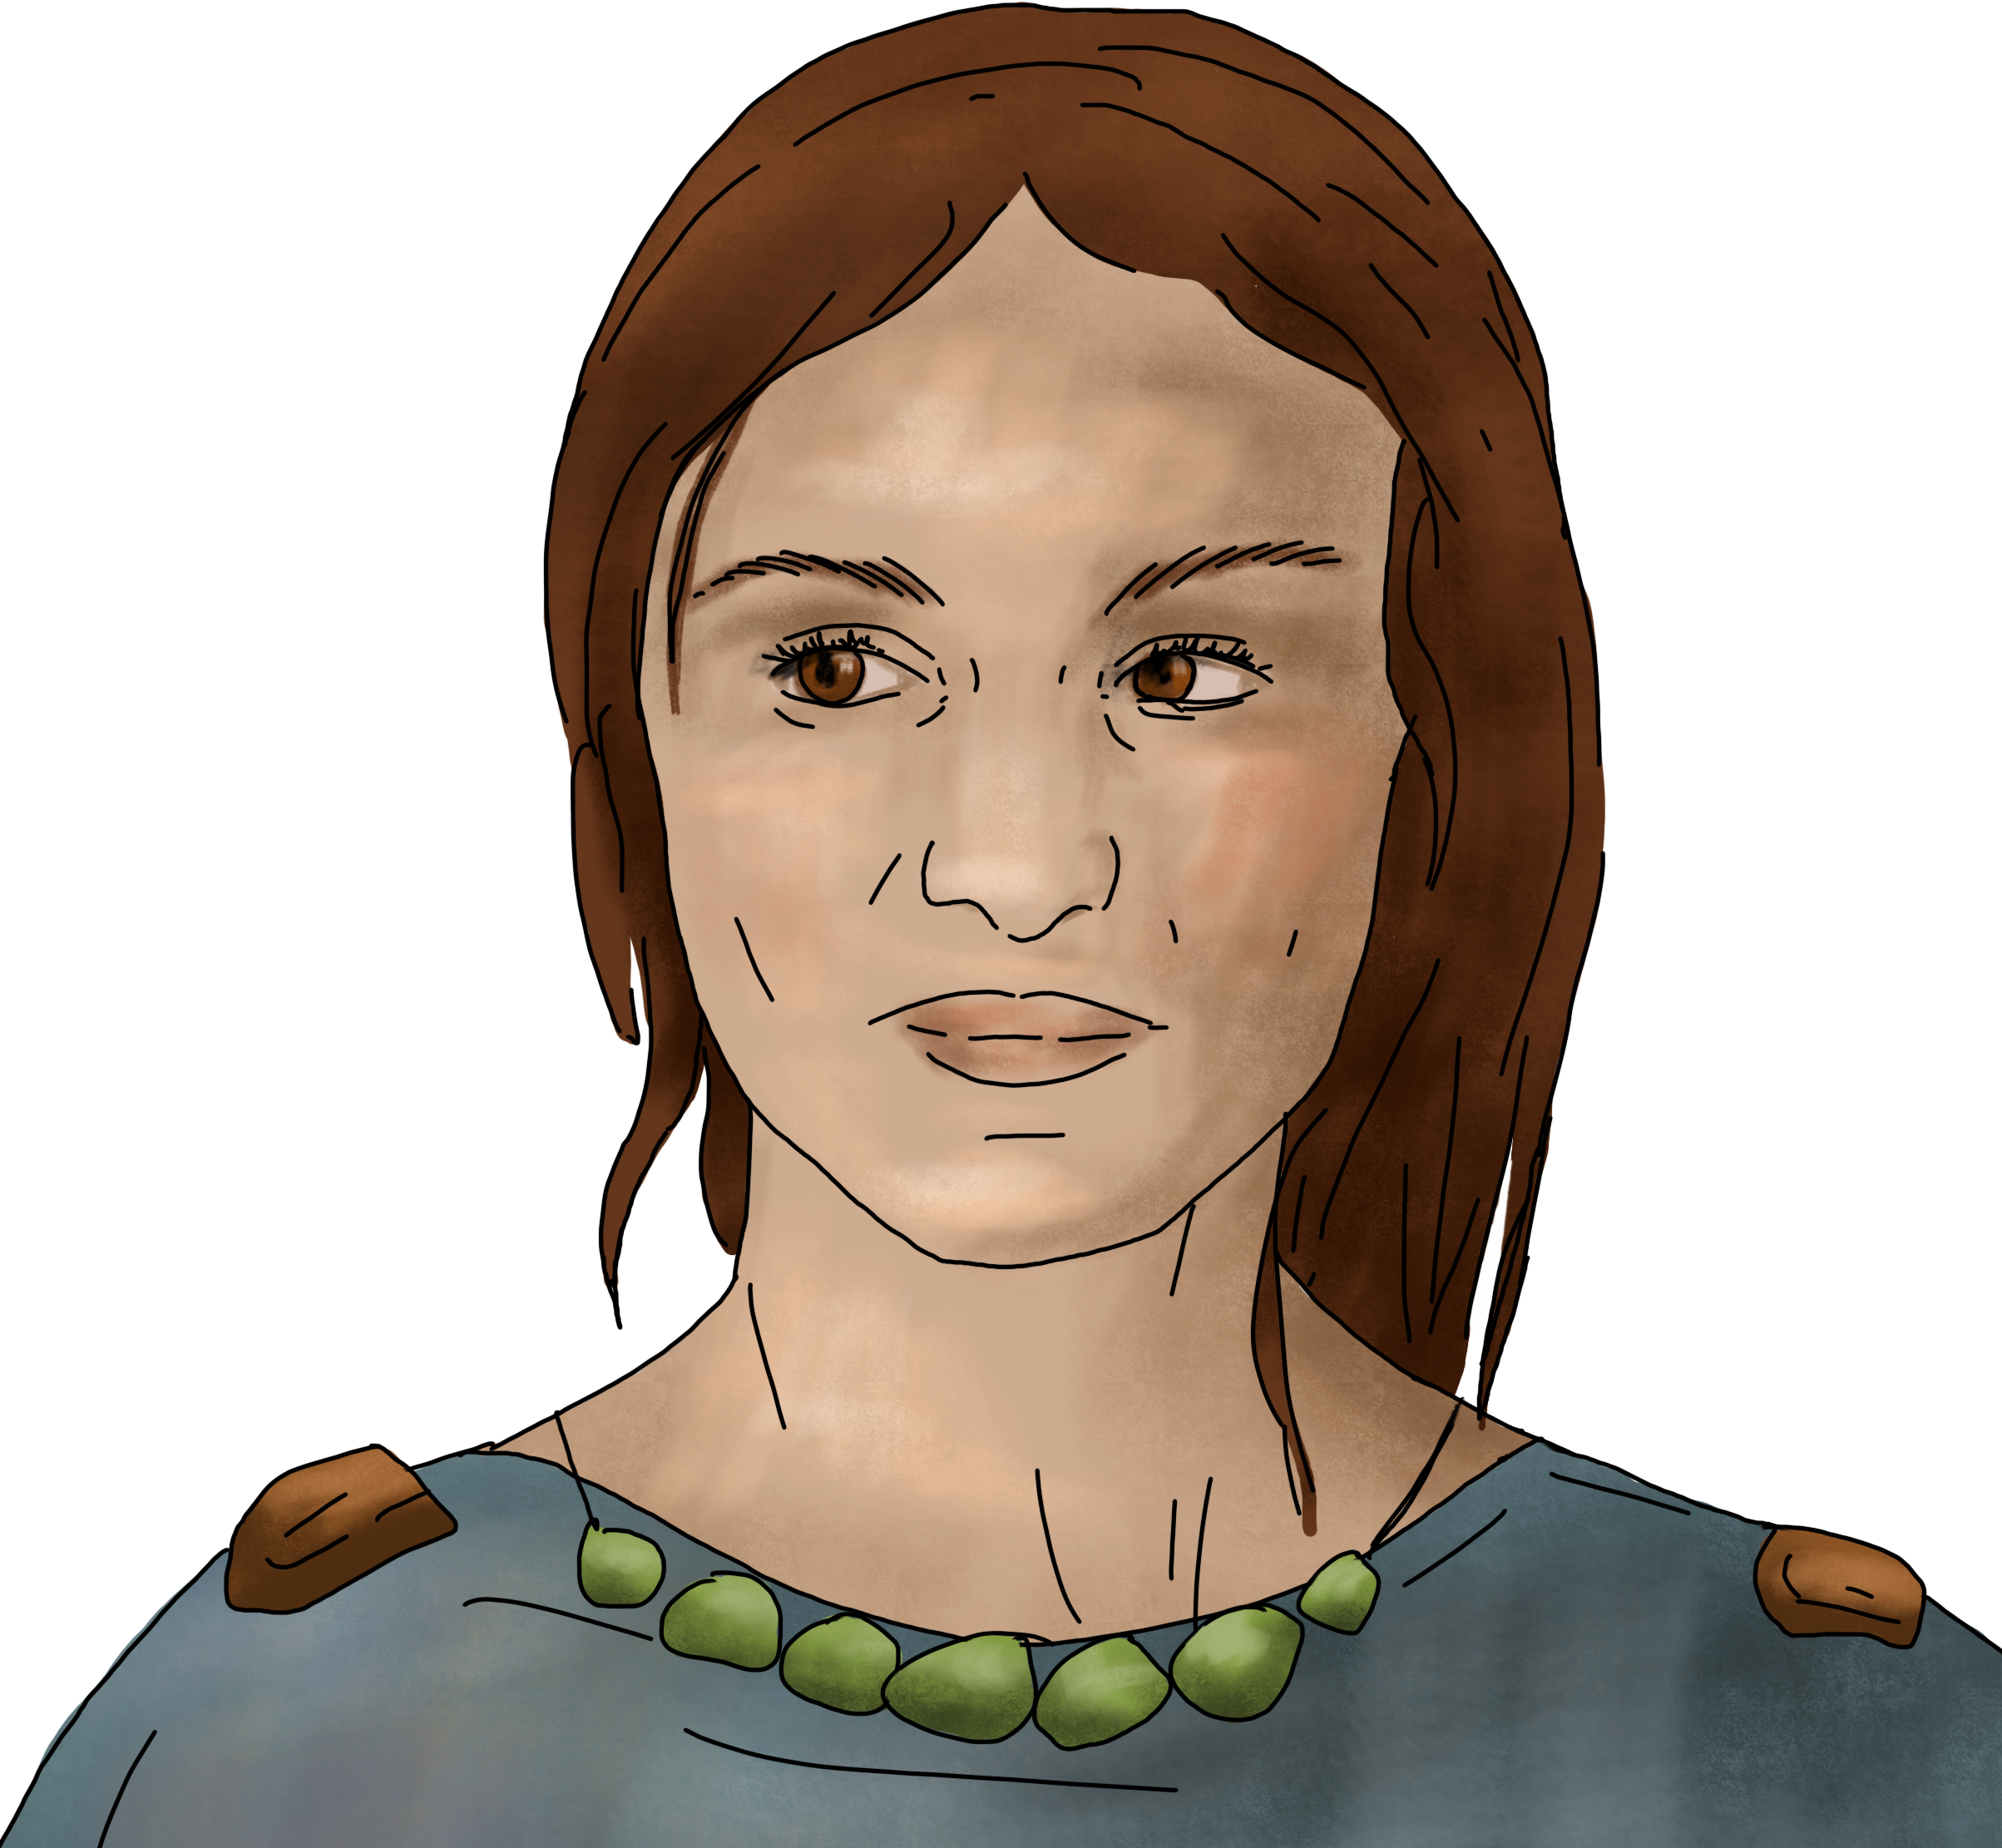
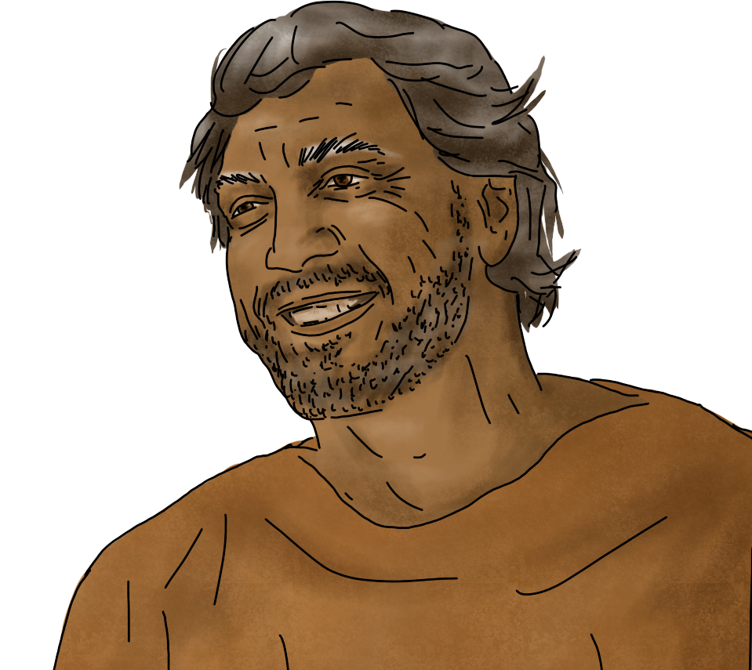
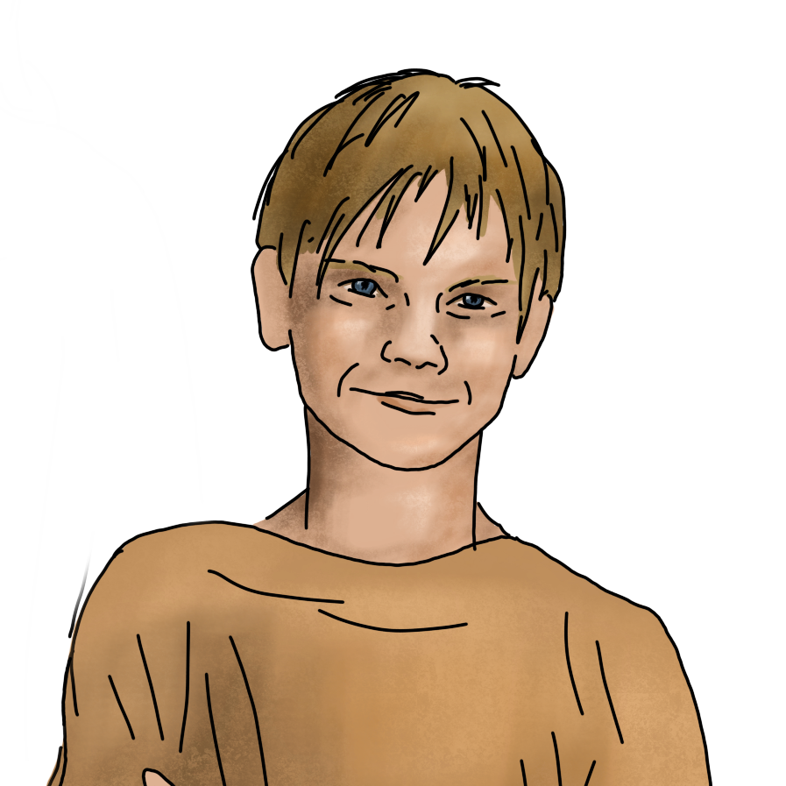
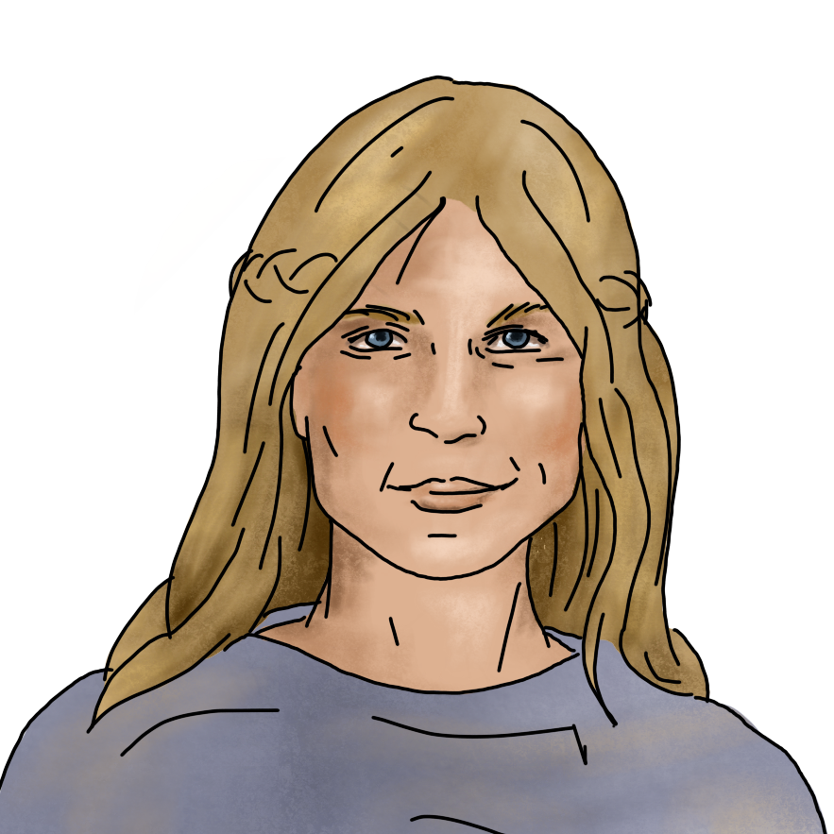
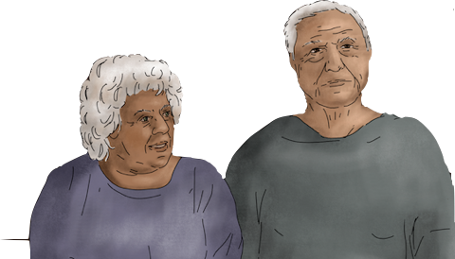
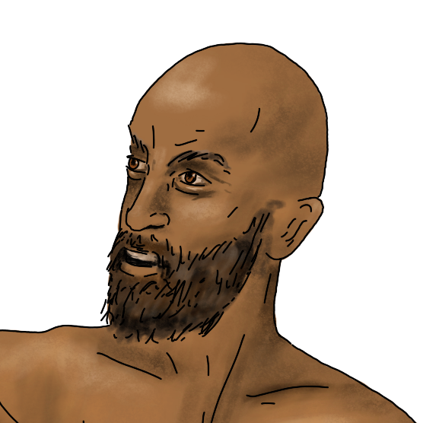
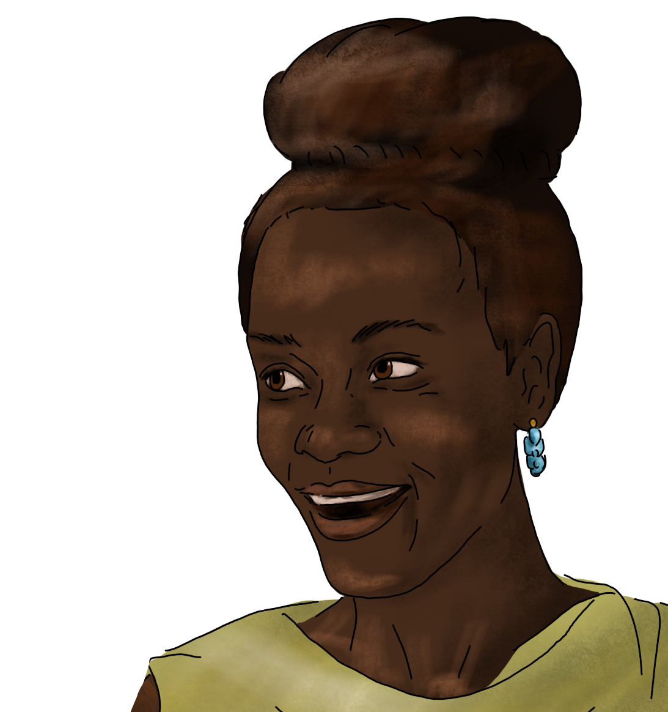
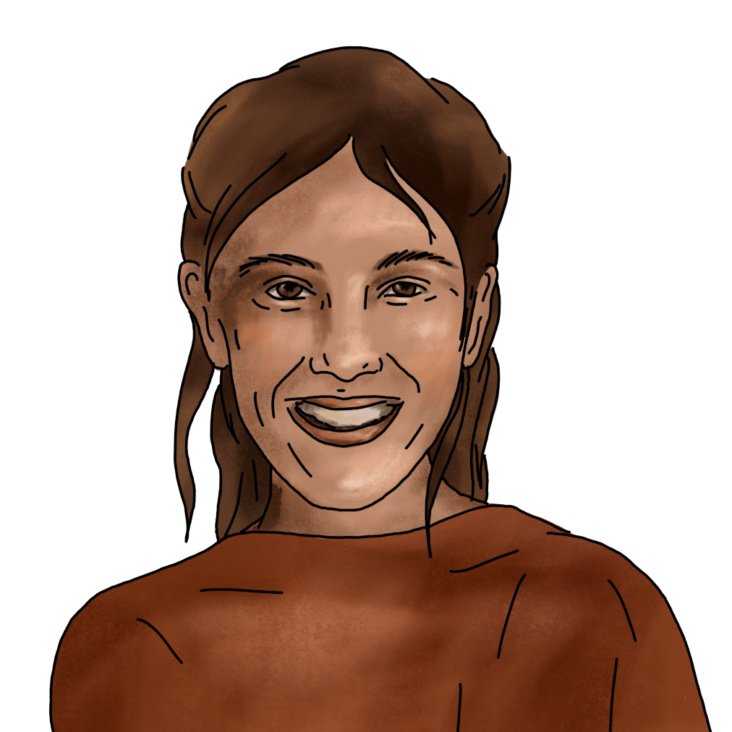
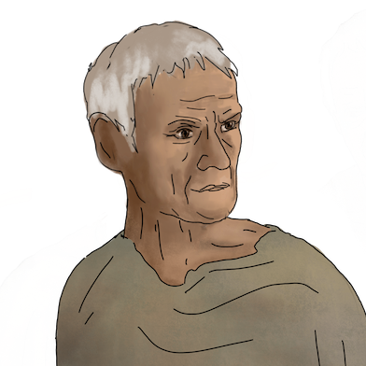
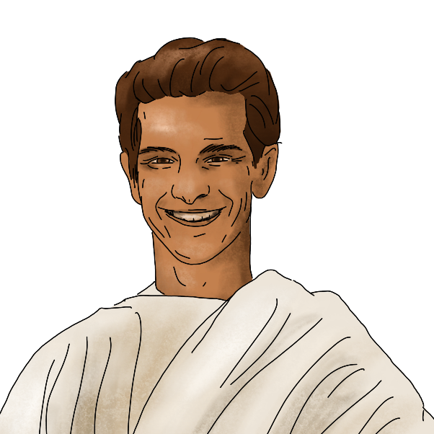
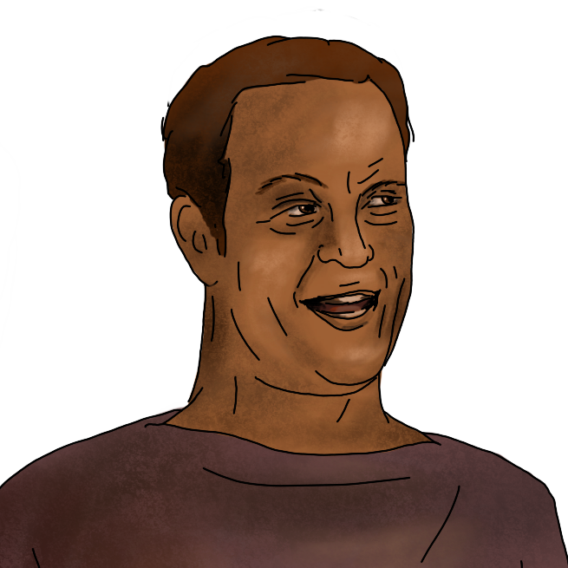
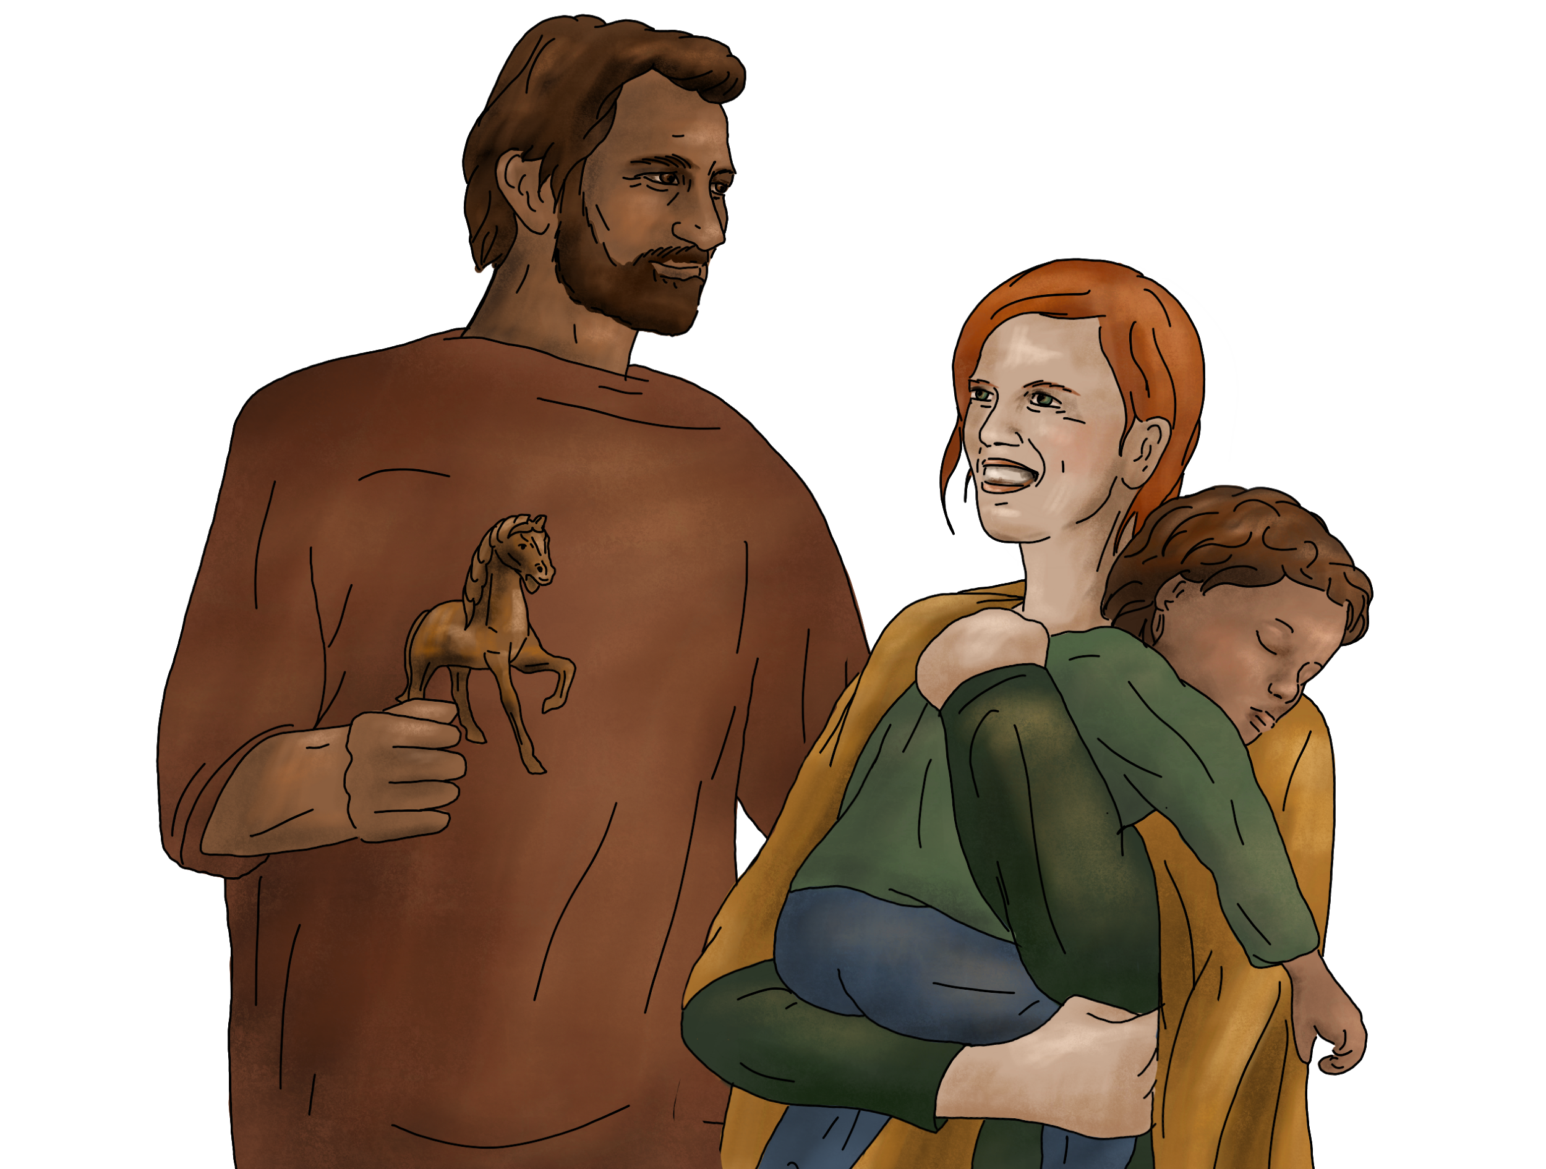
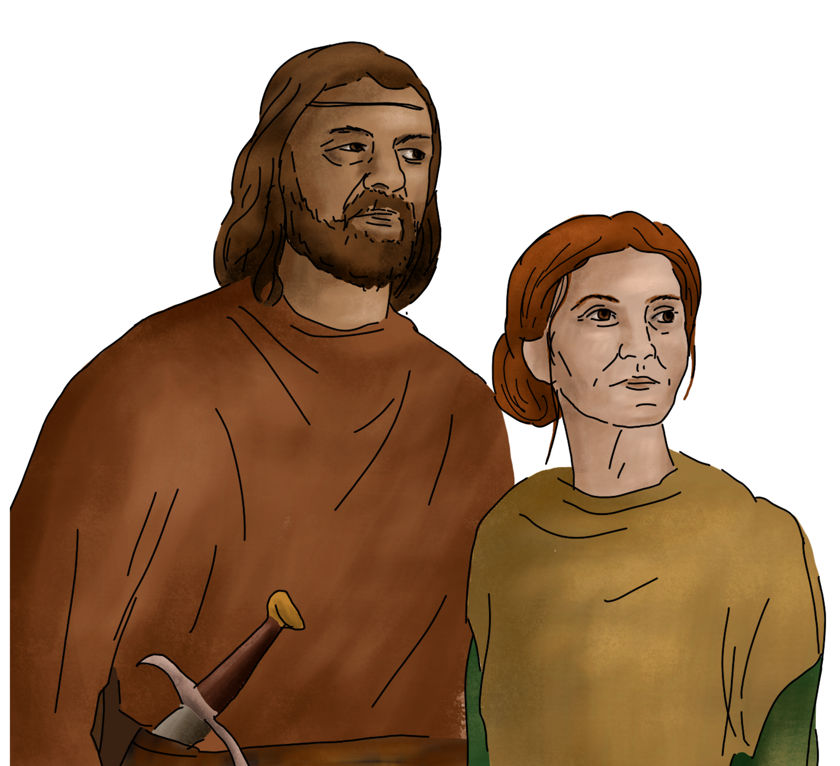
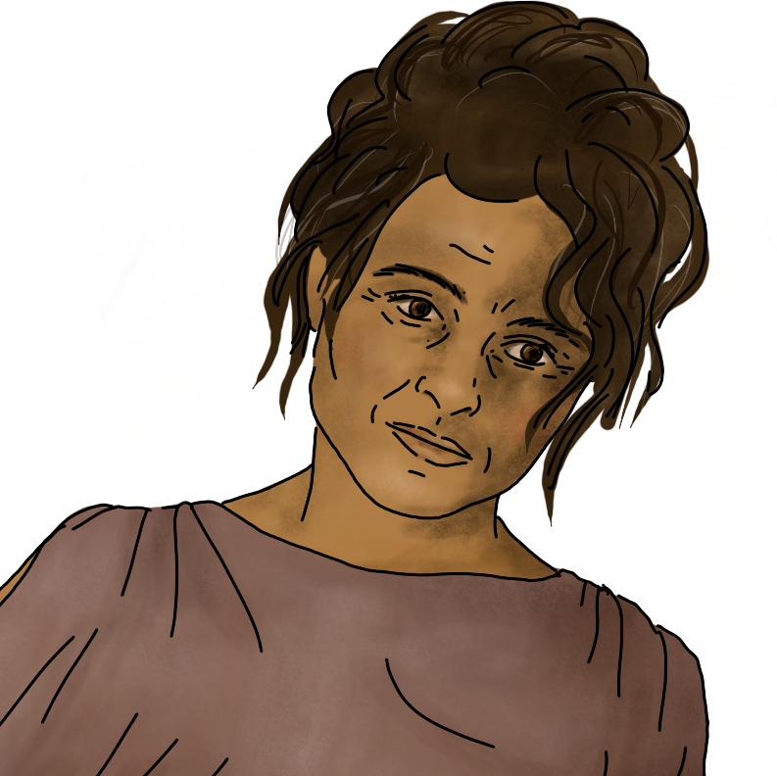
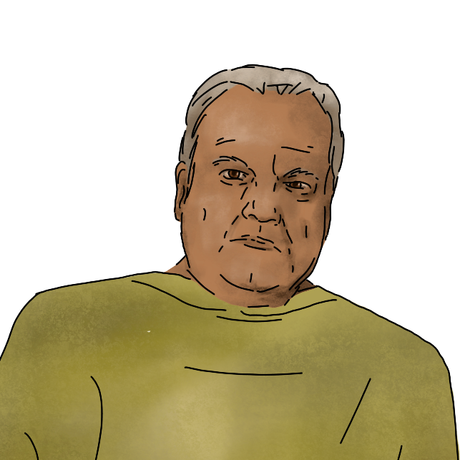
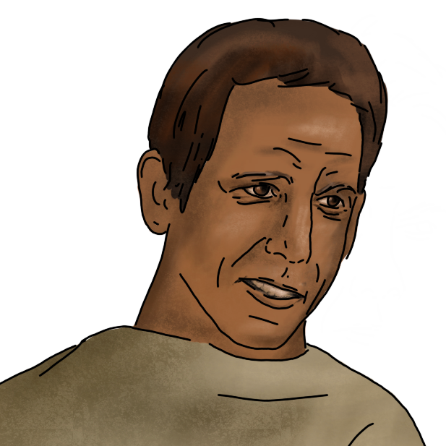
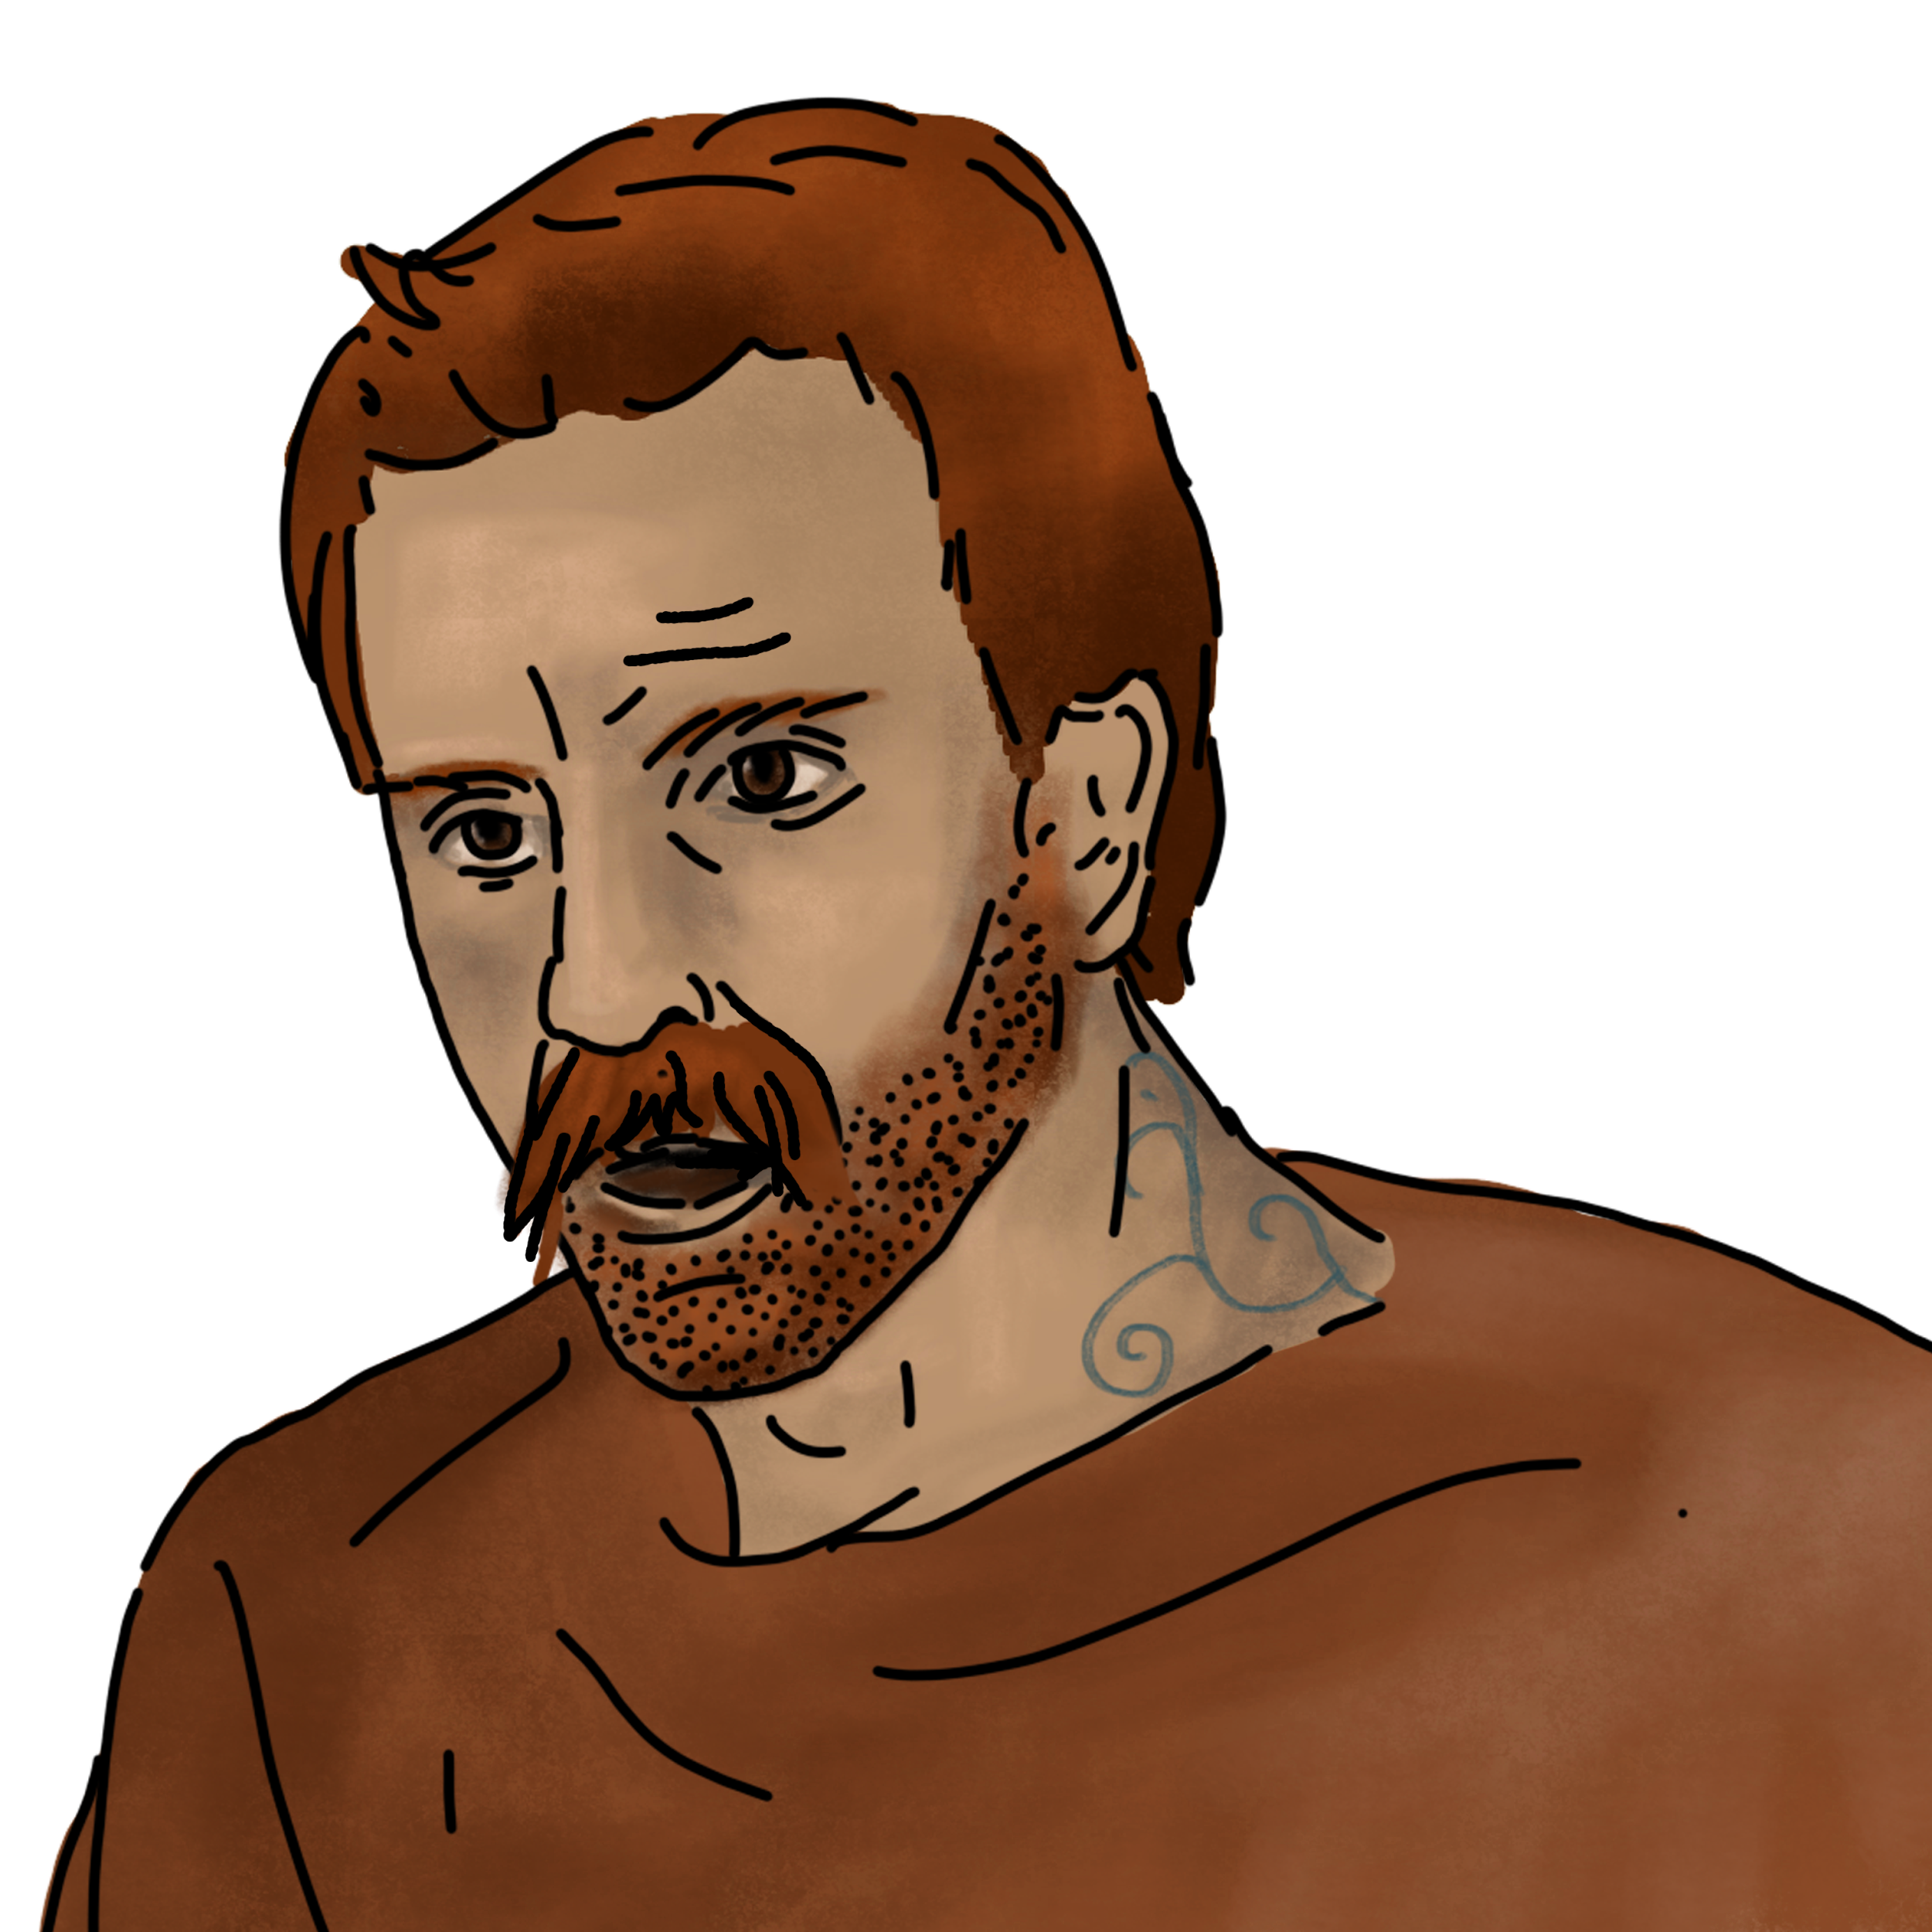

Slide 4
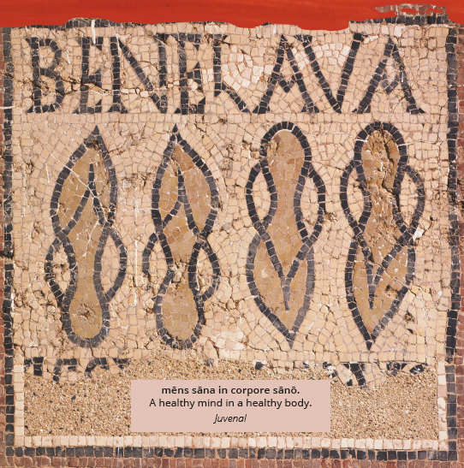
Linguistic map

Slide 5
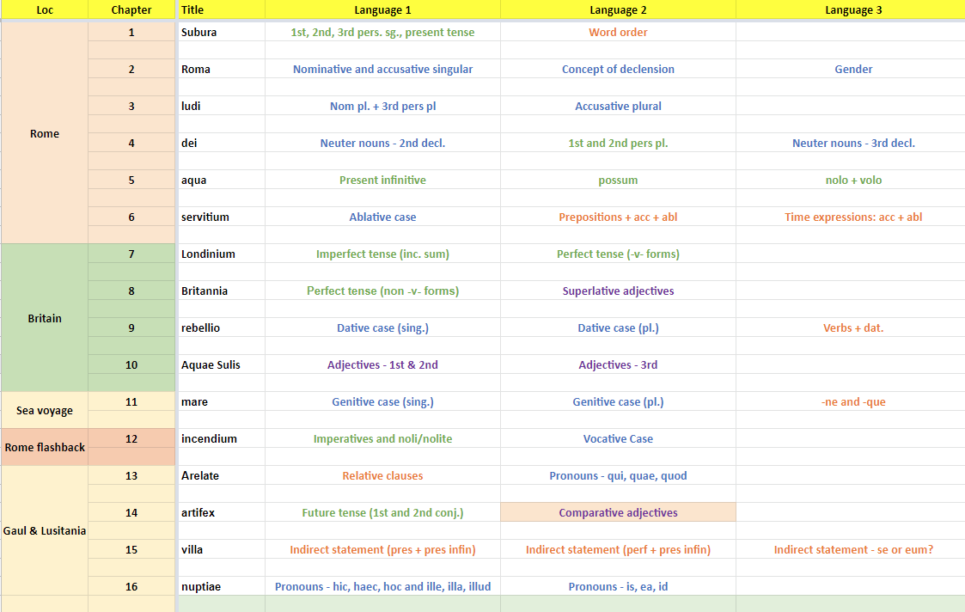

Slide 6
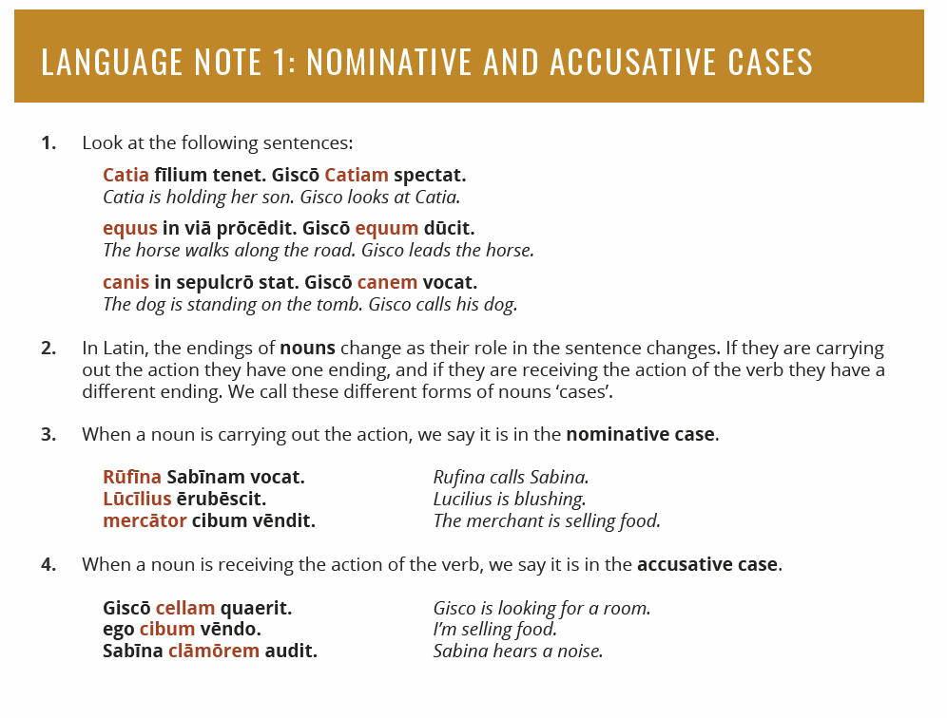

Slide 7
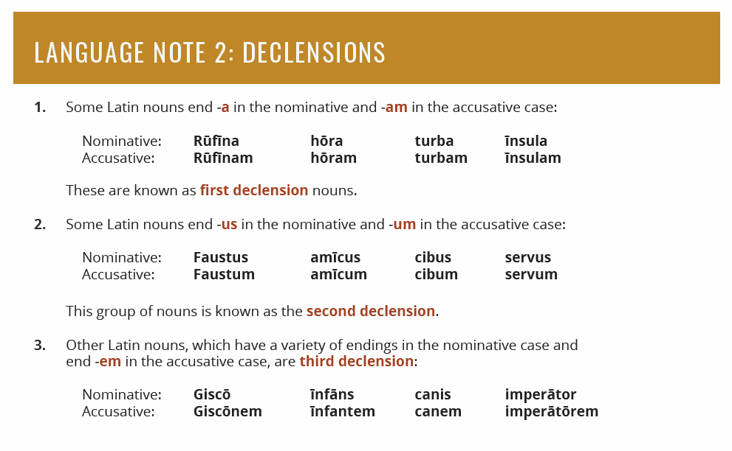

Slide 8
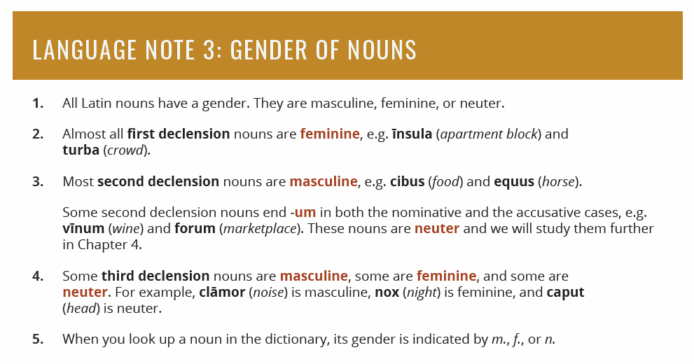

Slide 9
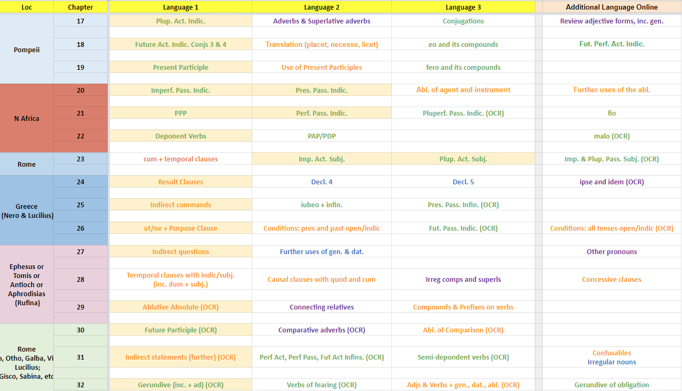

Slide 10
Teaching a chapter

Slide 11
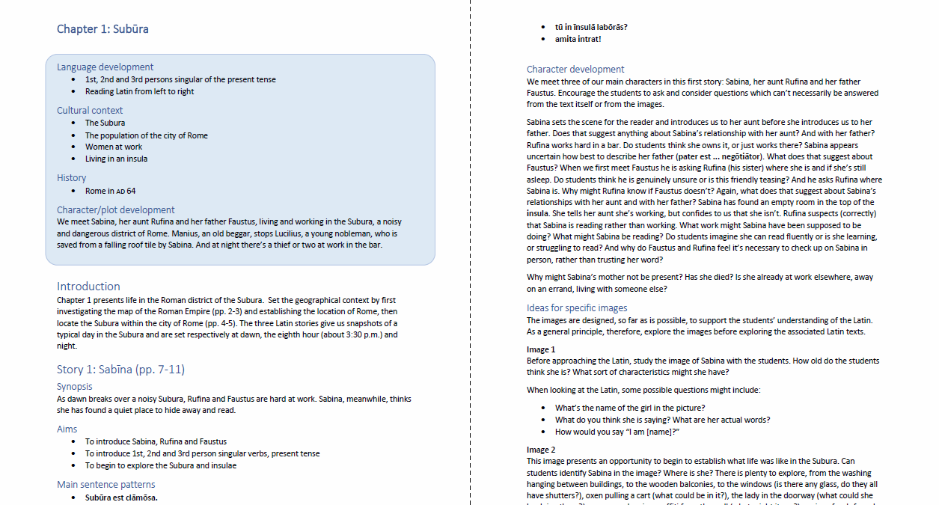

Slide 12
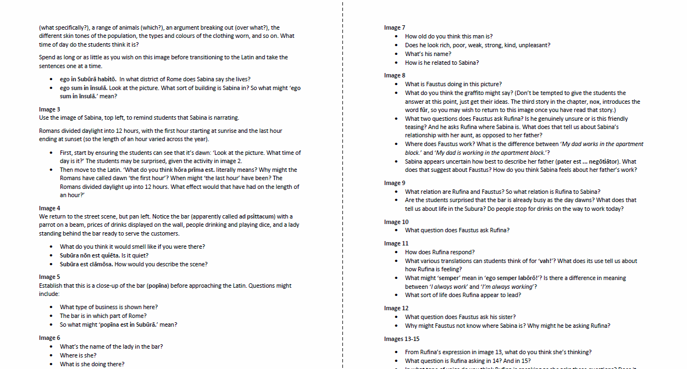

Slide 13
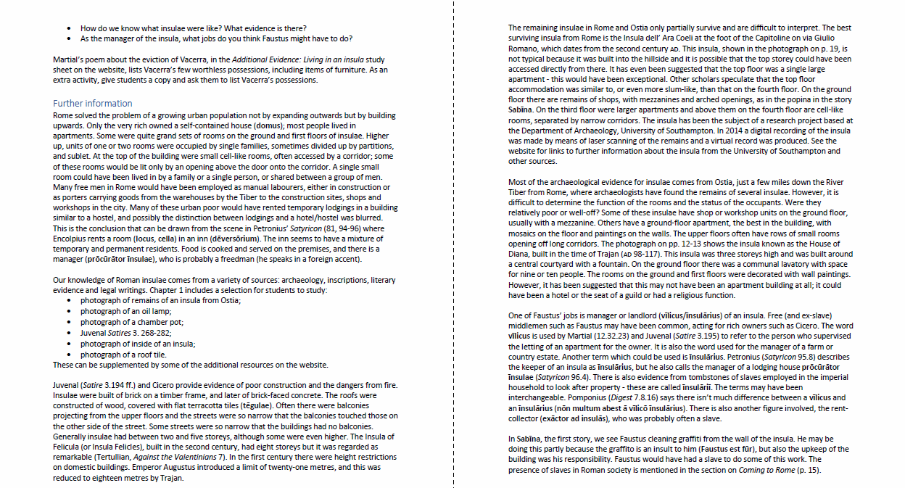

Slide 14
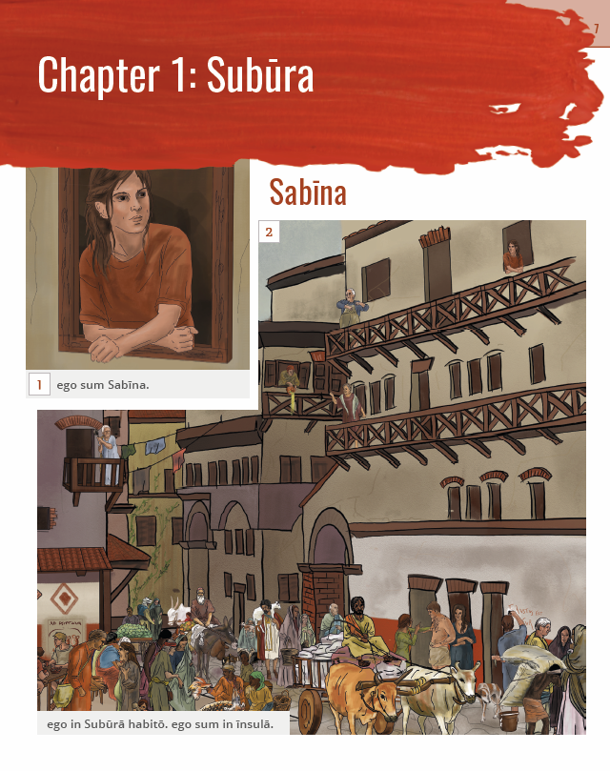

Slide 15
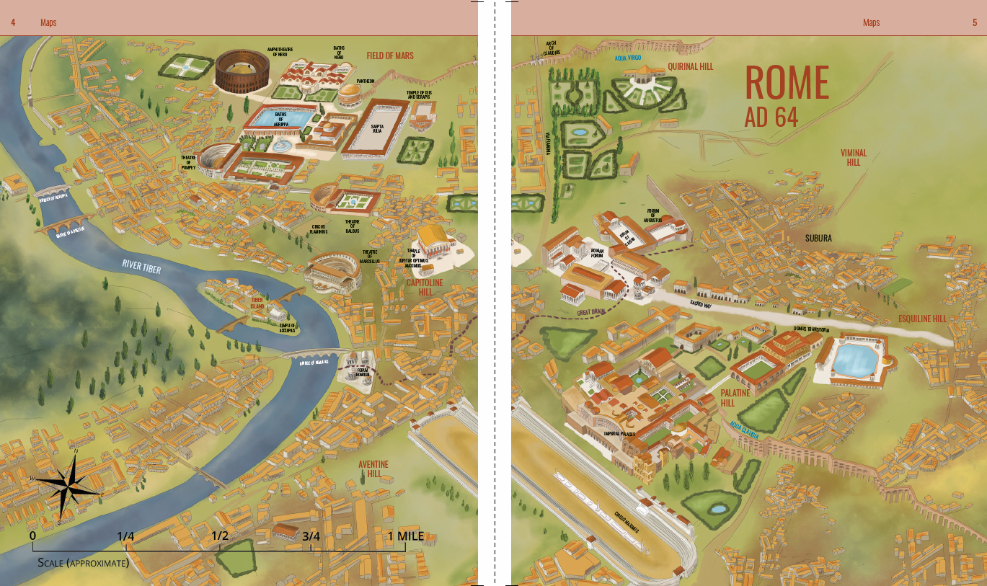

Slide 16
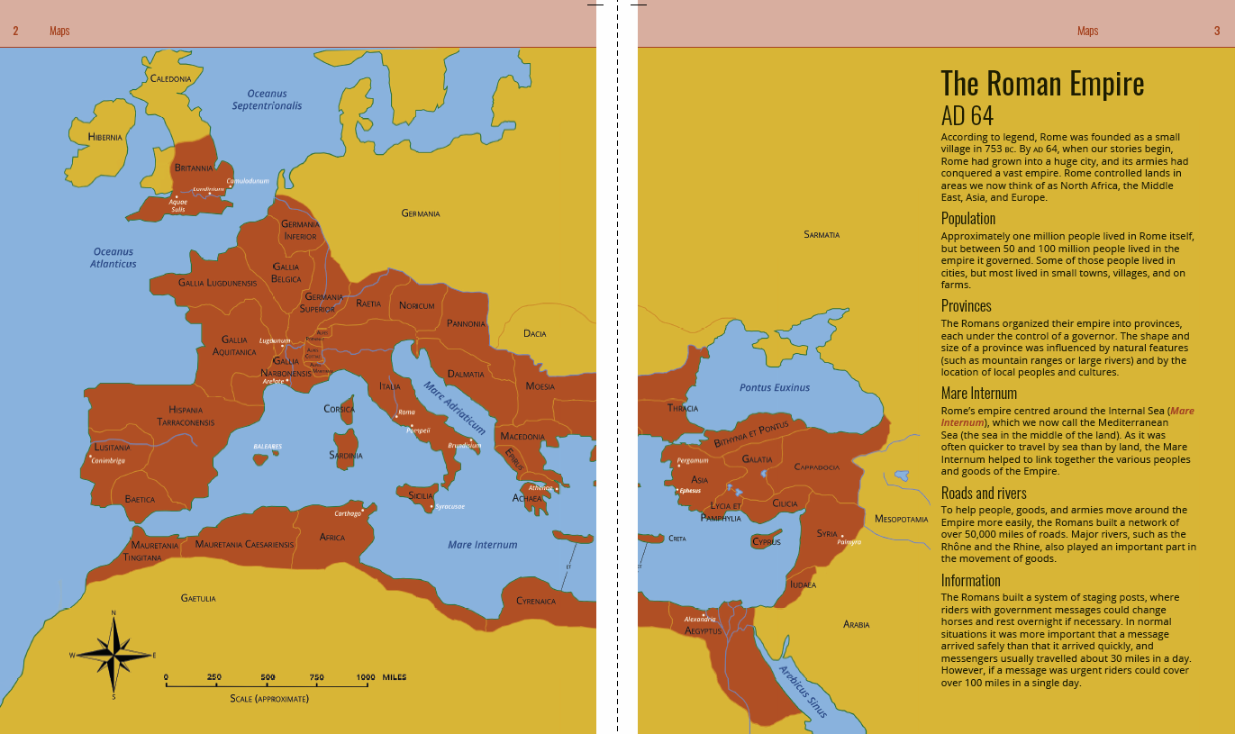

Slide 17
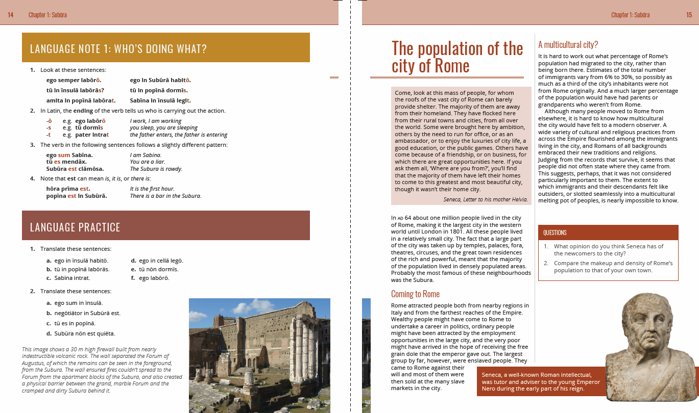

Slide 18
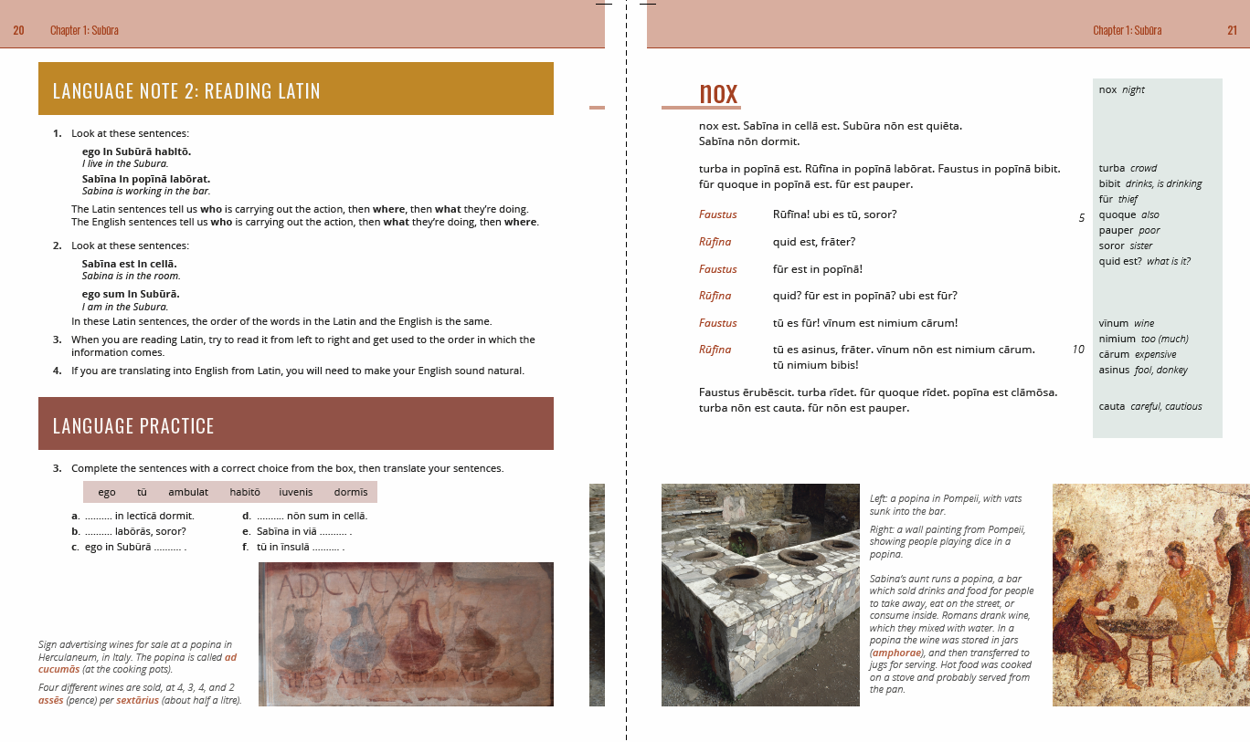

Slide 20
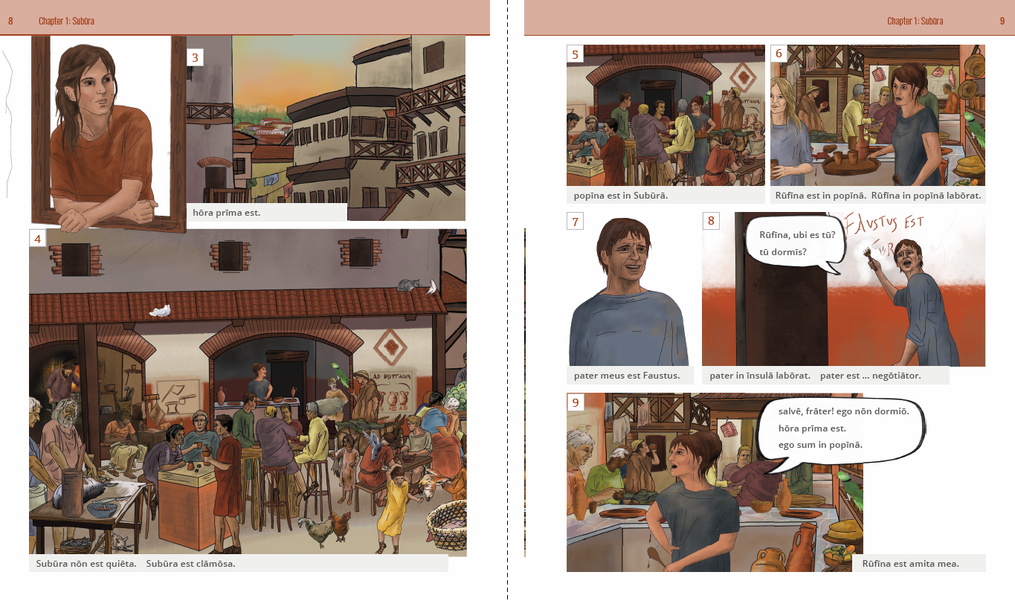

Slide 21
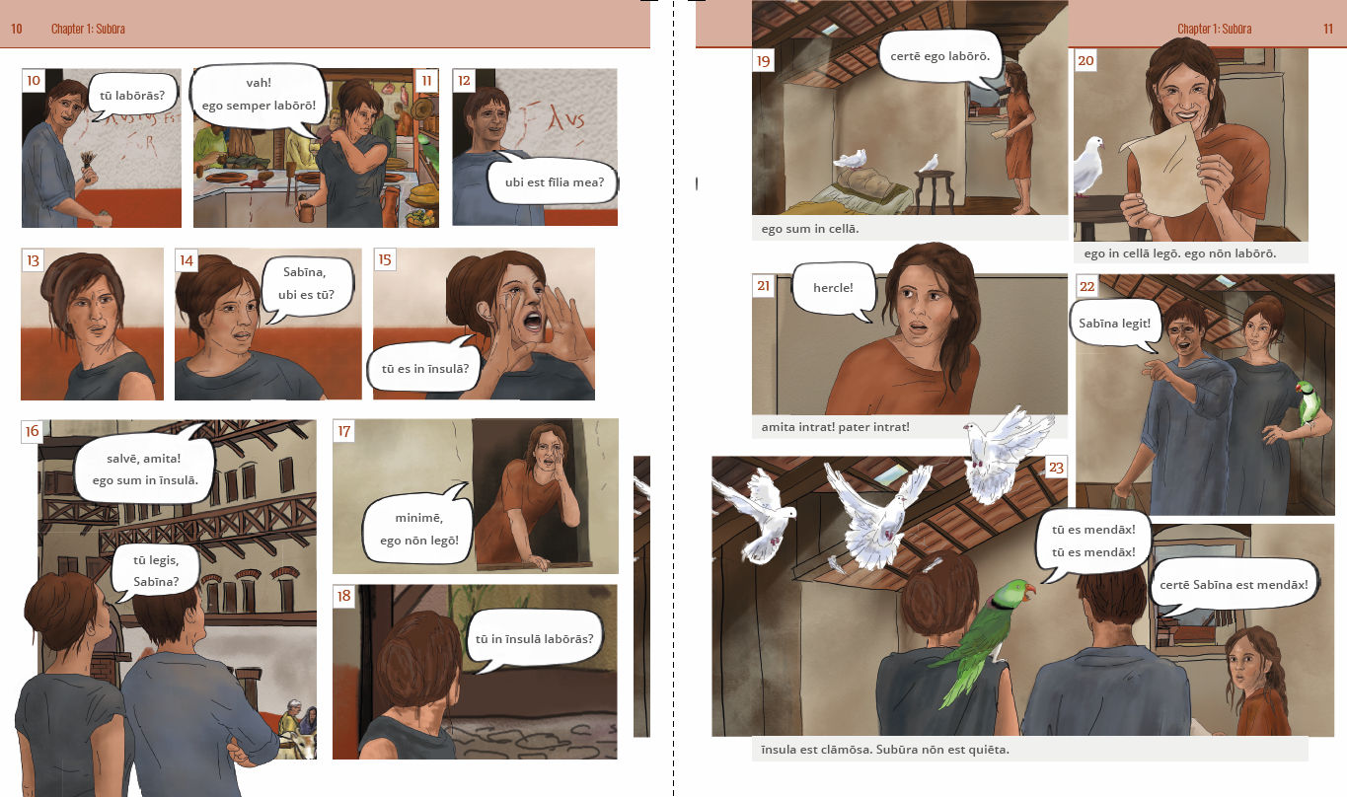

Slide 22
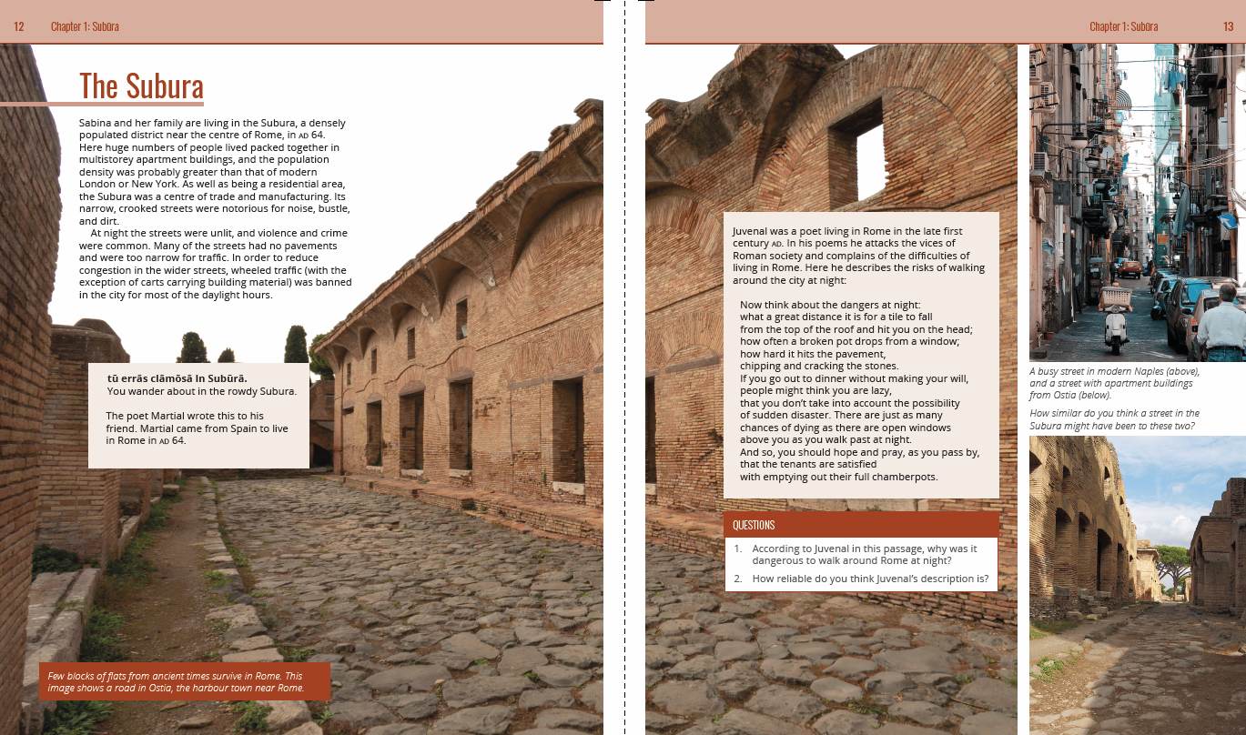

Slide 24
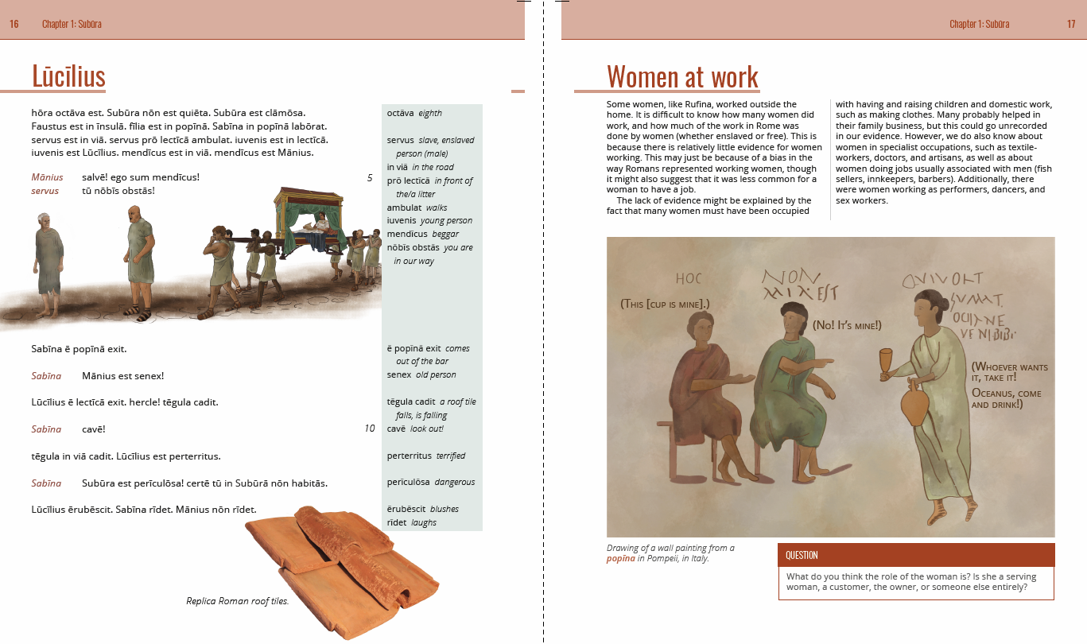

Slide 25
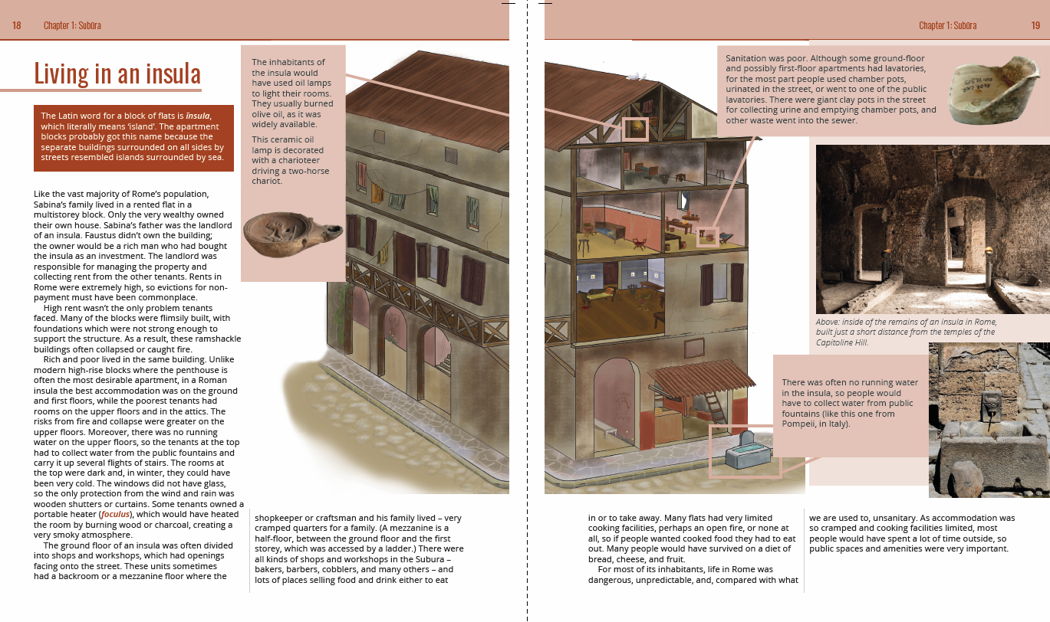

Slide 27
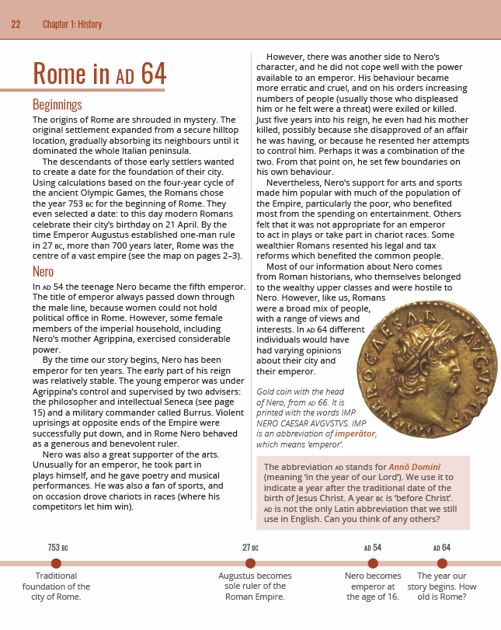

Slide 28
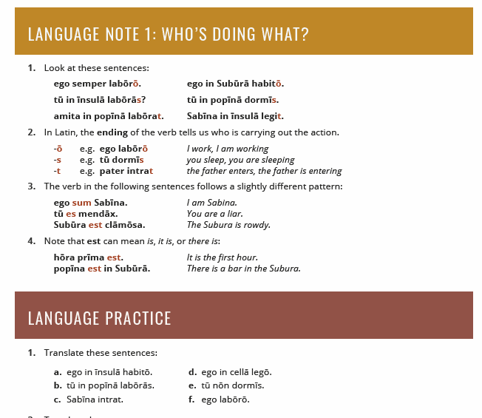

Slide 29
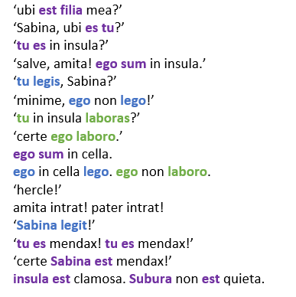
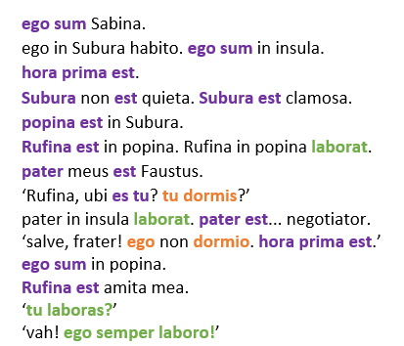

Slide 31
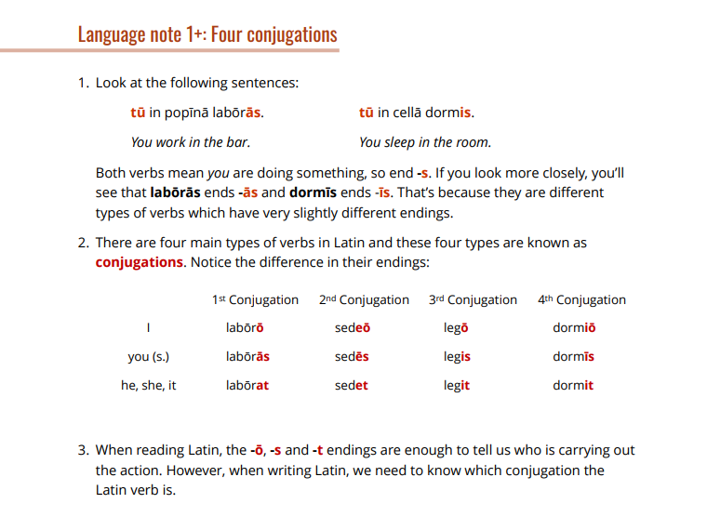

Slide 32
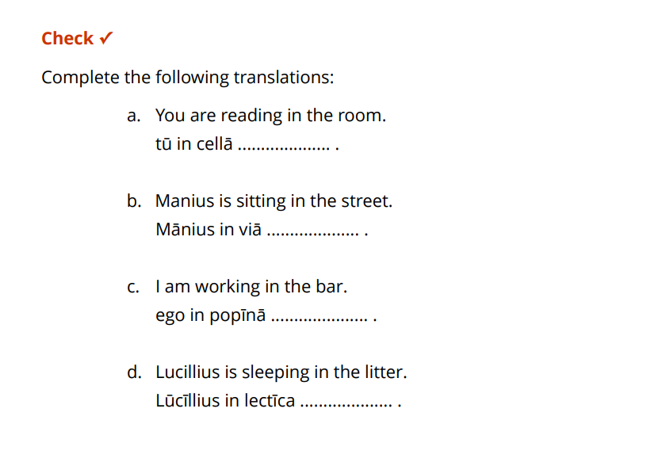

Slide 33
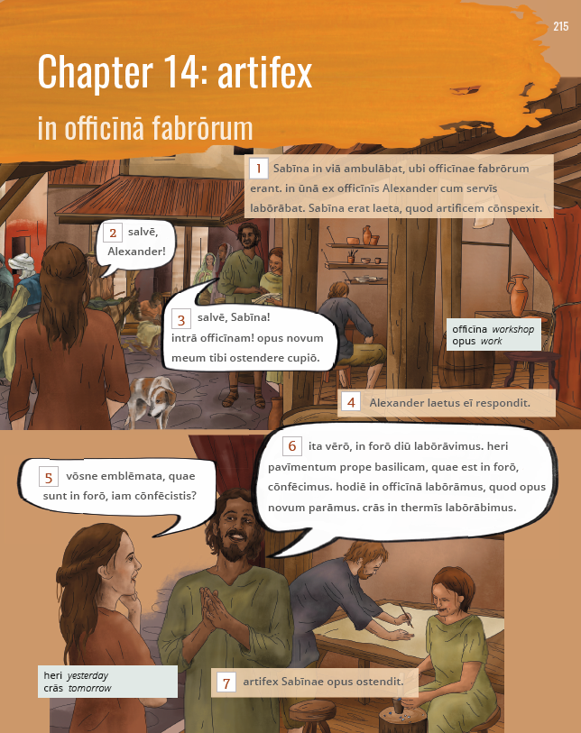

Slide 34


Slide 35


Slide 38


Slide 39


Slide 41


Slide 42


Slide 43


Slide 44


Slide 45


Slide 46


Slide 47


Slide 48

A few tips
The introduction of a new linguistic feature is the area of highest risk – keep it simple and control the focus
Use leading questions, with the appropriate tense, to increase chance of correct response at outset
‘How do you know?’
Separate reading ability from knowledge of terminology
Some, many, all
You cannot teach all Latin grammar in one lesson
Students will remember what they do more than what you say.

Slide 49
Vocabulary

Slide 50
Prioritising core vocabulary
Dickinson
  Top 500
  Top 1,000
  Not in top 1,000
GCSE DVLs (Defined Vocabulary Lists)
  B = Both
  E = Either (i.e. on one, but not both)
  N = Neither
puto = B1
repente = N3 (subito = B2)

Slide 51
Tracking vocabulary use
Spreadsheet analysis
Software analysis

Slide 52


Slide 53


Slide 54


Slide 55


Slide 56


Slide 57


Slide 58


Slide 59


Slide 60


Slide 61


Slide 62
Information in vocabulary lists
Gender: Chapter 2
Accusative: Chapter 2
Infinitive: Chapter 5
1st person perfect: Chapter 7
All forms of adjectives: Chapter 10
Genitive: Chapter 11
PPP: Chapter 21

Slide 63

Technology

Slide 64


Slide 65


Slide 66


Slide 67


Slide 68


Slide 69


Slide 70



Slide 71



Slide 72



Slide 73



Slide 74


Slide 75



Slide 76


Slide 77

Suburani: progress tracking (28pt Arial)
1 This is the body text: 8 lines of text max (18pt Arial)
2 This is the body text: 8 lines of text max (18pt Arial) - dark grey 3
3
4
5
6
7

Slide 78


Slide 79


Slide 80


Slide 81


Slide 82
The Research

Slide 83


Slide 84


Slide 85


Slide 86


Slide 87


Slide 88


Slide 89


Slide 90


Slide 91


Slide 92


Slide 93


Slide 94


Slide 95


Slide 96



Slide 97


Slide 98


Slide 99


Slide 100


Slide 101


