Slide 1
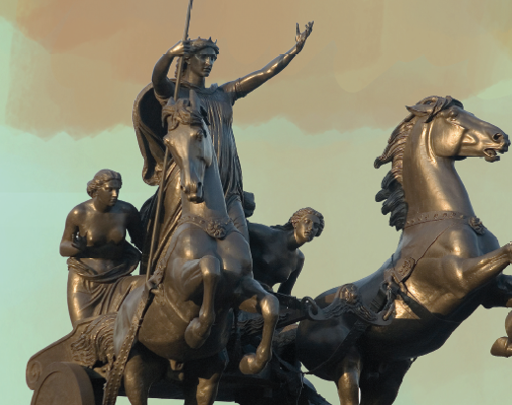
Teaching Roman culture in a reading course

Slide 2
Roman culture
Background
Paralinguistic
Cultural context
Foreground
Language as a tool for understanding culture
Culture as the focus

Slide 3
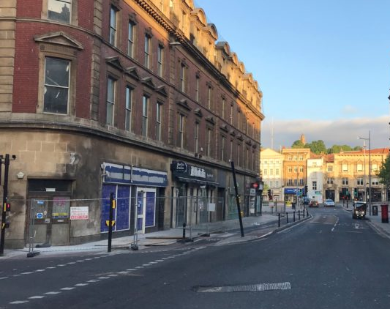
via

Slide 4
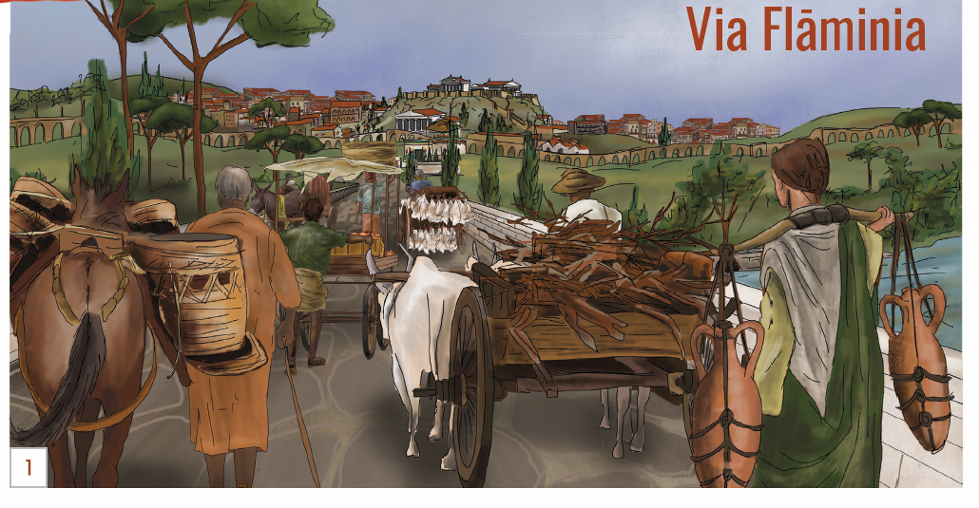

Slide 5

mercator

Slide 6
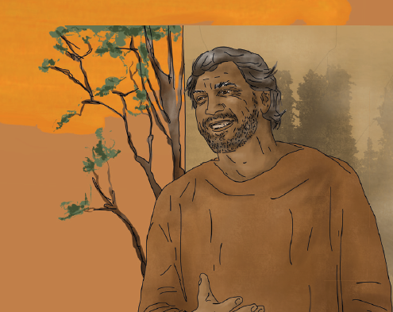
mercator

Slide 7
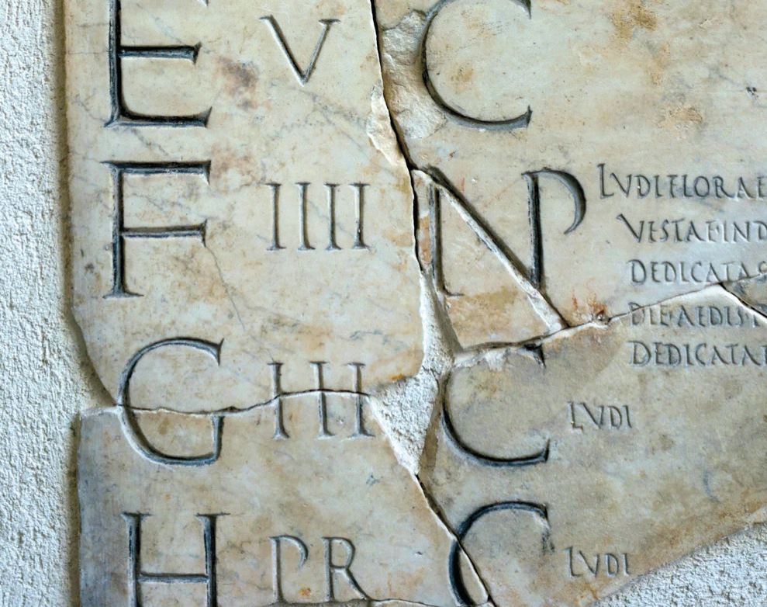
Why do we learn to read Latin?

Slide 8
Let me not to the marriage of true minds
Admit impediments. Love is not love
Which alters when it alteration finds,
Or bends with the remover to remove.
O no! it is an ever-fixed mark
That looks on tempests and is never shaken;
It is the star to every wand'ring bark,
Whose worth's unknown, although his height be taken.
Love's not Time's fool, though rosy lips and cheeks
Within his bending sickle's compass come;
Love alters not with his brief hours and weeks,
But bears it out even to the edge of doom.
If this be error and upon me prov'd,
I never writ, nor no man ever lov'd.

Slide 9
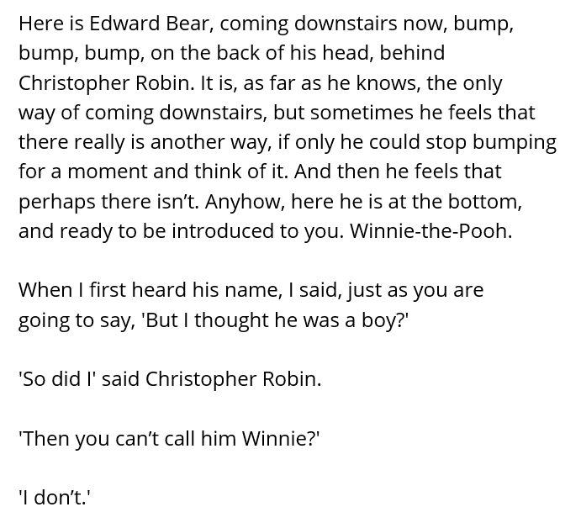

Slide 10


Slide 11
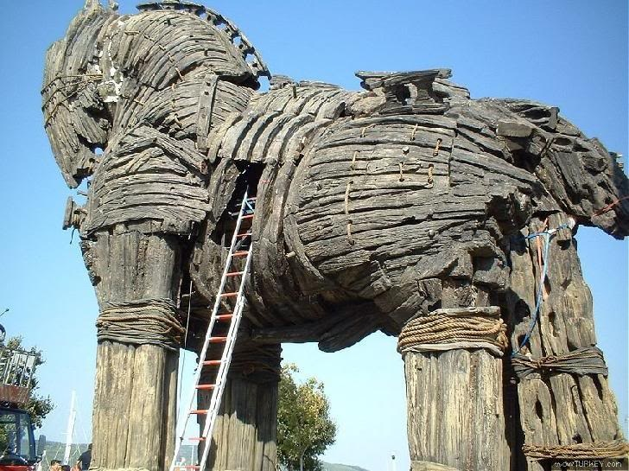
'quidquid id est, timeo Danaos et dona ferentis.'
sic fatus ualidis ingentem viribus hastam
in latus inque feri curvam compagibus alvum
contorsit. stetit illa tremens, uteroque recusso
insonuere cavae gemitumque dedere cavernae.
et, si fata deum, si mens non laeva fuisset,
impulerat ferro Argolicas foedare latebras,
Troiaque nunc staret, Priamique arx alta maneres.

Slide 12
Meanwhile the old couple noticed that, as soon as the mixing bowl was empty, it refilled itself, unaided, and the wine appeared of its own accord. They were fearful at this strange and astonishing sight, and timidly Baucis and Philemon murmured a prayer, their palms upwards, and begged the gods’ forgiveness for the meal, and their un-preparedness.
They had a goose, the guard for their tiny cottage: as hosts they prepared to sacrifice it for their divine guests. But, quick-winged, it wore the old people out and, for a long time, escaped them, at last appearing to take refuge with the gods themselves.
Then the heaven-born ones told them not to kill it. “We are gods,” they said, “and this neighbourhood will receive just punishment for its impiety, but to you we grant exemption from that evil. Just leave your house, and accompany our steps, as we climb that steep mountainside together.”

Slide 13
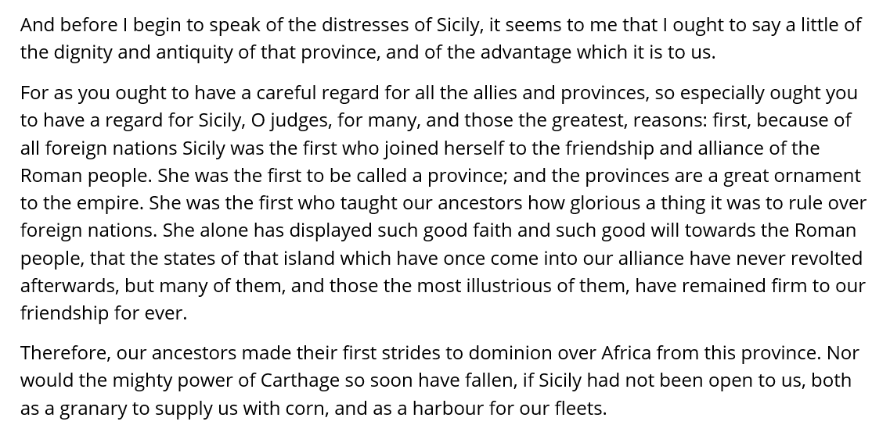

Slide 14
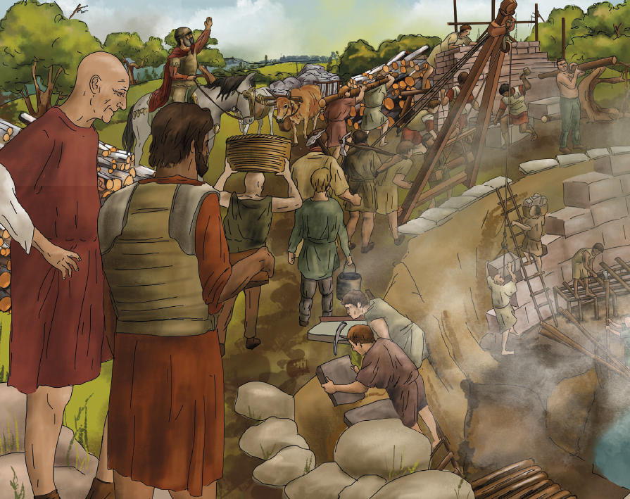
Using images

Slide 15
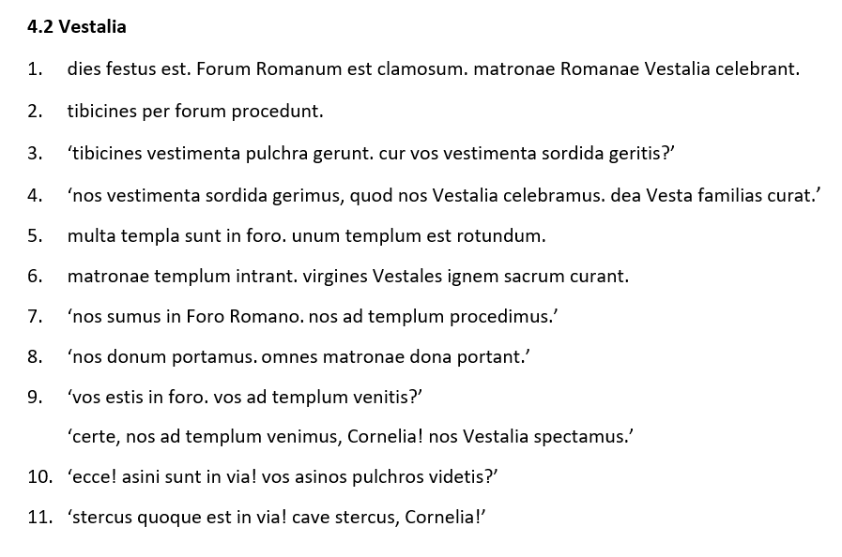

Slide 16
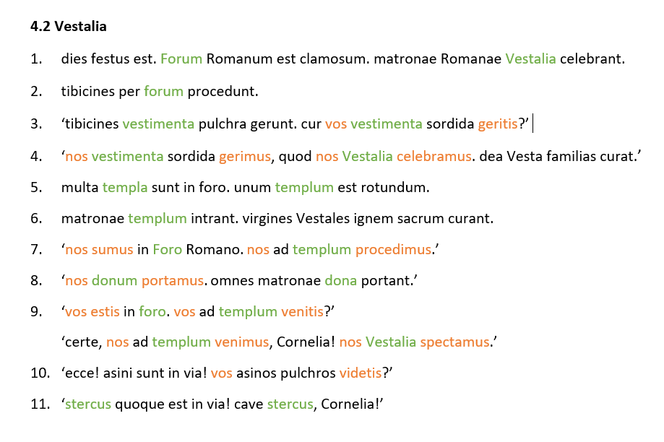

Slide 17
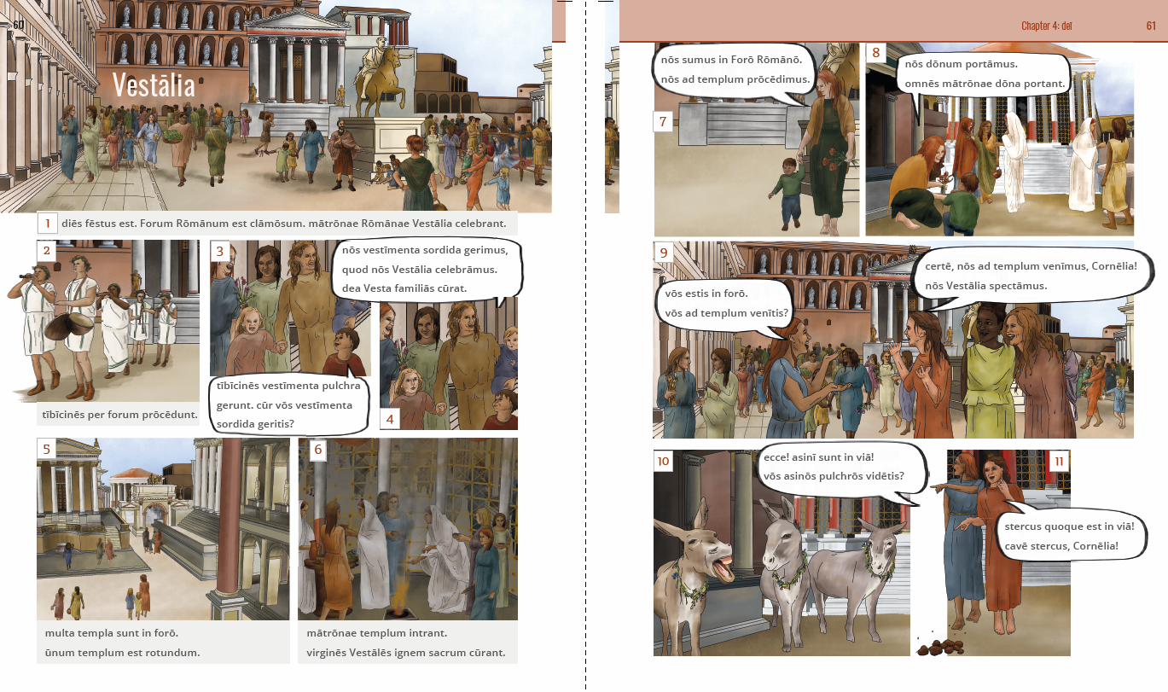

Slide 18
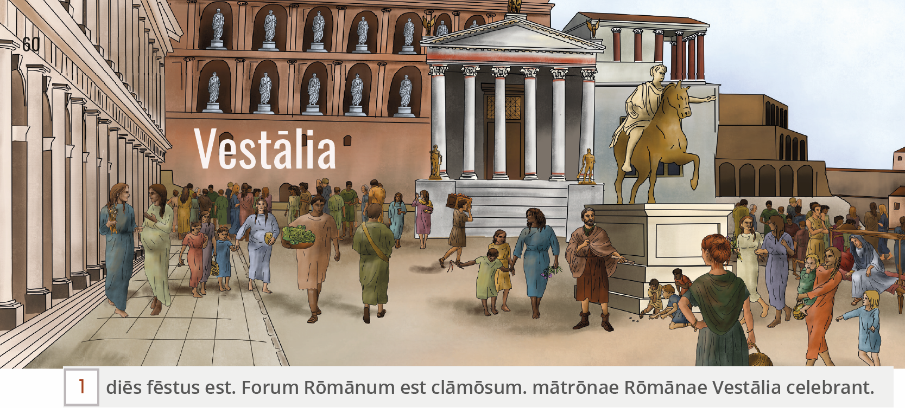

Slide 19
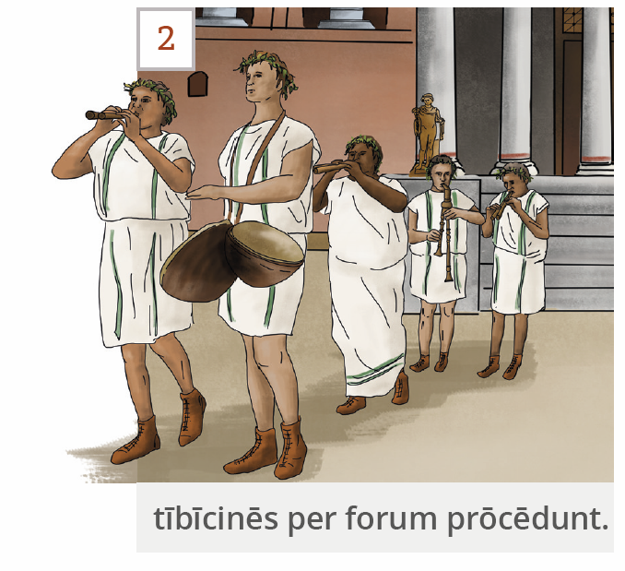

Slide 20
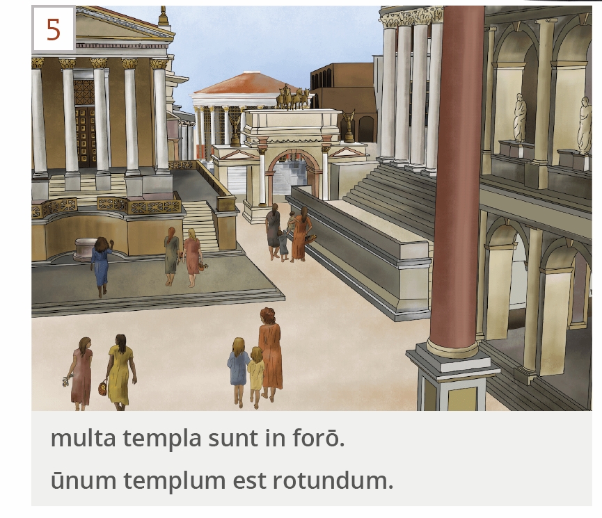

Slide 21
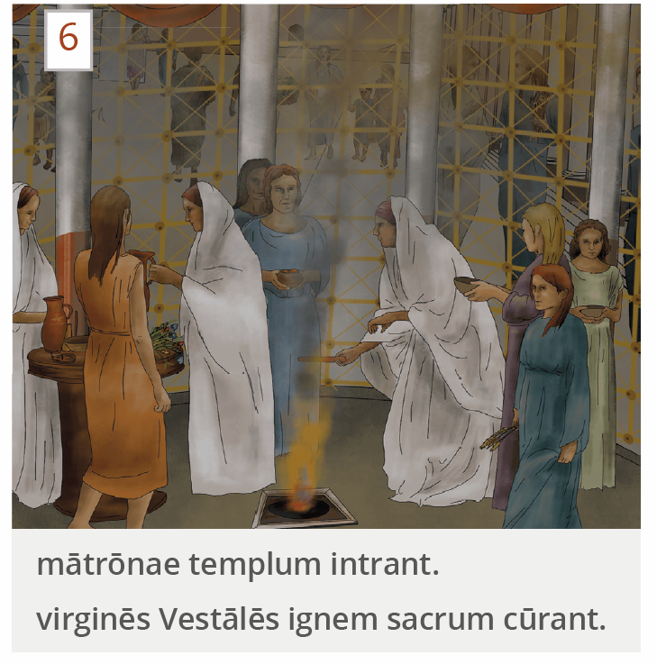

Slide 23
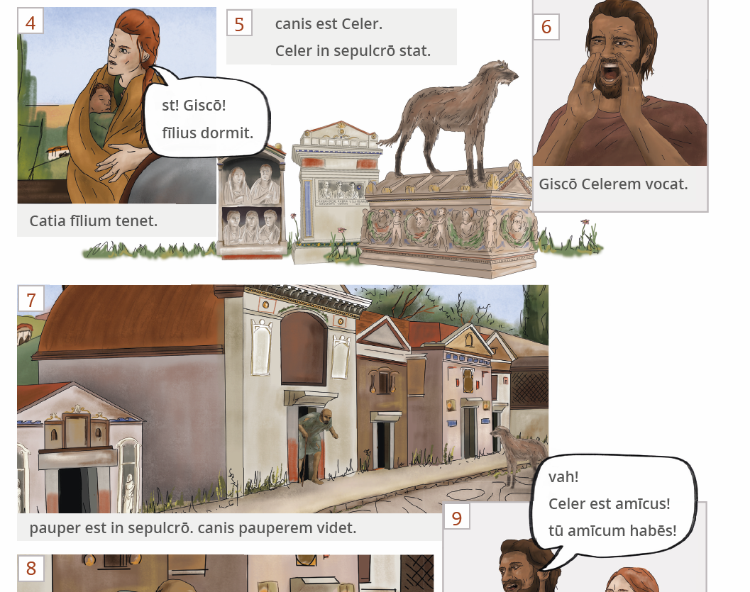

Slide 24
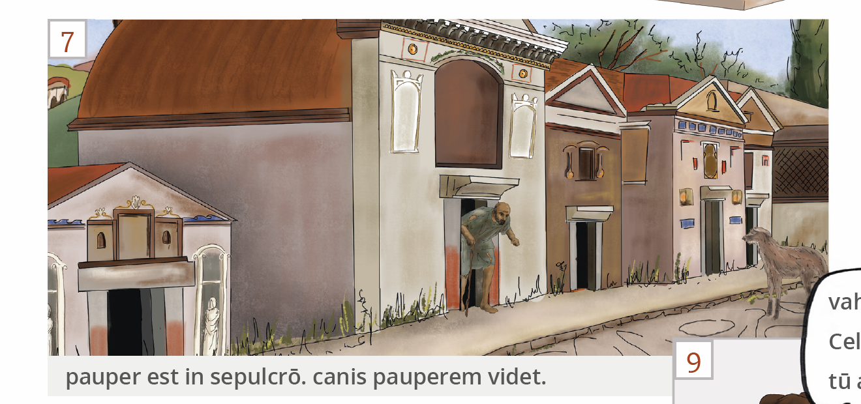

Slide 25
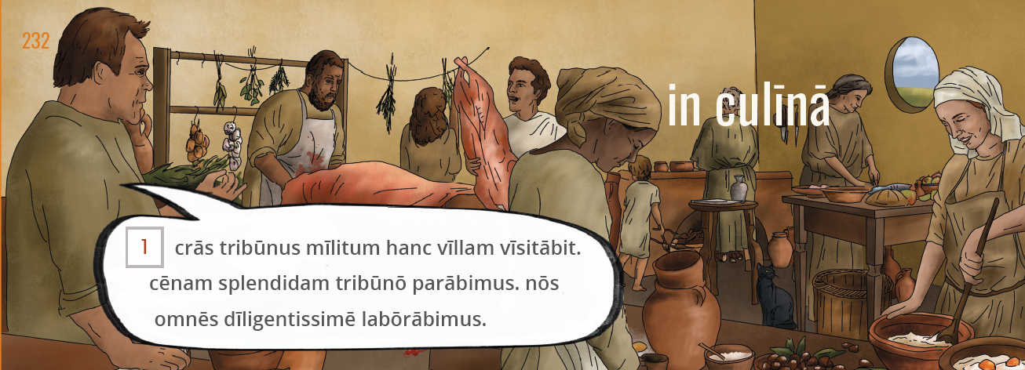

Slide 26
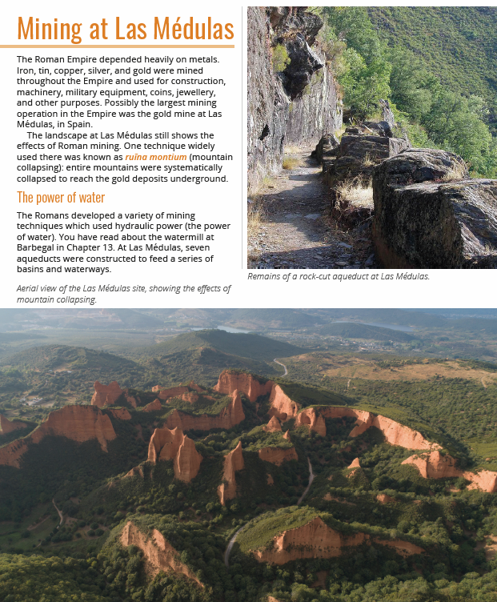

Slide 27
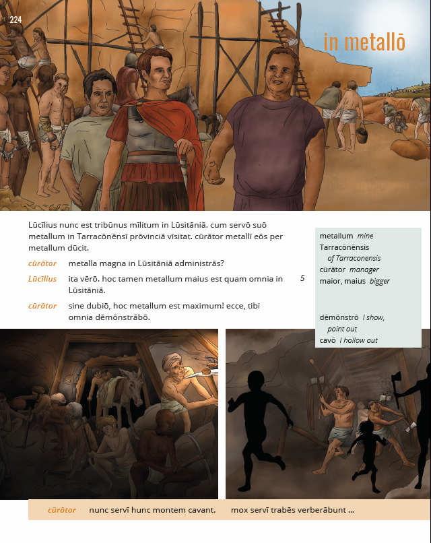
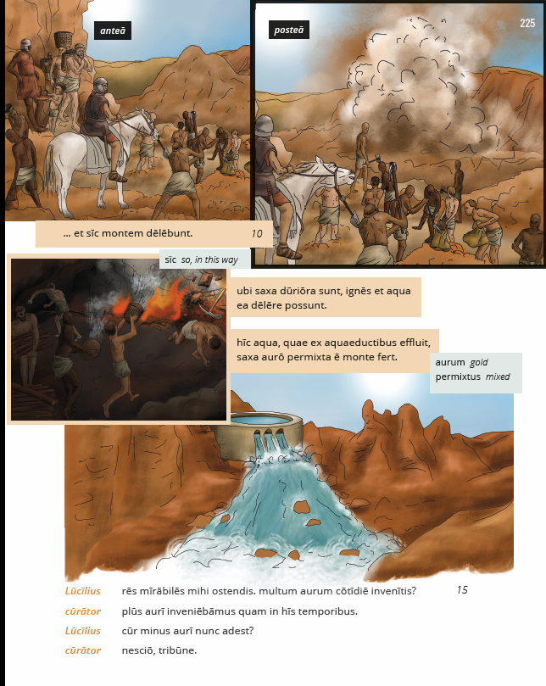

Slide 28
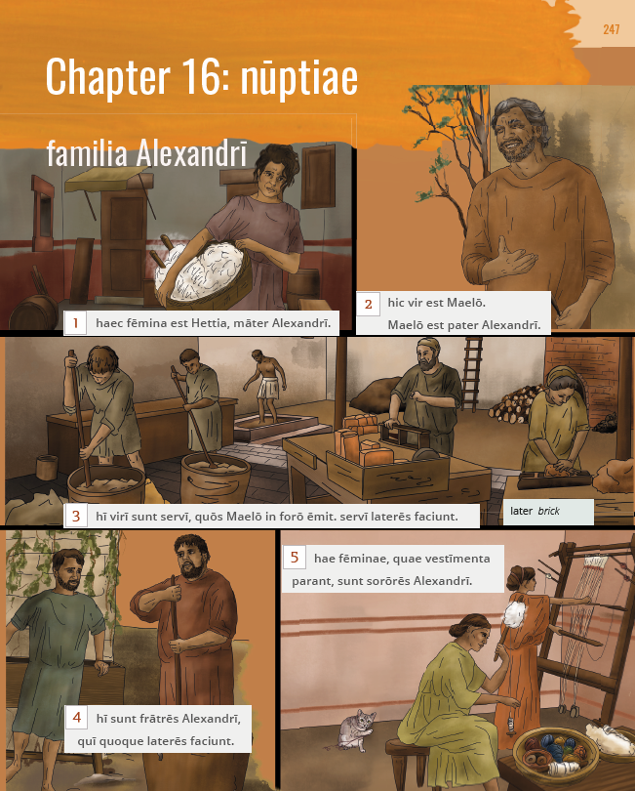

Slide 29
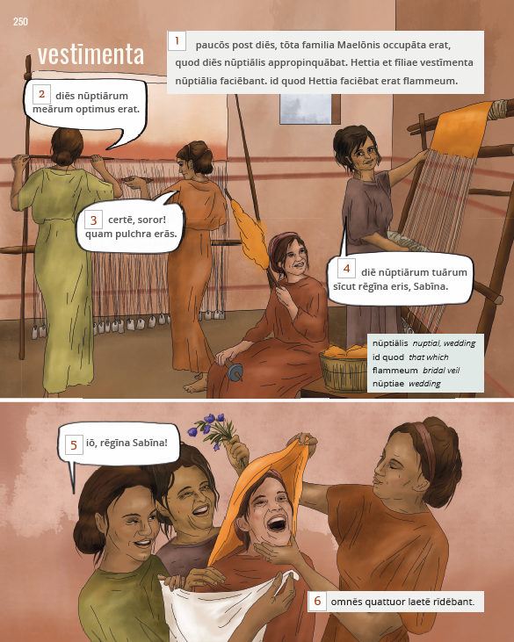

Slide 30
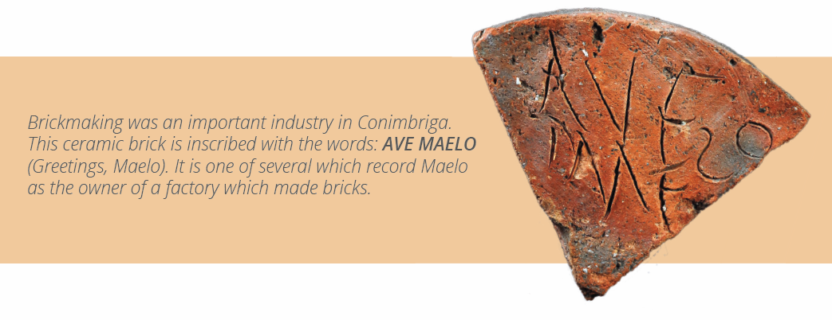

Slide 32
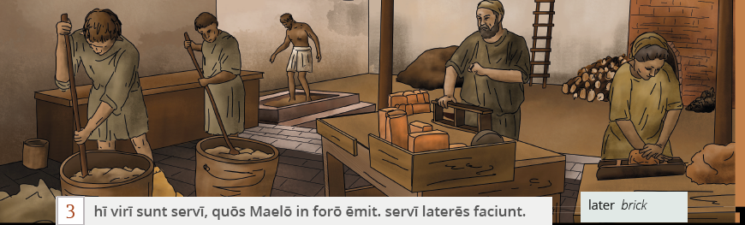

Slide 33
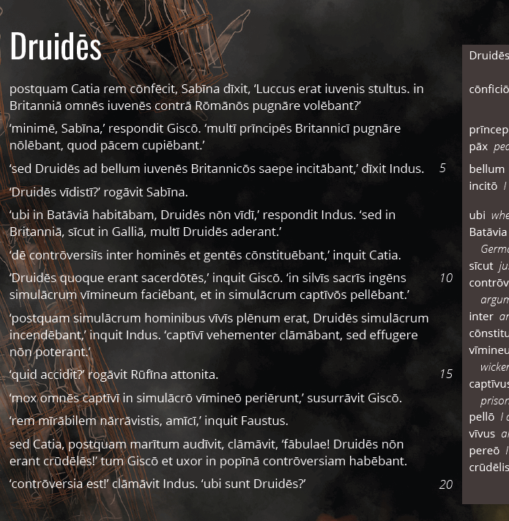
The story as a source

Slide 34
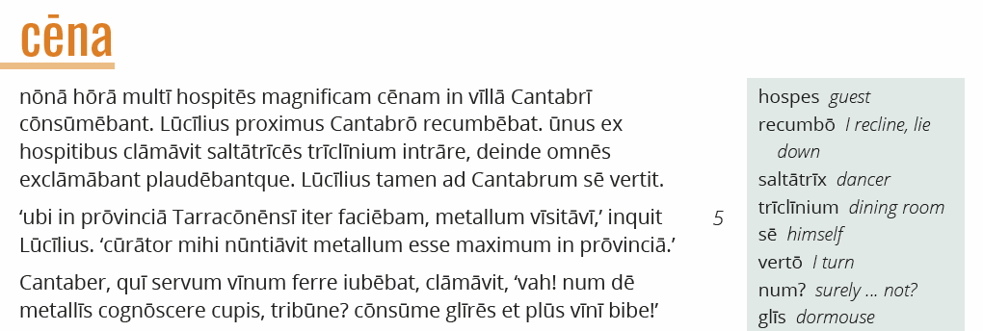

Slide 35
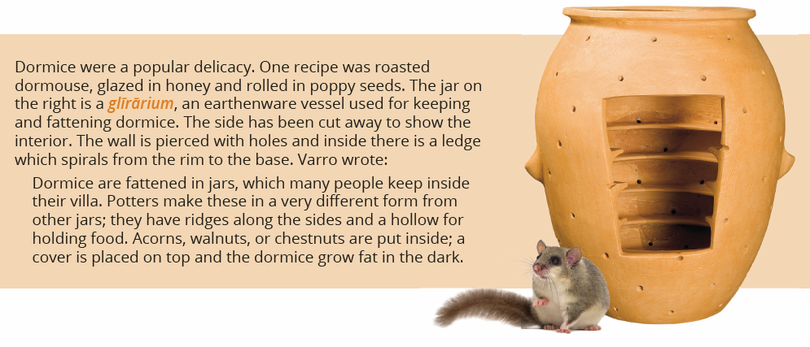

Slide 36
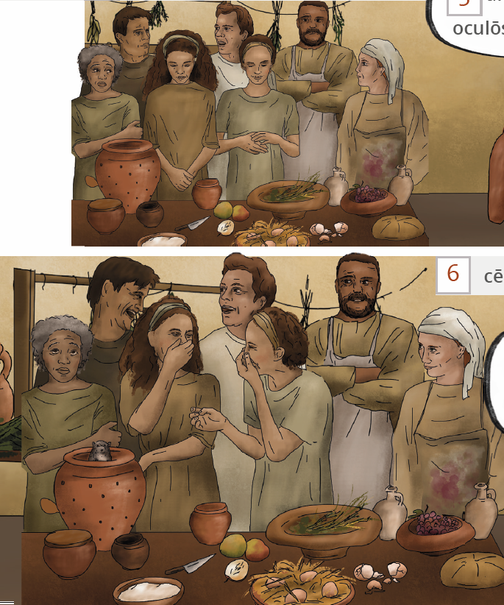

Slide 37
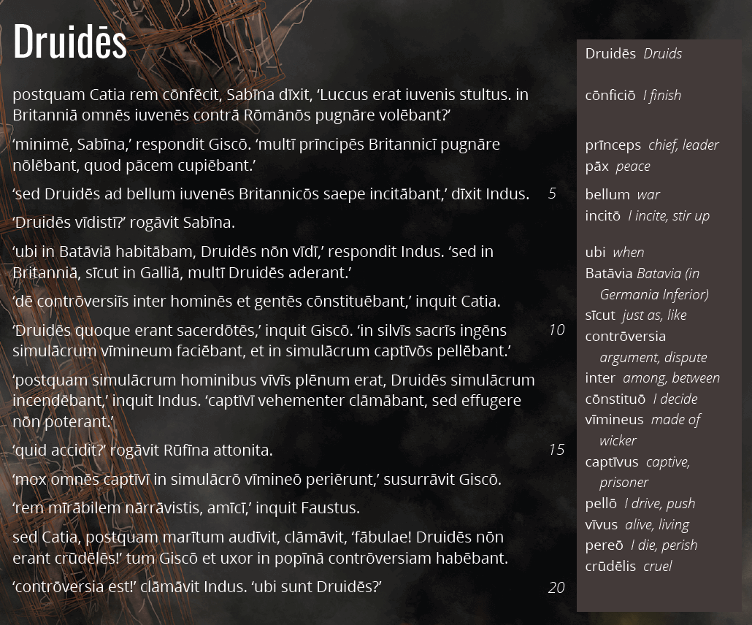

Slide 38
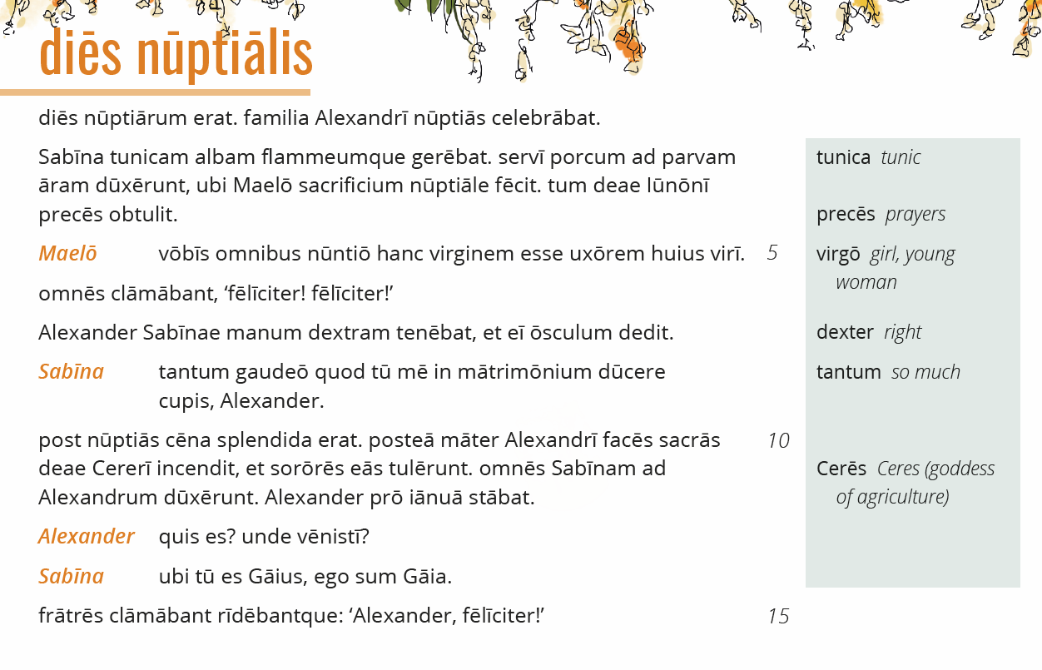

Slide 39
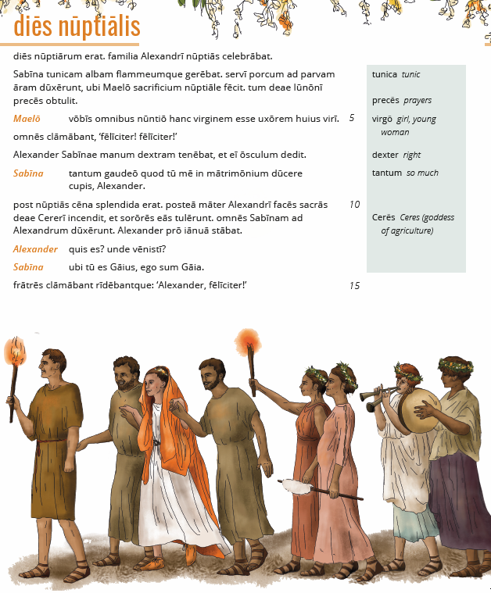

Slide 40
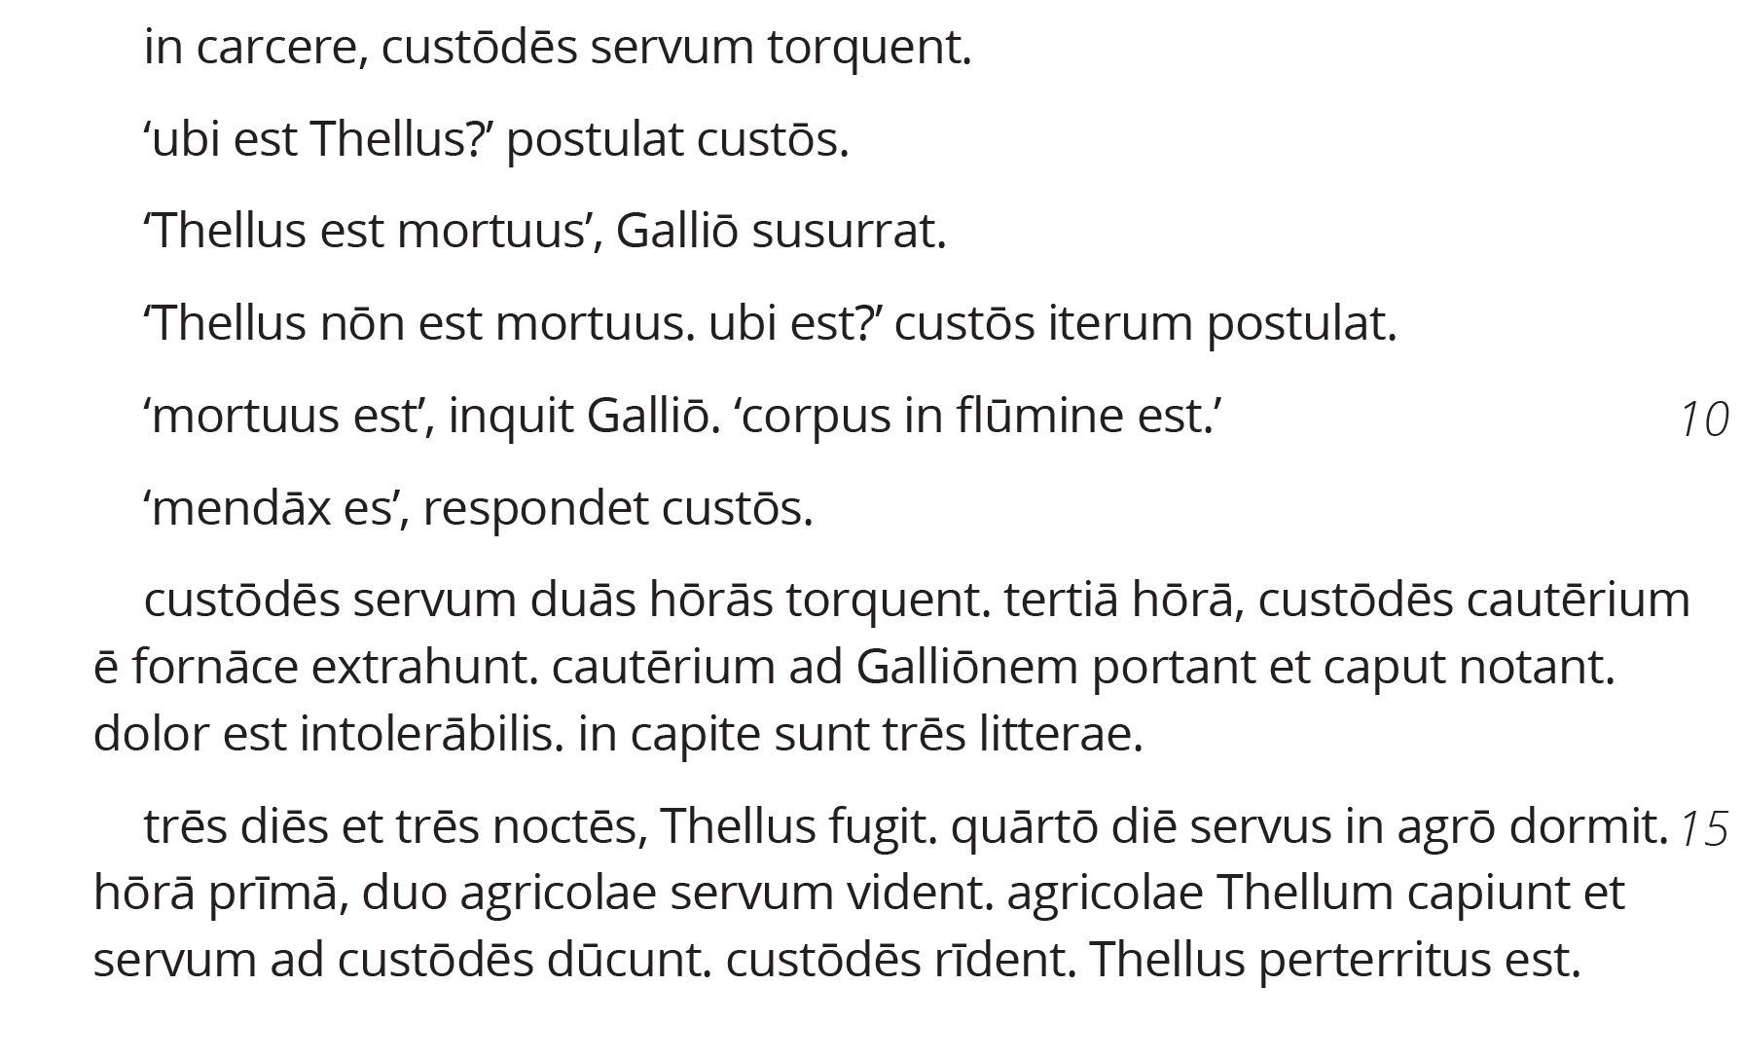

Slide 41
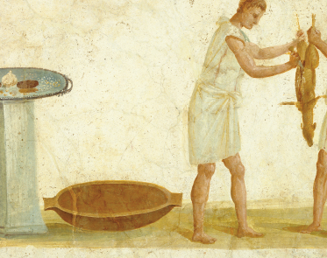
Using primary and secondary sources

Slide 42
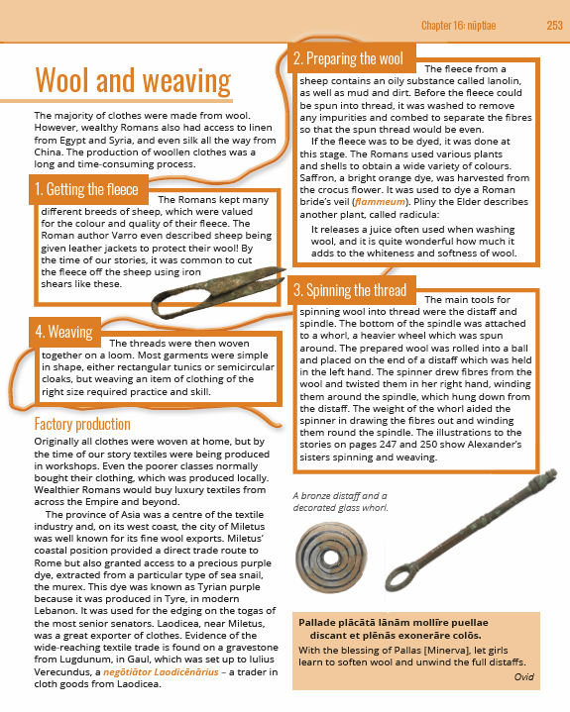

Slide 43
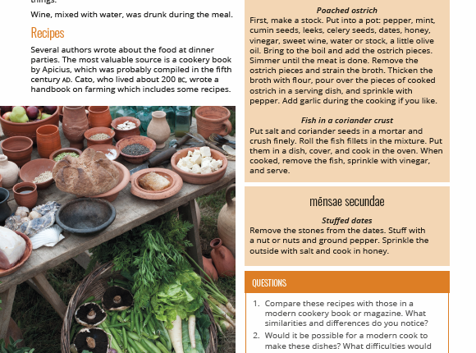

Slide 44
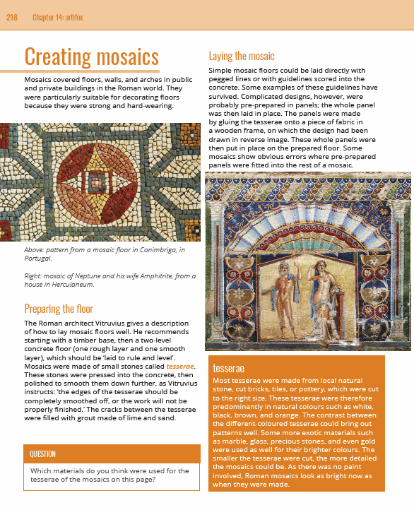

Slide 45
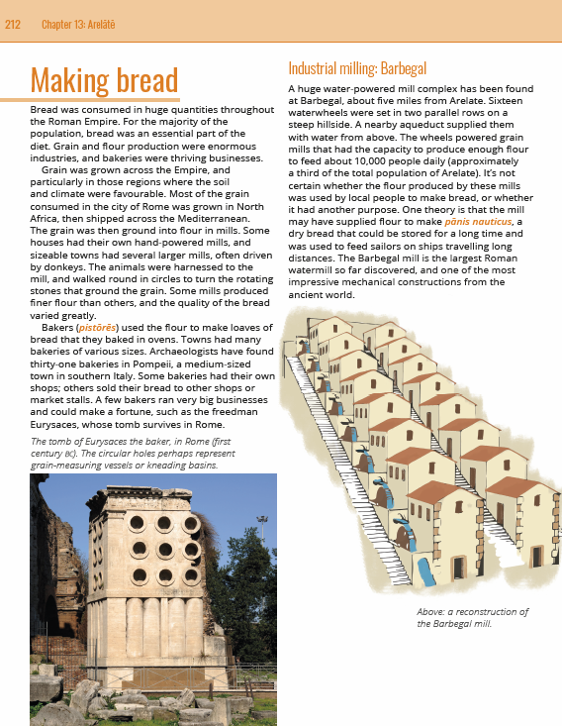

Slide 46
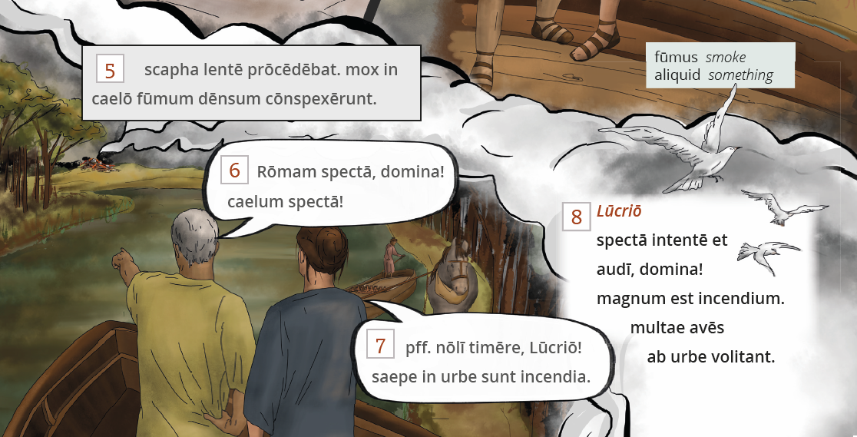

Slide 47
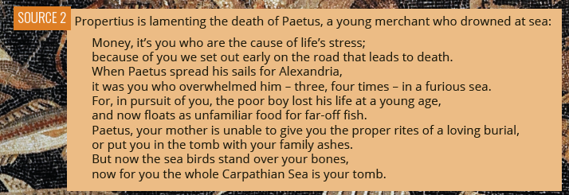

Slide 48
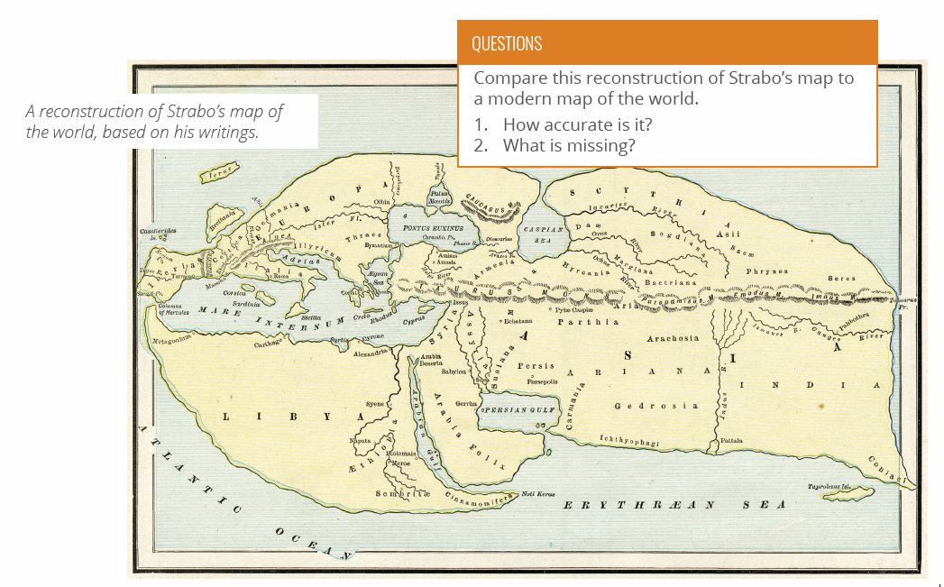

Slide 49
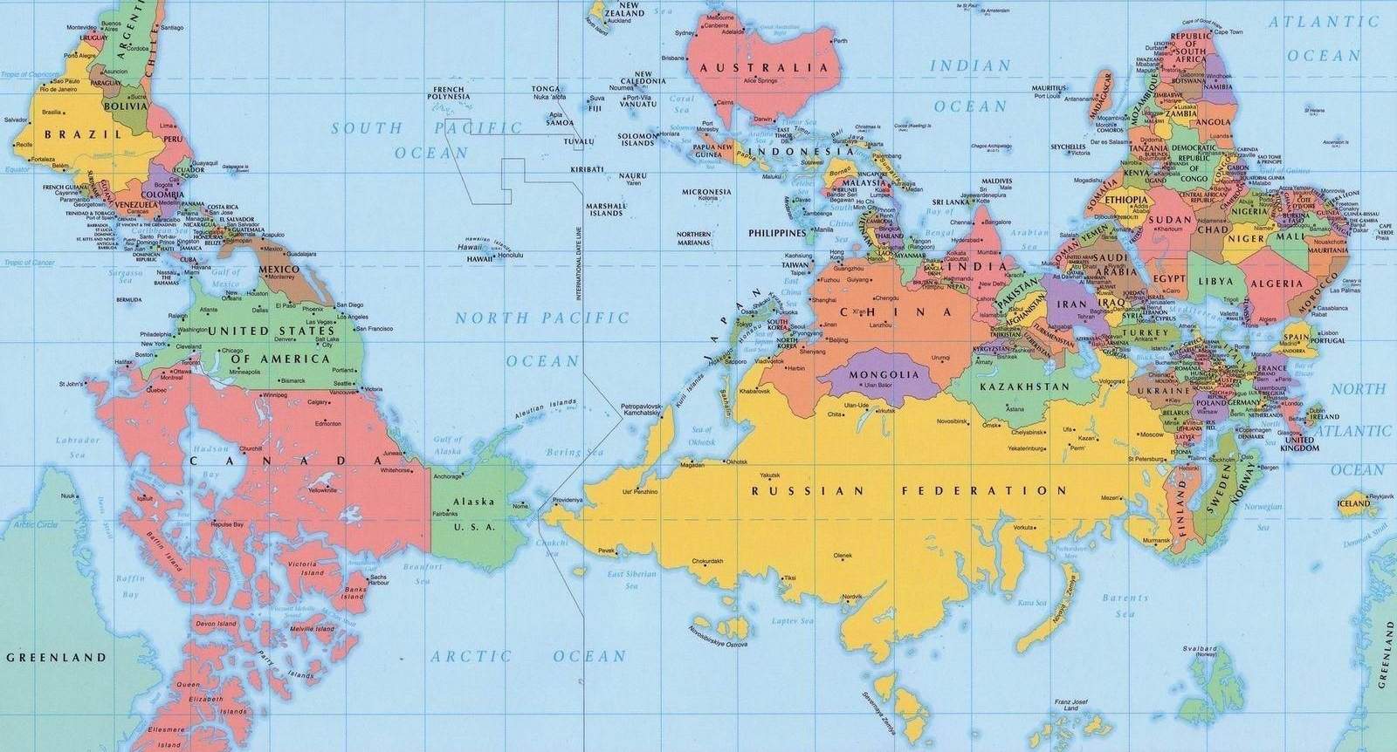

Slide 50
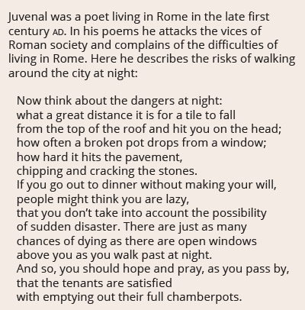
If this were the only source…

Slide 51
The Research

Slide 52
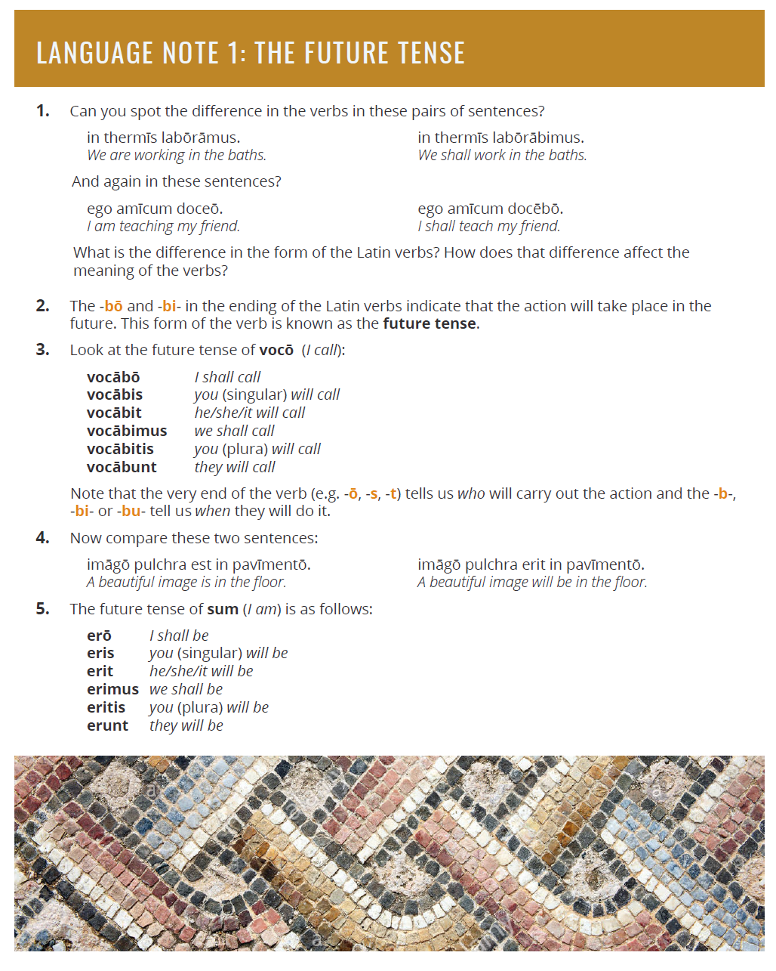

Slide 53
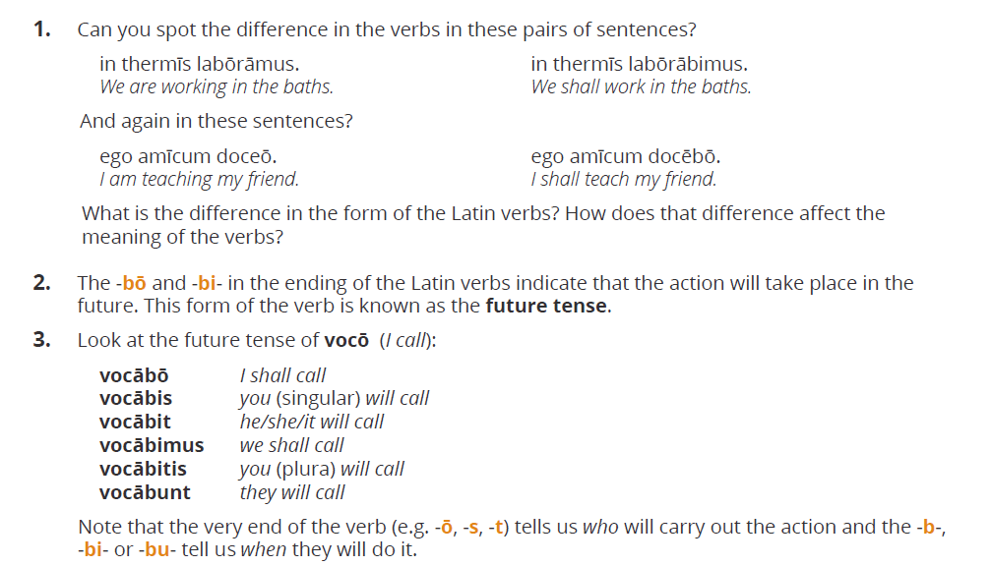

Slide 54
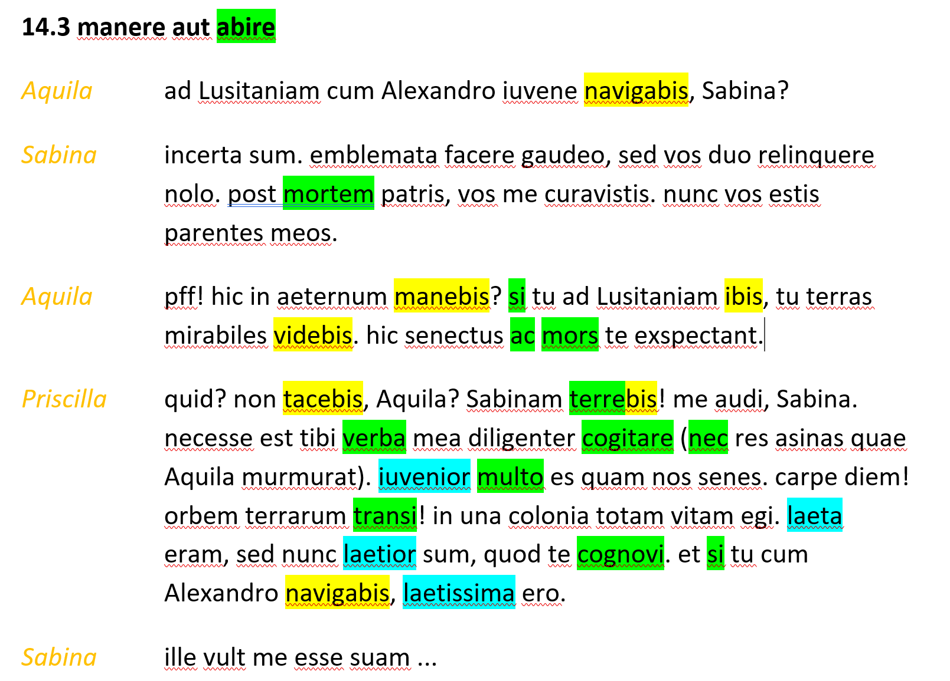

Slide 55
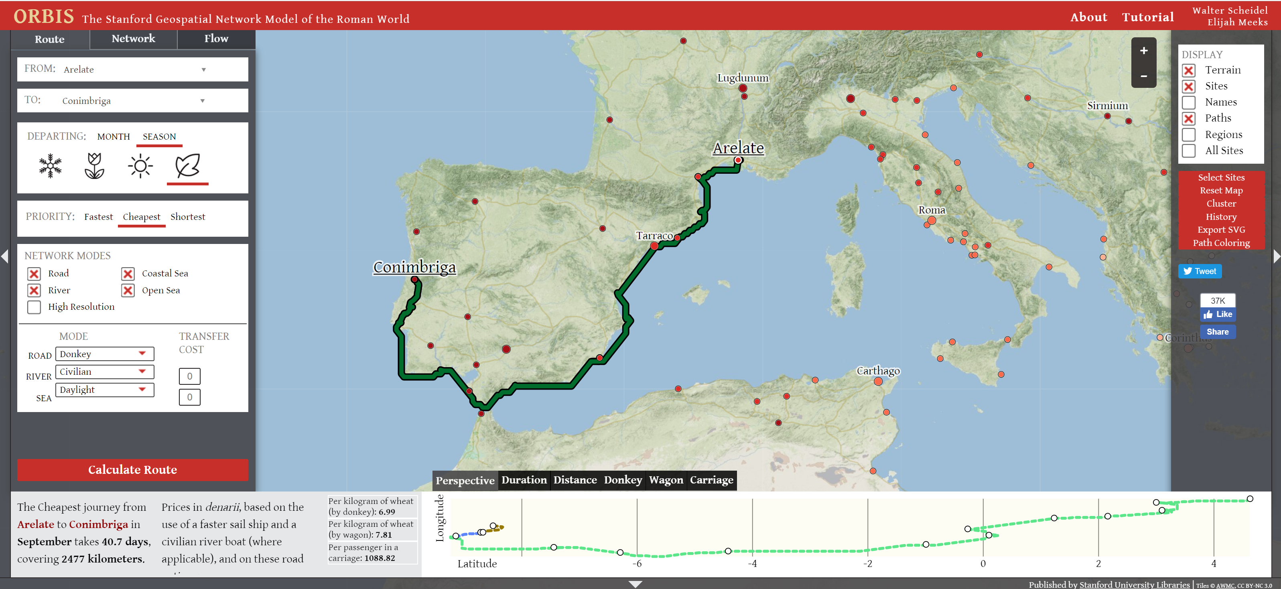

Slide 56
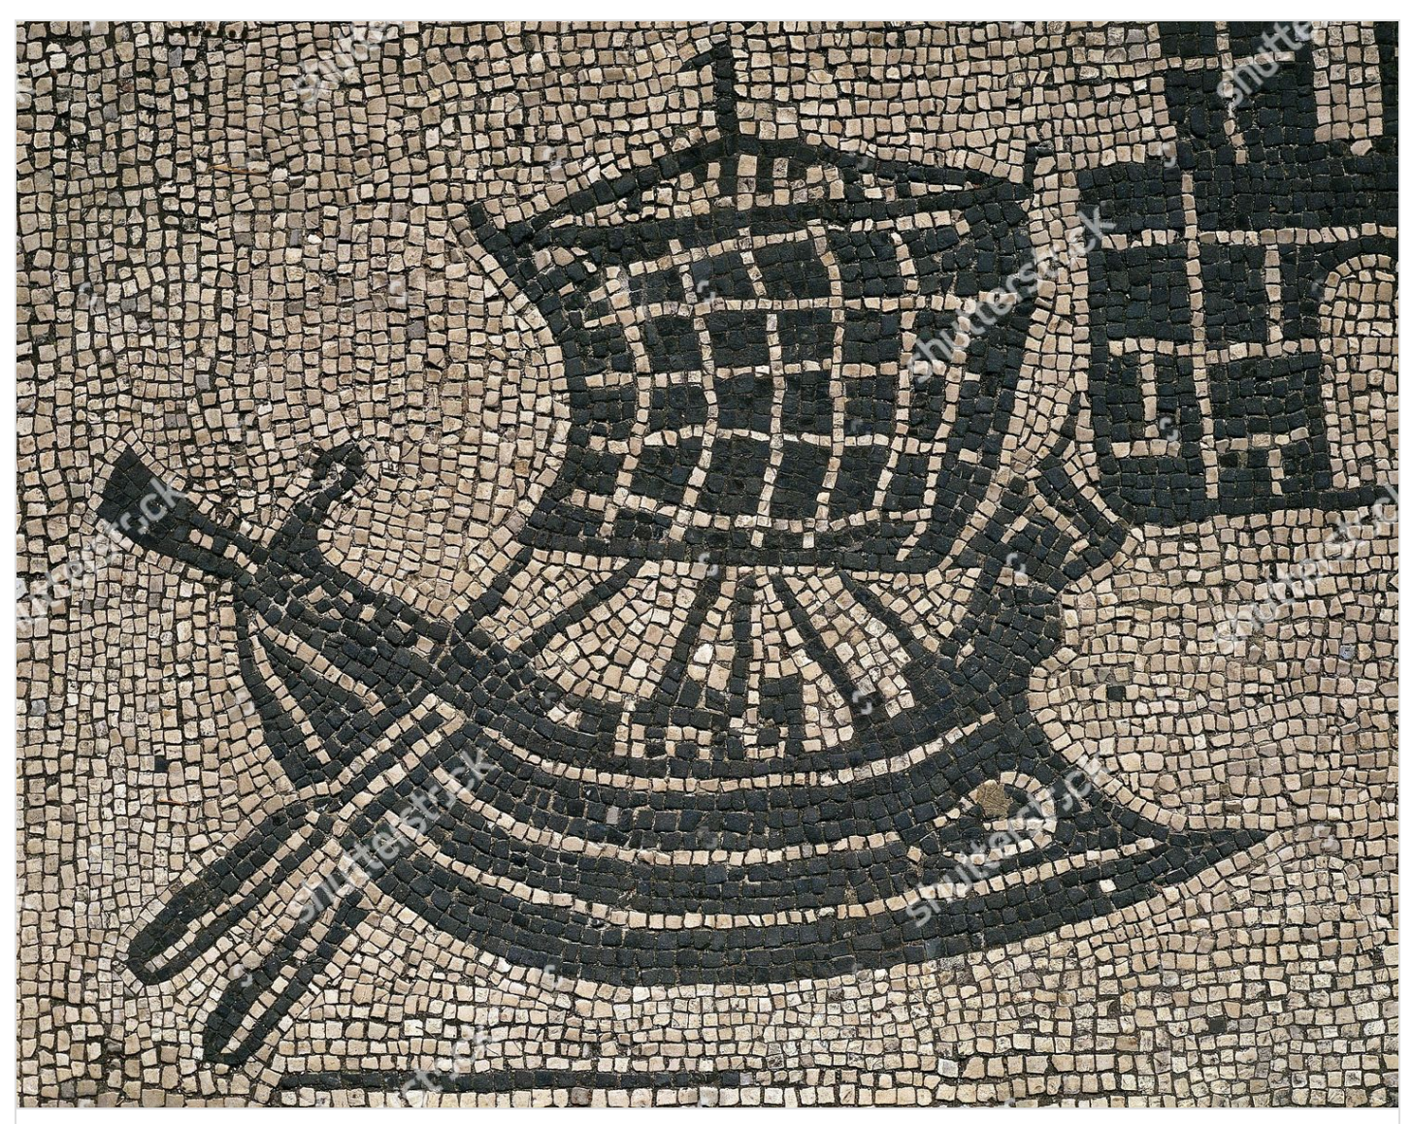

Slide 57
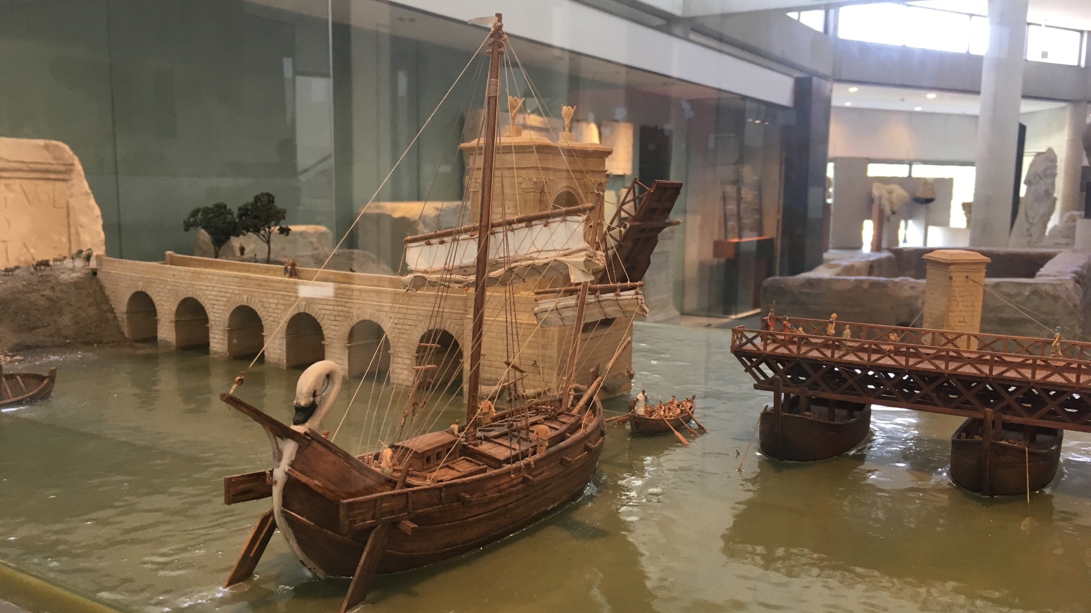

Slide 58


Slide 59


Slide 60


Slide 61


Slide 62


Slide 63


Slide 64


Slide 65


Slide 66


Slide 67





Slide 68


Slide 69


Slide 70


Slide 71


Slide 72


Slide 73


Slide 74


Slide 75


Slide 76


